Slide 1
Benchmarking Your Revenue Cycle
Paul Welchans
pwelchans@onpointoncology.com

Slide 2
Disclaimer and Introductions
Nothing in this presentation is to promote off-label use of any particular product or service.
No drug manufacturer sponsored this program or promoted use of products for this webinar. Thus, brand names are used where applicable.
Benchmarks are just suggestive. Your payer mix or patient acuity may significantly impact your numbers, and they may differ from what is seen herein.
This seminar is suggestive and is not consulting or legal advice.
CPT is trademarked to the American Medical Association. All Rights Reserved.

Slide 3

Agenda
focalPoint Data Set
Why Do or Don’t Benchmarks Matter?
The Revenue Cycle: Where Are We?
  Accounts Receivable Aging
  Days to Pay
  Days to File
  Collection Rates/ Contractual Adjustments
  Profiling
  Denials
Utilization
  Care Management
  RPM/RTM
Appendices
  Hall of Shame
  Clean Claims
  State Statistics
  Denials by Service
  Appeals: MA and Part D
Notes:
Put in a separate page for web sites of regulations

Slide 4
Learning Objectives
Explain the steps in the Revenue Cycle and where roadblocks can occur to jeopardize cash flow.
Discuss Revenue Cycle benchmarks that can be used by Cancer Practices to improve billing processes.
Provide national- and state-level benchmarks that can help practices gauge the quality of their billing practices.
Demonstrate participation by practices in Care Management and Remote Management
Do not reproduce without permission of
the author
5

Slide 5

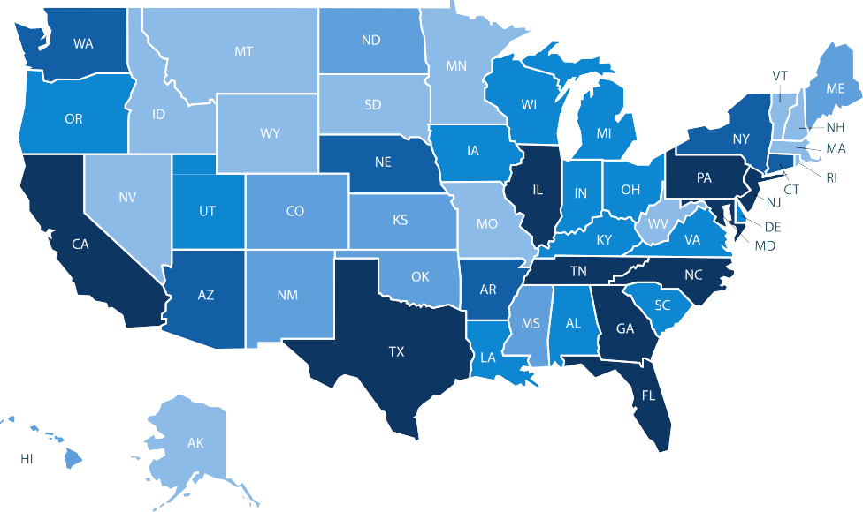
focalPoint 2025 Data Represents 160+ Cancer Centers, 725 sites of service, 498 payers and 2,200 Hematologists and Oncologists
Metrics for 5/1/2025-4/30/26 | Total for Drugs
Payer responses to claims (includes submission and resubmissions) | 6,764,012
Distinct patients | 534,557
Distinct claims | 2,635,985

Slide 6

focalPoint’s relationship is with the clearinghouse
Payer: Claims Adjudicated
Clearinghouse: Claims dispatched and processed for payment
Provider: Outbound Claim ANSI 837
Practice:
Inbound Remittance
ANSI 835

Slide 7
focalPoint Data Sets
National Services Data = Insurance Only Data June 1, 2025 – May 31,2026
The above are RESPONSE DATES
Collects data on
  Allowed Amounts
  Non-Reimbursed Amounts
  Clean Claims
  Days To Pay
  Days to File
  Claims Adjustment Codes (CARCs) which we will refer to herein as Denial codes
  Remittance Advice Remark Codes (RARCs) which we will refer to as Reason codes
Does not collect data on
  Statistics for individual practices, UNLESS requested by the practice
  Prescribing behavior of providers

Slide 8
The Revenue Cycle: Why, How, and Don’t

Slide 9
Why Do RCM Benchmarks Matter?
Identify Financial Leaks and Inefficiencies: Benchmarks highlight bottlenecks—such as high denial rates or long A/R days—that cause revenue loss and declines in daily cash.
Improves Cash Flow & Reimbursement Speeds: By tracking metrics against best-practice standards (e.g., A/R days between 30–40), organizations can reduce the time between service delivery and final payment.
Proactive vs. Reactive Management: Instead of discovering financial issues at the end of the year, tracking KPIs like first-pass yield allows for immediate corrective action.
Increases Staff Productivity & Accountability: Benchmarking provides clear targets, helping staff focus on reducing avoidable denials—which now make up 50%+ of all Community Oncology denials—and improving coding accuracy.

Slide 10

When Don’t RCM Benchmarks Matter?
Cybercrime Attacks—The first Iranian cyberattack was on a healthcare company. Cyberattacks and ransomware are ubiquitous in our business.
Type of Facility—Hospital-owned facilities often have higher A/R due to a disjointed billing process and/or higher dollar claims.
Staffing—Larger practices may have centralized billing which has more people than a 2-3 doctor practice. Staff that is functionally diluted, i.e. wears many hats, is not as efficient.
Gene Pool—Experienced billers and/or coders are not available.

Slide 11
The Billing Cycle: Average Office
Pre-Visit
Denials/Appeals
Authorization
Collections
Service/ Order Entry
Billing
Documentation
& Coding

Slide 12
Roadblocks Created Pre-Visit and Front Desk
Inaccurate or Out of Date Demographics.
Patient Registered Under a Different Name than on Insurance Card.
Poor insurance verification or lack thereof
Relationship of Patient to policyholder error.
Failure to ascertain insurance or employment change.
Wrong payer order
Date of Birth (DOB), Social Security Card, Charge Card, Insurance #s missing or wrong or transposed
Payer website not updated.
Medicare Secondary Payer Questionnaire.
Workers’ Comp-related Cancer
11

Slide 13

Roadblocks When Services are Provided
Documentation does not support E/M billed or does not meet -25.
Documentation supports only non-specific ICD-10-CM codes.
Up/down times not recorded.
Medical necessity guidelines/payer pathways for drug or service not followed.
Prior auth not obtained or still in peer-to-peer or medical exception..
Poor documentation of on-site or remote supervision.
Billing system not updated with current CPT/HCPCS/ICD-10 codes
New Authorization or referral needed due to # of units/visits already used or Auth/referral expired or new HCPCS
Not all charges or drug units captured.
12

Slide 14

Roadblocks in Claims Processing
Providers and/or specialty not set up correctly in payer system.
Incomplete prior authorizations or mismatching claim to PA.
Wrong information submitted or submitted for the wrong patient.
Submitting Duplicate Claims rather than working the claim.
Missing or incomplete patient information requested by payer.
Claim submitted to wrong payer—primary or secondary
Transposed NDCs or incorrect UOM (BCBS).
Drugs billed beyond MUE limit.
Conflicts with payer’s business rules/LCD/NCD.
Functional dilution—too many hats per person
14

Slide 15
Roadblocks to Collections/Payments
Errors in posting payments and adjustments.
Not having a firm Conditions of Admission with patients, incurring bad debt.
Not collecting co-pays, deductibles and co-insurance amounts at the time of service.
Not having checks & balances with your billing company.
Not enforcing or following up with self-pay payment plans or financing.
Not sending statements in a timely manner. (with a return envelope)
Not running statement addresses through change of address software
Not having e-statement options, payment reminder, and additional bill pay options online, including financing
Not sending patients to collection per practice policy.
Clinicians not supportive of collections.
15

Slide 16
Benchmarking for Revenue Cycle Improvement

Slide 17
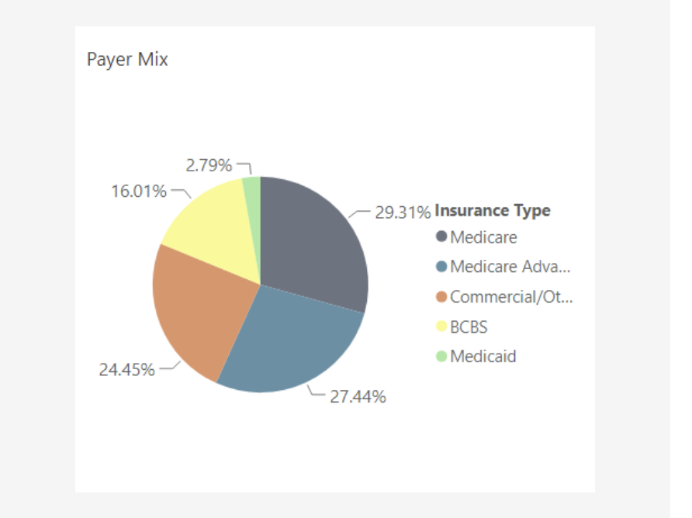
Payer Mix focalPoint Database of U.S. Office –Administered Drugs Q1
16

Slide 18
Why Care About Patient Mix?
Medicare tends to pay faster with less denials. So, if you have more Medicare than average
− Your A/R should be less than average
− Your Days to Pay should be shorter
− But your secondary and patient balances may be slower
Commercial/MA accounts may have
− More denials due to prior authorization
− May have higher Days to File due to Peer-to-Peer/ Medical Exceptions
− May have higher Days to Pay due to lack of statutory requirement for clean claims (varies by state in terms Prompt Pay Laws)

Slide 19
Revenue Cycle Metrics
A/R Balance and A/R Days
Billing Work in Process
Follow-up Work in Process
A/R Aging from Date of Service
Measure of overall A/R performance
Days to Pay for Insurance
ONLY (DRUGS)
A/R for Patient Balances
Average Daily Cash $
Measure of accounts that are prevented from being billed the first time by cause
  Days to Prior auth metric
  More info: NDC, Diagnosis guidelines, etc.
  Coding
  Dictation
  Audit
Days to File is a key metric
Measure of accounts that have been filed and not paid
Measure accounts with “delays” (CARC codes 16, 197, 226, 251, 252, et al)
Measured at unit and individual employee level
Measure of aging of accounts; stratified by dollar amount and age
Drug claim velocity should be measured from the date that you pay for your drugs (Drug claims > 30 days)
Analysis of aged accounts by $ can support staff resource allocation
If you are focused on accounts at 120+ days, it’s too late to resolve issues in a timely manner
Notes:
Need someone who handles data requirements on a daily basis. How much $ is available to cover costs

Slide 20
What Should You Look At?
Accounts Receivable from Date of Service
  A/R for Insurance Only (Primary)
  A/R for drug claims only
  A/R Patient Balances
Average Daily Cash (Total Cash Collected 2026/# of Working Days 2026)
Days to File (Days from Service to Filing)
Days to Pay (Days from Service to Insurance Payment)
Denial Reasons (Claims Reason Adjustment Codes)
Clean Claims: Claims Paid At First Submission
Net Collection Percentage (All Collections/ (Charges-Contractual)
Average Patient Responsibility (Commercial)
E/M Profiling, once per year, unless there are problems

Slide 21
How Should You Look At Stats?
Accounts Receivable from Date of Service
  A/R for Insurance Only (Primary)
  A/R for Non-Primary
  A/R Patient Balances
Average Daily Cash
  By Payer Class
  By Personnel Section
DTF/DTP
  By Payer Class
  By Type of Service
  By Provider
Clean Claims
  By Biller
  By Payer Class

Slide 22

Create A Feedback Loop to Ensure Performance Improvement in your Revenue Cycle
Final
Payment
Front Desk Registration
Teamwork
& CQI
Back Office or Billing Company
Nursing Staff and Providers
Coders & Billers
22
Notes:
Make sure you are giving people feedback to get the A/R etc in line

Slide 23
Part B Accounts Receivable: Insurance Across U.S. 6/1/2025-
5/31/2026
Caveats
Patient portions not all captured in terms of collections
All patient program coverage may not be captured
In terms of line items in A/R
0-30 Days = 64.54%
31-60 Days = 21.34%
61-90 Days = 4.66%
91-120 Days = 2.66%
120+ Days = 6.80%
In terms of $ in A/R
0-30 Days = 71.94%
31-60 Days = 20.33%
61-90 Days = 3.57%
91-120 Days = 1.52%
120+ Days = 2.64%

Slide 24
Days to File By Service (Without Outliers) 2025-2026
DTF | Service
10.68 | Overall Days to File
11 | Rad Onc Days to File
9 | Imaging Days to File
10 | E/M Days to File
9 | Drugs Days to File
25

Slide 25
U.S. Days To Pay Without Outliers 2025-2026 by Service
Days to Pay | Service
31 | Overall Days to Pay
34 | Rad Onc Days to Pay
32 | Imaging Days to Pay
32 | E/M Days to Pay
24.5 | Drugs Days to Pay

Slide 26
Denials 2025-2026
Cancer Services

Slide 27
Overall Denial Rates 2025-2026
Type | Denial Rate
Imaging | 16.55%
E/M | 12.88%
Radiation Tx* | 14.86%
Drugs | 10.18%
Overall | 16.59%
*--Mostly old codes

Slide 28
Top 10 2025-2026 Denials for All Services
Code | Definition | lineitems | Category
16 | Claim/service lacks information or has submission/billing error(s) which is needed for adjudication. | 939,315 | Overall
97 | The benefit for this service is included in the payment/allowance for another service/procedure that has already been adjudicated. | 598,646 | Overall
96 | Non-covered charge(s). | 435,294 | Overall
B13 | Previously paid. Payment for this claim/service may have been provided in a previous payment. | 298,438 | Overall
22 | This care may be covered by another payer per coordination of benefits. | 257,616 | Overall
252 | An attachment/other documentation is required to adjudicate this claim/service. | 257,018 | Overall
197 | Precertification/authorization/notification absent. | 228,448 | Overall
B11 | The claim/service has been transferred to the proper payer/processor for processing. Claim/service not covered by this payer/processor. | 219,637 | Overall
50 | These are non-covered services because this is not deemed a "medical necessity" by the payer.. | 211,052 | Overall
29 | The time limit for filing has expired. | 206,779 | Overall
28

Slide 29
Drug Denial Trends 2019-2020
True Denial % All Drugs
18.00%
16.00%
14.00%
12.00%
10.00%
8.00%
6.00%
4.00%
2.00%
0.00%
OCT
NOV
DEC
JAN
FEB
MAR
APR
MAY
JUN
JUL
AUG
SEP
29

Slide 30
Drug Denial Trends 2025-2026

Slide 31
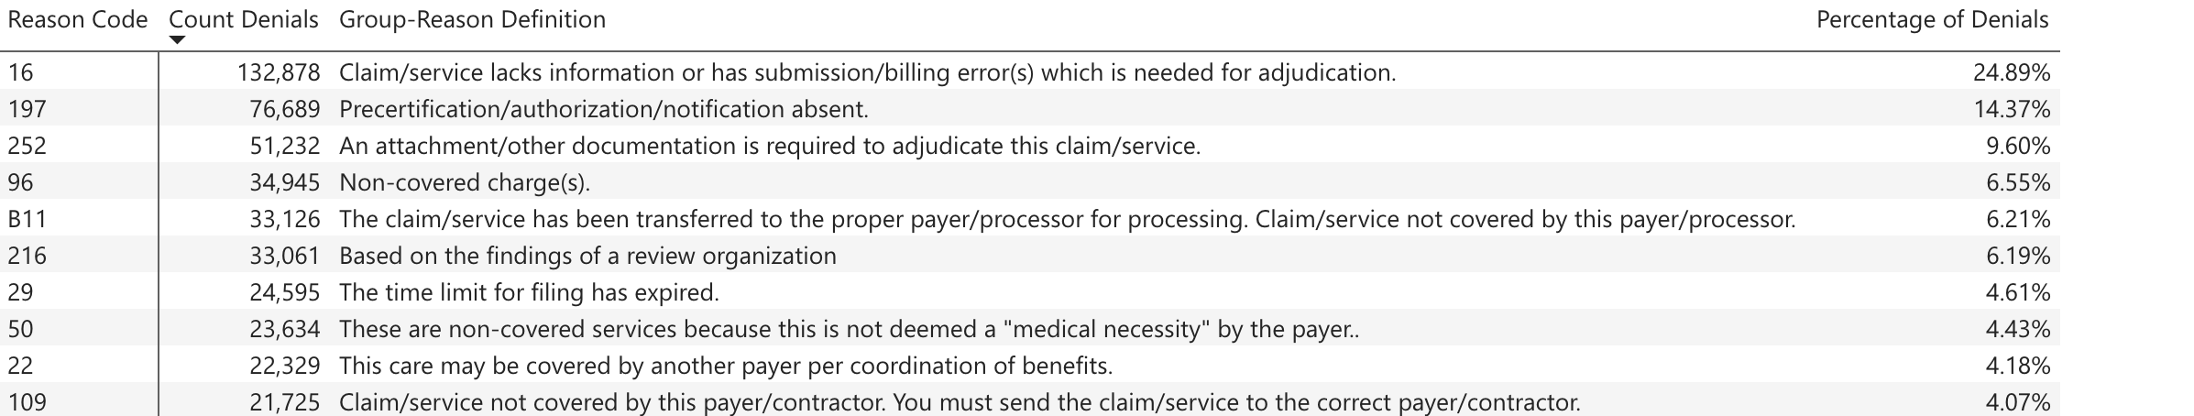
Top Ten Drug Denial Codes 2025- 2026

Slide 32
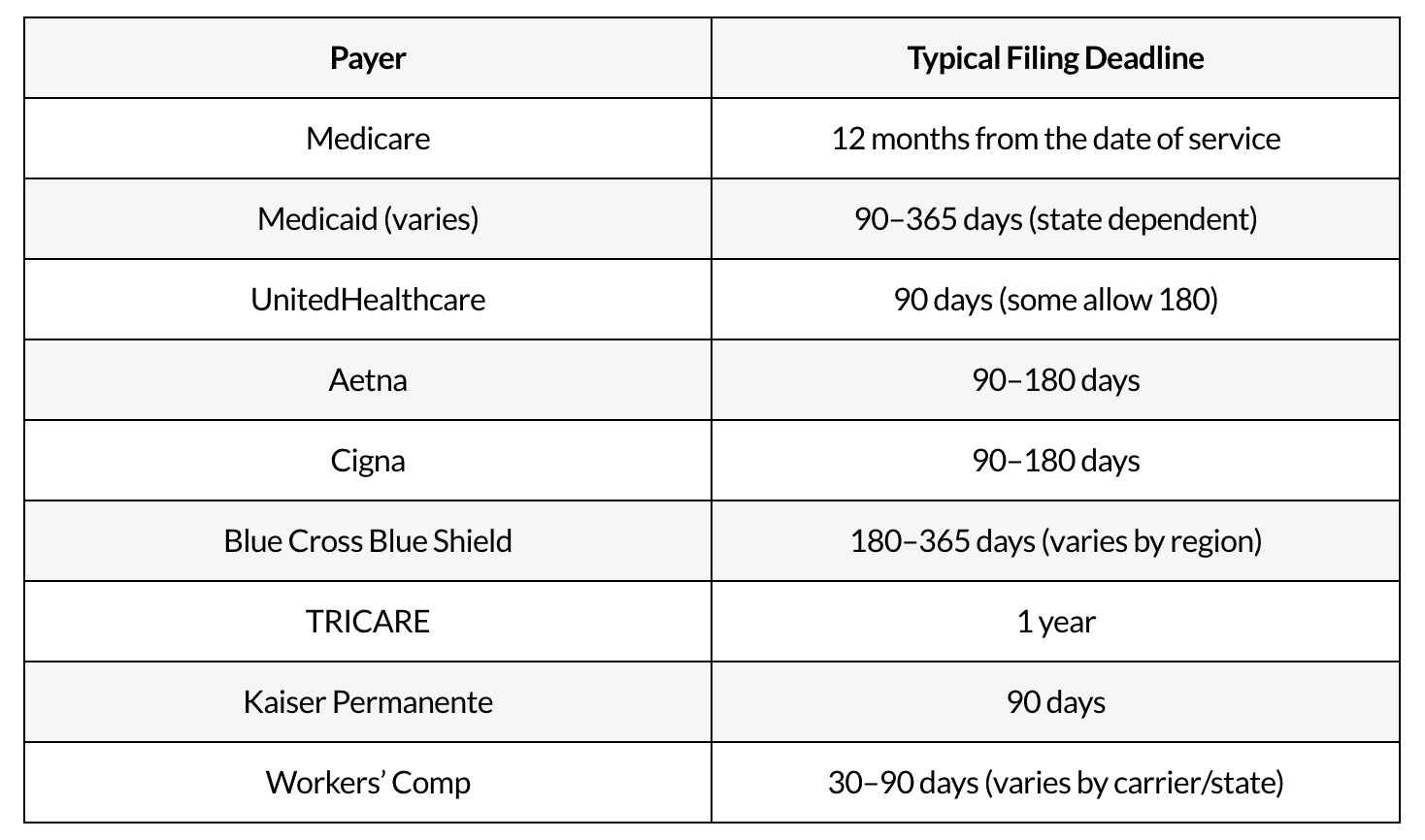
Filing Deadlines for Commercial/MA Payers
Check Your Contracts and State Laws!!!
https://cadencecollaborative.com/blog/medical-billing-time-limits-by-state/#:~:text=Typical%20Filing%20Deadline-,Medicare,Proof%20of%20eligibility%20verification

Slide 33
Top (N ≥ 1000 claims) Payers Most Zero (> 180 Days) Paid Claims Over The Last Year
Insurance Name | Patients | Claims | Payer Responses | Denial Percent | Zero Paid Claims | Zero Paid Percent
LOUISIANA HEALTH CONNECTIONS | 266 | 1,705 | 10,124 | 15.75% | 348 | 20.41%
United Healthcare PPO One | 1,119 | 3,938 | 6,437 | 14.23% | 417 | 10.59%
CALIFORNIA MEDI-CAL | 394 | 1,539 | 9,852 | 18.79% | 151 | 9.81%
CAL OPTIMA DIRECT | 668 | 2,893 | 12,567 | 25.10% | 244 | 8.43%
ANTHEM BLUE CROSS | 1,656 | 6,810 | 32,957 | 33.08% | 399 | 5.86%
ALTAMED | 560 | 1,929 | 5,218 | 26.79% | 96 | 4.98%
ALIGNMENT HEALTH CARE | 706 | 2,561 | 9,896 | 33.68% | 117 | 4.57%
HEALTH NET OF CALIFORNIA AND OREGON (CLAIMS) | 1,264 | 4,697 | 14,038 | 15.61% | 211 | 4.49%
ALLIANCE IPA | 526 | 3,254 | 9,355 | 25.93% | 137 | 4.21%
Cal-Optima Direct | 487 | 1,557 | 5,635 | 22.93% | 64 | 4.11%
HEATLHCARE LA, IPA | 1,460 | 7,062 | 17,783 | 6.65% | 268 | 3.79%
Molina Healthcare California | 695 | 2,737 | 8,443 | 23.26% | 103 | 3.76%
ARIZONA COMPLETE HEALTH | 582 | 2,070 | 8,067 | 23.78% | 76 | 3.67%
Presbyterian (Medicare Advantage) | 410 | 1,548 | 3,674 | 10.04% | 48 | 3.10%
FLORIDA MEDICAID | 555 | 2,068 | 12,169 | 27.32% | 61 | 2.95%
Premera BC Washington | 488 | 2,068 | 6,104 | 11.70% | 61 | 2.95%
BCBS New Mexico | 741 | 3,192 | 10,324 | 13.13% | 93 | 2.91%
NEBRASKA TOTAL CARE | 482 | 2,252 | 9,377 | 22.80% | 65 | 2.89%
Molina Healthcare (Medicaid IL MCO) | 452 | 1,691 | 6,347 | 11.11% | 48 | 2.84%
INLAND EMPIRE HEALTH PLAN - DOS AFTER 3/31/18 | 861 | 3,523 | 11,198 | 15.23% | 96 | 2.72%
GEORGIA BCBS | 2,201 | 9,095 | 24,966 | 32.21% | 240 | 2.64%
Medicare New Mexico | 1,409 | 6,289 | 14,802 | 5.44% | 163 | 2.59%
Medicare Arizona Part B | 1,294 | 4,404 | 10,742 | 9.44% | 110 | 2.50%
CALIFORNIA BLUE CROSS | 995 | 4,133 | 14,662 | 23.46% | 100 | 2.42%
Anthem BC California | 2,880 | 10,225 | 27,359 | 27.06% | 245 | 2.40%
Blue Cross Illinois (Medicare Advantage) | 711 | 2,634 | 5,583 | 6.39% | 63 | 2.39%
DEVOTED HEALTH | 971 | 4,533 | 17,415 | 20.36% | 106 | 2.34%
HORIZON NJ HEALTH | 443 | 2,141 | 5,716 | 18.44% | 50 | 2.34%
TENNESSEE BLUECARE | 971 | 3,311 | 9,956 | 18.30% | 72 | 2.17%
Wellmark BCBS Iowa | 438 | 1,917 | 5,353 | 22.83% | 40 | 2.09%
Medicaid California (Medi-Cal) | 390 | 1,775 | 9,018 | 12.35% | 37 | 2.08%
SANTE COMMUNITY PHYSICIANS MEDICAL GROUP CORP | 621 | 1,688 | 4,103 | 40.26% | 35 | 2.07%

Slide 34
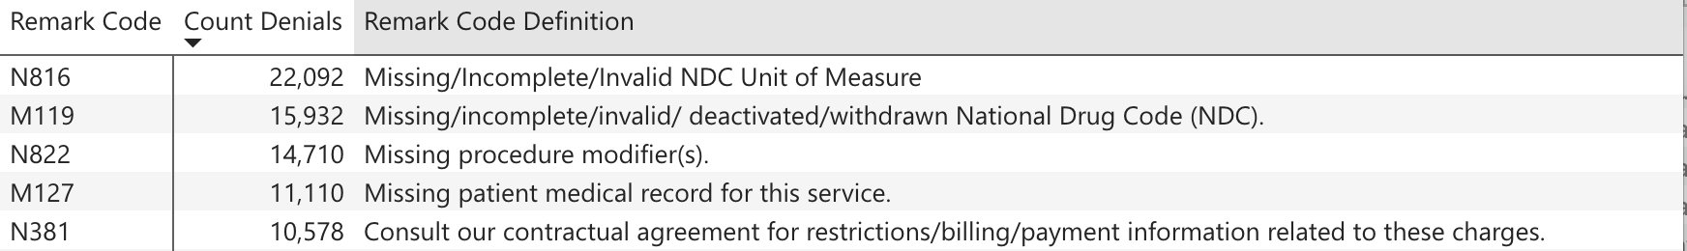
Top 10 Drug Denial Reason (RARC)Codes 2025-2026

Slide 35
Unit of Measure for NDC Billing
Blue Cross/Blue Shield has been editing the NDC Loop Unit of Service (not the J-code units). You can see this under CARC code 16 and RARC code N816
  Proper Units of Measure include:
    UN (Unit) – Powder-filled vials for injection (needs to be reconstituted), pellet, kit, patch, tablet,
    device
    ML (Milliliter) – Liquid, solution, or suspension
    GR (Gram) – Ointments, creams, inhalers, or bulk powder in a jar
    F2 (International Unit) – Products described as IU/vial, or micrograms
  TEXAS BCBS: ME is also a recognized billing qualifier that may be used to identify milligrams as the NDC unit of measure; however, drug costs are generally created at the UN or ML level. If a drug product is billed using milligrams, it is recommended that the milligrams be billed in an equivalent decimal format of grams (GR). BCBSTX allows up to three decimals in the NDC Units (quantity ornumber of units) field
  ANTHEM: Allows ME on claims
Check your BCBS!

Slide 36
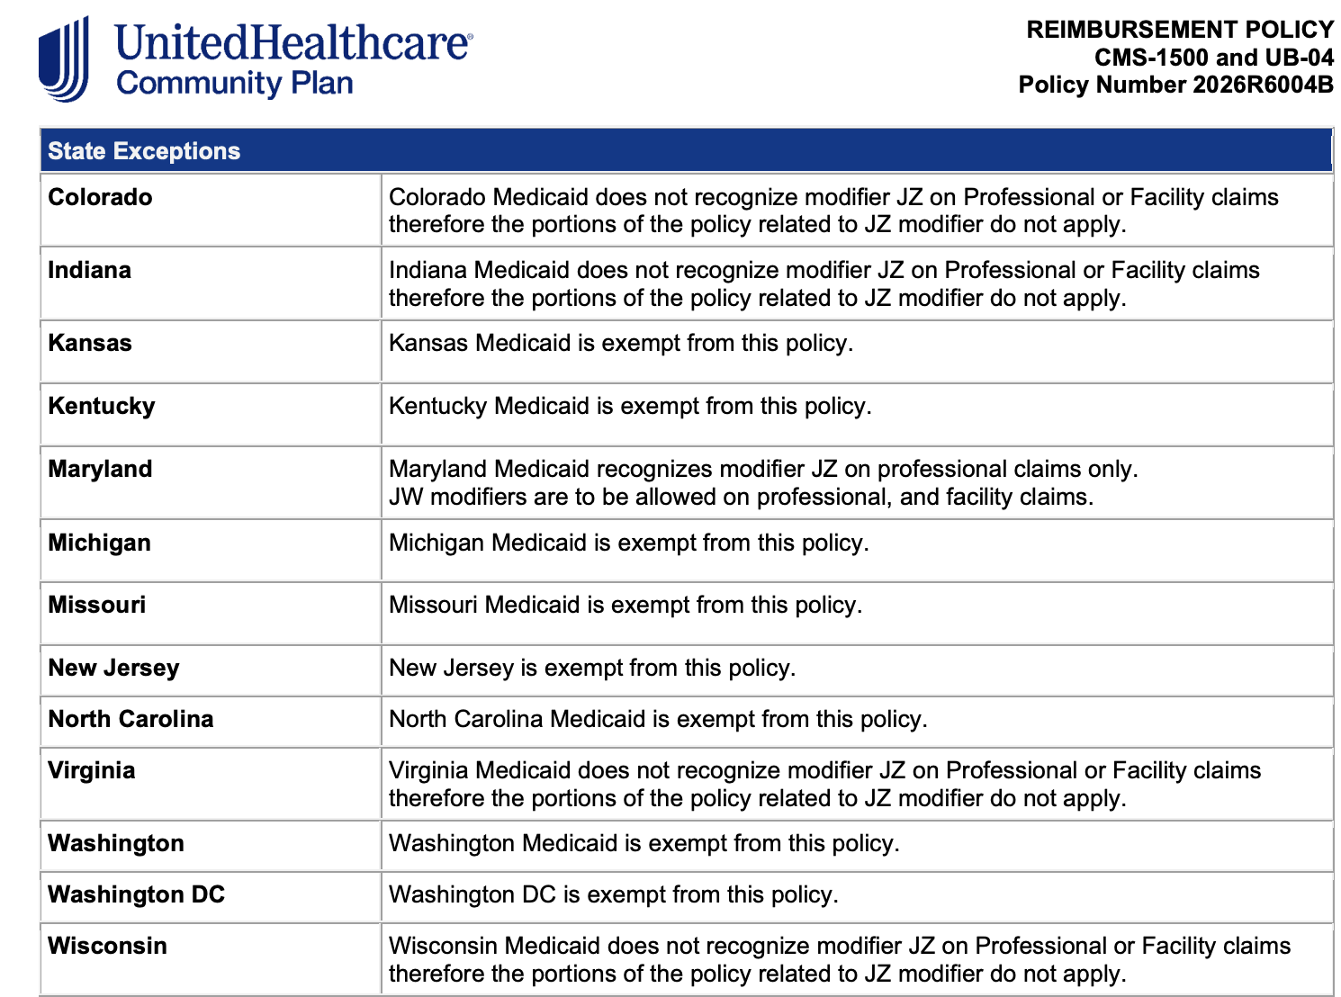
United’s Confusing Waste Policies
United’s policies vary by plan and, for Medicaid, by the State:
  United Medicare Advantage requires –JW, -JZ
  United Commercial requires –JW
  United Community Health Plans require –JW, -JZ EXCEPT

Slide 37
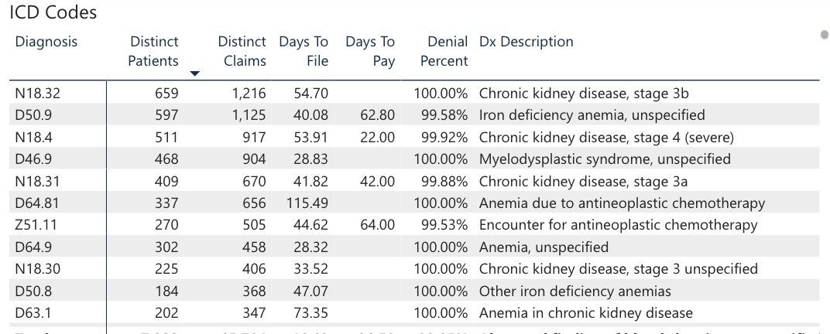
Top ICD-10-CM Denied Codes
OA Drugs CO-50 Q1 2026
Community Oncology Alliance © www.CommunityOncology.org

Slide 38
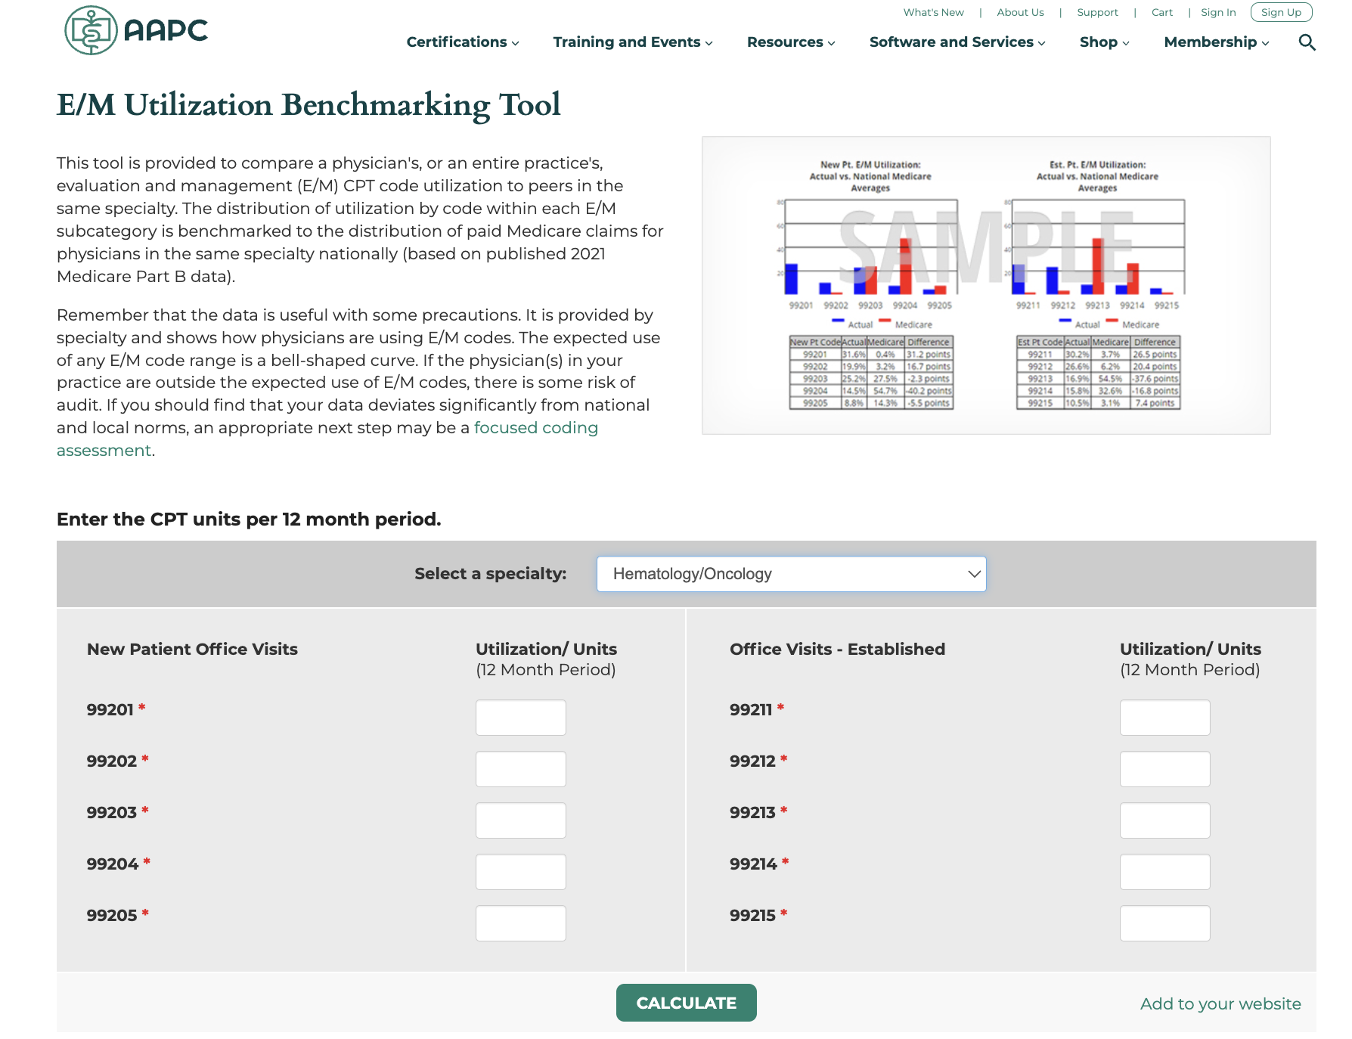
AAPC Web Site https://www.aapc.com/resources/em_utilization.aspx
Notes:
Some payers are downcoding E/M so compare you profile from 2024 to now (possibly Aetna and/or Cigna. Please monitor you E/M

Slide 39
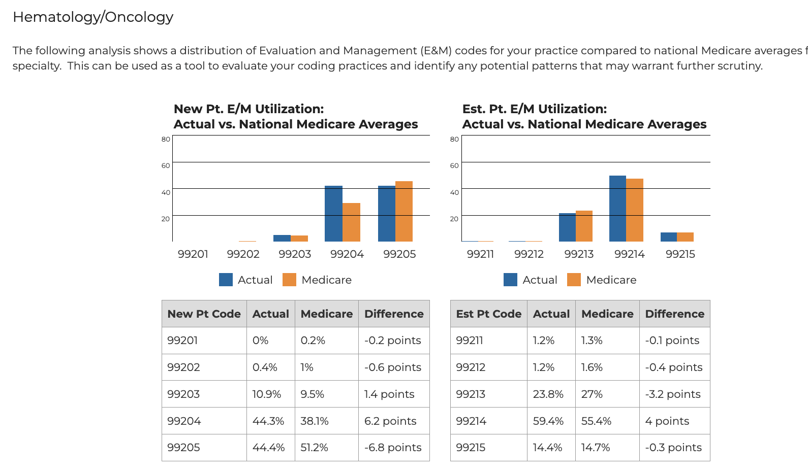
E/M Profile for Medicare 4/1/2025-3/31/2026

Slide 40
Care Management Stats 2025-2026

Slide 41
RPM/RTM 4/1/2025-3/31/2026
Codes Billed | Sum of Distinct Claims
98975 | 744
98980 | 1,949
98981 | 1,262
99445 | 122
99454 | 2,342
99457 | 4,051
99458 | 2,149
99470 | 12
Grand Total | 12,631
Notes:
Physiologic V Therapeutic. RTM is picking up with companies doing it in Oncology. RPM-monitoring all physical-temp, etc. RTM-Self Reported from patient

Slide 42
Oncology Volume (from focalPoint®)
E/M Patients 4/1/2025-3/31/2026= 2,619, 231
Code | Brief Descriptor | Patients
99490 | Care Management, Staff, monthly | 50,079
99495 | TCM, Moderate MDM, monthly | 6,914 (2894 Discharges)
99497 | ACP, First 30 minutes | 5,247
99426 | PCM, 30 minutes, monthly, staff | 16,844
99424 | PCM, by physician, monthly | 539
G0023 | PIN, Monthly | 3,754
G2211 | E/M add-on O/O | 1,043,174

Slide 43
Take-Aways from This Module
Secure your data—cyberattacks are too common. Change is still impacting practices.
Benchmarks are useful in terms of measuring yourself against your peers but know where you are different.
Days to Pay are a more important metric in Hem-Onc practices than other specialties due to the drug payment obligation.
Most denials in 2026 are clerical and, therefore, they need no appeal and should process quickly.
Know your claim filing deadlines! Do not sign up for “short windows”.
Is this the year to start RPM/RTM?

Slide 44

Thank you for Taking Care of Your Patients!!

Slide 45
Appendices—
Benchmarks:
By Insurance Company
By State
Denials by Service
Appeals for Parts C&D

Slide 46
Benchmarks By Insurance Company
The Hall of Shame

Slide 47
Worst Days to File (No Outliers) Drugs in 2025-2026
(N ≥ $500,000)
Insurance Name | Actual Allowed | Payment Amount | Non-Reimbursed Amount | Days To File
NeueHealth | $565,083 | $558,758 | $6,326 | 46.05
IBC Personal Choice Pennsylvania | $998,697 | $875,660 | $123,037 | 43.03
CareFirst BlueCross BlueShield Medicare Advantage | $581,914 | $570,980 | $10,934 | 37.04
CENTRAL VALLEY MEDICAL PROVIDERS | $1,615,075 | $483,834 | $1,131,241 | 36.49
SANTE HEALTH SYSTEM AND AFFILIATES | $1,394,184 | $576,141 | $818,043 | 35.59
COMMUNITY HEALTH CHOICE TEXAS - HIM | $654,623 | $601,446 | $53,177 | 33.77
Anthem BCBS Maine | $12,095,206 | $11,620,261 | $474,945 | 33.19
Medicaid Maine | $1,902,469 | $1,750,540 | $151,929 | 32.72
Medicare Maine | $16,423,537 | $12,397,578 | $4,025,959 | 31.08
Empire BCBS New York | $712,523 | $590,947 | $121,576 | 31.02
Keystone Health Plan East | $873,844 | $787,650 | $86,194 | 30.55
AMBETTER FROM SUNSHINE HEALTH | $48,744,901 | $52,773,181 | ($4,028,280) | 27.43
Community Oncology Alliance © www.CommunityOncology.org

Slide 48
Insurance Name | Days To Pay | Patients | Claims | Responses | Denials | Denial Percent
River City Medical Group | 47.33 | 743 | 3,113 | 8,237 | 1,772 | 21.51%
Medicare Maine | 45.02 | 730 | 2,353 | 5,512 | 127 | 2.30%
ALIGNMENT HEALTH CARE | 42.81 | 706 | 2,561 | 9,896 | 3,333 | 33.68%
CBSA | 42.51 | 1,013 | 4,191 | 9,140 | 864 | 9.45%
ALLIANCE IPA | 39.34 | 526 | 3,254 | 9,355 | 2,426 | 25.93%
Meritain Health (Minneapolis, Minnesota) | 38.36 | 762 | 2,563 | 5,328 | 455 | 8.54%
Health Care LA IPA | 36.45 | 901 | 2,957 | 6,452 | 977 | 15.14%
FLORIDA MEDICAID | 36.30 | 555 | 2,068 | 12,169 | 3,324 | 27.32%
Health Net Claims (California, Oregon) | 34.80 | 829 | 2,869 | 7,739 | 727 | 9.39%
Medicare Maryland Part B | 34.16 | 607 | 2,704 | 5,313 | 297 | 5.59%
Optimum Healthcare, Inc (Medicare Advantage) | 32.57 | 1,128 | 4,329 | 8,934 | 121 | 1.35%
HORIZON NJ HEALTH | 32.41 | 443 | 2,141 | 5,716 | 1,054 | 18.44%
UMR | 32.21 | 3,519 | 12,987 | 31,144 | 4,826 | 15.50%
Freedom Health Plan | 31.77 | 720 | 2,777 | 5,731 | 84 | 1.47%
OPTIMUM HEALTHCARE | 31.75 | 1,307 | 6,736 | 13,953 | 150 | 1.08%
MEDSOLUTIONS, INC. | 31.62 | 658 | 3,977 | 8,044 | 205 | 2.55%
FREEDOM HEALTH | 31.36 | 986 | 5,020 | 9,907 | 112 | 1.13%
BCBS North Carolina | 30.80 | 1,398 | 4,522 | 10,075 | 861 | 8.55%
Simply Healthcare | 30.58 | 656 | 3,150 | 10,423 | 4,798 | 46.03%
HEATLHCARE LA, IPA | 30.56 | 1,460 | 7,062 | 17,783 | 1,183 | 6.65%
United Healthcare PPO One | 29.94 | 1,119 | 3,938 | 6,437 | 916 | 14.23%
COMMUNITY PREFERRED HEALTH PLAN | 29.61 | 3,570 | 15,937 | 45,187 | 8,549 | 18.92%
INDEPENDENCE BLUE CROSS PERSONAL CHOICE | 29.26 | 967 | 3,192 | 8,957 | 633 | 7.07%
RETIRED RAILROAD MEDICARE | 29.26 | 899 | 5,029 | 11,466 | 1,001 | 8.73%
Medicare Alabama | 29.23 | 2,957 | 11,000 | 24,446 | 694 | 2.84%
Medicare Railroad | 29.20 | 897 | 3,980 | 7,888 | 690 | 8.75%
Anthem BCBS Georgia | 29.13 | 2,884 | 10,135 | 32,854 | 10,099 | 30.74%
Worst Payers: Days To Pay-–OA Drugs 2025-2026
(No Outliers; > 2000
claims)

Slide 49
Worst Insurance Companies with OA Drug Denials 2025-2026 (≥ 1500 claims)
Insurance Name | Patients | Claims | Denials | Denial Percent
Simply Healthcare | 656 | 3,150 | 4,798 | 46.03%
SANTE COMMUNITY PHYSICIANS MEDICAL GROUP CORP | 621 | 1,688 | 1,652 | 40.26%
MISSOURI BLUE SHIELD - ST LOUIS MO | 395 | 1,641 | 2,266 | 34.55%
SIMPLY HEALTHCARE PLANS, INC. | 806 | 3,853 | 3,247 | 34.51%
ALIGNMENT HEALTH CARE | 706 | 2,561 | 3,333 | 33.68%
ANTHEM BLUE CROSS | 1,656 | 6,810 | 10,903 | 33.08%
GEORGIA BCBS | 2,201 | 9,095 | 8,041 | 32.21%
SHARP COMMUNITY MEDICAL GROUP | 1,440 | 5,757 | 4,570 | 31.99%
Anthem BCBS Georgia | 2,884 | 10,135 | 10,099 | 30.74%
Anthem BCBS Connecticut | 572 | 2,717 | 1,981 | 28.94%
VIRGINIA BLUE SHIELD | 1,926 | 8,429 | 7,509 | 28.47%
INDIANA BLUE SHIELD | 1,164 | 5,605 | 4,702 | 28.43%
Anthem BCBS Ohio | 1,276 | 4,013 | 1,934 | 27.55%
FLORIDA MEDICAID | 555 | 2,068 | 3,324 | 27.32%
Anthem BC California | 2,880 | 10,225 | 7,404 | 27.06%
ALTAMED | 560 | 1,929 | 1,398 | 26.79%
ALLIANCE IPA | 526 | 3,254 | 2,426 | 25.93%
HILL PHYSICIANS MEDICAL GROUP | 415 | 1,781 | 1,277 | 25.49%
CAL OPTIMA DIRECT | 668 | 2,893 | 3,154 | 25.10%
AMBETTER FROM SUNSHINE HEALTH | 3,650 | 23,307 | 25,238 | 24.96%
MAINE BLUE SHIELD | 805 | 3,410 | 2,812 | 24.62%
ARIZONA COMPLETE HEALTH | 582 | 2,070 | 1,918 | 23.78%
BS California | 1,723 | 6,295 | 4,209 | 23.69%
CALIFORNIA BLUE CROSS | 995 | 4,133 | 3,440 | 23.46%
Molina Healthcare California | 695 | 2,737 | 1,964 | 23.26%
HARMONY HEALTH PLAN OF ILLINOIS, INDIANA, MISSOURI | 1,437 | 5,932 | 4,916 | 23.04%
Cal-Optima Direct | 487 | 1,557 | 1,292 | 22.93%
SUNSHINE STATE HEALTH PLAN | 2,224 | 9,413 | 6,351 | 22.84%
Wellmark BCBS Iowa | 438 | 1,917 | 1,222 | 22.83%
NEBRASKA TOTAL CARE | 482 | 2,252 | 2,138 | 22.80%
VIRGINIA BLUE CROSS | 329 | 1,718 | 1,018 | 22.55%
ARIZONA COMPLETE HEALTH - DOS AFTER 10/1/18 | 302 | 1,704 | 1,396 | 22.01%
Community Oncology Alliance © www.CommunityOncology.org

Slide 50

Clean Claims By Payer/Drug

Slide 51
Payers With Most Clean Claims As A % 2025-2026
Insurance Name | Patients | Claims | Clean Claims | Clean Claim Percent
MAINE MEDICARE | 821 | 4,280 | 4,210 | 98.36%
MEDSOLUTIONS, INC. | 658 | 3,977 | 3,902 | 98.11%
Medicare Mississippi | 2,340 | 12,668 | 12,412 | 97.98%
Medicare Nevada Part B | 1,224 | 4,469 | 4,377 | 97.94%
Medicare Idaho | 477 | 1,997 | 1,950 | 97.65%
Medicare South Carolina | 2,317 | 12,179 | 11,881 | 97.55%
MedSolutions, Inc | 541 | 2,253 | 2,197 | 97.51%
OPTUM VA CCN | 2,661 | 14,620 | 14,246 | 97.44%
Optum - VA (CCN) Region 1,2,3 | 3,559 | 16,154 | 15,737 | 97.42%
UTAH MEDICARE | 724 | 3,588 | 3,489 | 97.24%
Optimum Healthcare, Inc (Medicare Advantage) | 1,128 | 4,329 | 4,208 | 97.20%
MISSOURI MEDICARE | 838 | 3,603 | 3,500 | 97.14%
DELAWARE MEDICARE | 886 | 4,166 | 4,045 | 97.10%
Medicare Oregon Part B | 823 | 3,609 | 3,501 | 97.01%
Medicare New Hampshire | 556 | 2,579 | 2,500 | 96.94%
OPTIMUM HEALTHCARE | 1,307 | 6,736 | 6,528 | 96.91%
CAPITAL HEALTH PLAN | 382 | 2,583 | 2,501 | 96.83%
TRIWEST REGION 4 CCN | 356 | 2,206 | 2,135 | 96.78%
Medicare Missouri | 356 | 1,759 | 1,702 | 96.76%
INDIANA MEDICARE | 1,122 | 6,055 | 5,856 | 96.71%
PENNSYLVANIA MEDICARE | 3,032 | 14,541 | 14,056 | 96.66%
Medicare Maine | 730 | 2,353 | 2,272 | 96.56%
FREEDOM HEALTH | 986 | 5,020 | 4,844 | 96.49%
NEBRASKA MEDICARE | 1,299 | 6,646 | 6,404 | 96.36%
TriWest Healthcare Alliance - VA (CCN) Region 4,5,6 | 1,202 | 5,368 | 5,171 | 96.33%
TENNESSEE MEDICARE | 8,991 | 44,223 | 42,562 | 96.24%
COMMUNITY HEALTH GROUP | 1,051 | 4,455 | 4,284 | 96.16%
VIRGINIA MEDICARE | 2,464 | 12,391 | 11,912 | 96.13%
MARTINS POINT HEALTH CARE USFHP/GENERATIONS ADV | 510 | 2,460 | 2,359 | 95.89%
NEW YORK EMPIRE MEDICARE | 308 | 1,631 | 1,564 | 95.89%

Slide 52
Drugs With > 90% Clean Claims 2025-2026
Drug Name | Patients | Claims | Clean Claims | Clean Claim Percent
Boruzu | 289 | 1,899 | 1,786 | 94.05%
Asceniv | 46 | 279 | 262 | 93.91%
Leqvio | 4,929 | 6,386 | 5,992 | 93.83%
Monoferric | 29,889 | 37,024 | 34,734 | 93.81%
Epkinly | 136 | 935 | 877 | 93.80%
Decitabine | 775 | 7,627 | 7,146 | 93.69%
Azacitidine | 3,458 | 63,184 | 59,094 | 93.53%
Pemrydi RTU | 798 | 2,550 | 2,382 | 93.41%
Rolvedon | 6,303 | 19,054 | 17,761 | 93.21%
Tecvayli | 449 | 4,060 | 3,782 | 93.15%
Belrapzo | 870 | 4,712 | 4,383 | 93.02%
Evenity | 2,371 | 8,654 | 8,047 | 92.99%
Empliciti | 324 | 2,215 | 2,056 | 92.82%
Padcev | 2,590 | 18,656 | 17,296 | 92.71%
Enjaymo | 100 | 1,056 | 979 | 92.71%
Opdualag | 991 | 4,073 | 3,770 | 92.56%
Reblozyl | 3,653 | 19,939 | 18,424 | 92.40%
Bavencio | 283 | 2,418 | 2,232 | 92.31%
Herzuma | 334 | 1,247 | 1,151 | 92.30%
Focinvez | 12,855 | 56,901 | 52,470 | 92.21%
Faspro | 14,119 | 101,864 | 93,629 | 91.92%
PacPro | 2,043 | 9,140 | 8,399 | 91.89%
Elrexfio | 117 | 1,067 | 979 | 91.75%
Frindovyx | 2,708 | 8,220 | 7,542 | 91.75%
Kimmtrak | 74 | 1,124 | 1,031 | 91.73%
Vivimusta | 480 | 2,298 | 2,106 | 91.64%
Granisetron | 15,371 | 72,726 | 66,479 | 91.41%
Libtayo | 3,967 | 20,103 | 18,366 | 91.36%
Stoboclo | 4,495 | 4,644 | 4,240 | 91.30%
Bivigam | 375 | 2,050 | 1,870 | 91.22%
POSFREA | 11,538 | 47,388 | 43,195 | 91.15%
Releuko | 1,775 | 9,948 | 9,053 | 91.00%

Slide 53
DTF/DTP/Denials by State

Slide 54
Days To File Without Outliers By State OA Drugs
2025-2026 (N ≥ 50 Claims)
Row Labels | Sum of Count of Claims | Average of Avg Days To File
AK | 8600 | 13.70
AL | 89663 | 11.73
AR | 104335 | 8.88
AZ | 104351 | 6.72
CA | 173034 | 12.13
CO | 4337 | 5.39
CT | 13253 | 22.25
DE | 8146 | 5.42
FL | 796229 | 10.34
GA | 93986 | 11.42
HI | 589 | 9.75
IA | 9000 | 10.66
ID | 6544 | 6.09
IL | 88272 | 8.01
IN | 30869 | 8.93
KS | 35763 | 8.44
KY | 1367 | 8.11
LA | 24725 | 9.78
MD | 5932 | 17.20
ME | 24498 | 13.94
MI | 7108 | 20.25
MO | 14560 | 9.94
MS | 34001 | 7.94
NC | 50582 | 9.98
ND | 3315 | 8.98
NE | 60445 | 9.28
NH | 9115 | 11.20
NJ | 61473 | 21.73
NM | 19352 | 8.91
NV | 15388 | 11.82
NY | 34529 | 7.39
OH | 20152 | 5.51
OK | 22817 | 7.54
OR | 20426 | 9.58
PA | 65113 | 14.18
SC | 42688 | 9.54
TN | 203368 | 7.92
TX | 113786 | 8.95
UT | 23356 | 14.53
VA | 57994 | 9.04
VT | 451 | 3.65
WA | 2071 | 16.76
WY | 6209 | 8.83
Community Oncology Alliance © www.CommunityOncology.org

Slide 55
Row Labels | Sum of Count of Paid Claims | Average of Avg Days To Pay
AK | 7514 | 26.08
AL | 79201 | 26.01
AR | 85741 | 23.76
AZ | 94342 | 23.20
CA | 127553 | 27.94
CO | 3484 | 22.32
CT | 11513 | 37.51
DE | 7479 | 21.13
FL | 714437 | 25.26
GA | 78615 | 26.13
IA | 7856 | 26.36
ID | 5953 | 22.29
IL | 80661 | 22.71
IN | 26590 | 27.83
KS | 33005 | 24.98
KY | 1141 | 22.20
LA | 20291 | 23.03
MD | 5061 | 35.24
ME | 21919 | 41.09
MI | 6156 | 21.86
MO | 12482 | 26.30
MS | 30328 | 23.64
NC | 42556 | 25.54
ND | 3021 | 26.28
NE | 55280 | 24.72
NH | 8424 | 28.07
NJ | 52762 | 36.62
NM | 16697 | 22.82
NV | 13650 | 26.29
NY | 31031 | 24.73
OH | 17359 | 22.24
OK | 21103 | 24.09
OR | 19077 | 27.36
PA | 58029 | 26.43
SC | 39521 | 25.32
TN | 183393 | 23.90
TX | 103212 | 21.92
UT | 21131 | 28.90
VA | 52916 | 23.86
VT | 370 | 25.64
WA | 1532 | 25.92
WY | 5679 | 25.35
Days to Pay 2025- 2026: Without Outliers By State
for OA Drugs YTD (N≥100
claims)

Slide 56
Denial Percentage By State 2025 to 2026
(OA Drugs Only)
Row Labels | Sum of Count Responses | Sum of Count Denials | Denial Percentage
AK | 28022 | 4307 | 15.4%
AL | 233996 | 16023 | 6.8%
AR | 253504 | 18777 | 7.4%
AZ | 269477 | 22450 | 8.3%
CA | 554076 | 110645 | 20.0%
CO | 10633 | 2004 | 18.8%
CT | 39459 | 6328 | 16.0%
DE | 23037 | 1979 | 8.6%
FL | 1961527 | 180065 | 9.2%
GA | 239141 | 37066 | 15.5%
HI | 2087 | 469 | 22.5%
IA | 27015 | 3112 | 11.5%
ID | 15572 | 1013 | 6.5%
IL | 248285 | 16947 | 6.8%
IN | 95916 | 10932 | 11.4%
KS | 92828 | 7016 | 7.6%
KY | 3055 | 485 | 15.9%
LA | 85305 | 12132 | 14.2%
MA | 110 | 20 | 18.2%
MD | 13391 | 1300 | 9.7%
ME | 65955 | 5905 | 9.0%
MI | 24072 | 2240 | 9.3%
MN | 102 | 7 | 6.9%
MO | 46302 | 6199 | 13.4%
MS | 88597 | 6466 | 7.3%
NC | 125463 | 13431 | 10.7%
ND | 9499 | 873 | 9.2%
NE | 211094 | 16482 | 7.8%
NH | 26497 | 2494 | 9.4%
NJ | 145294 | 17260 | 11.9%
NM | 58139 | 7049 | 12.1%
NV | 41133 | 4632 | 11.3%
NY | 86005 | 7185 | 8.4%
OH | 45316 | 7724 | 17.0%
OK | 62658 | 3574 | 5.7%
OR | 53972 | 3521 | 6.5%
PA | 172778 | 14753 | 8.5%
SC | 101991 | 6573 | 6.4%
TN | 536791 | 48753 | 9.1%
TX | 281519 | 20137 | 7.2%
UT | 94869 | 8282 | 8.7%
VA | 144693 | 17390 | 12.0%
VT | 901 | 37 | 4.1%
WA | 5069 | 1056 | 20.8%
WY | 22885 | 3456 | 15.1%
45

Slide 57
DENIAL TYPES BY SERVICE

Slide 58
Denial Types: Radiation 2025-2026 (Most data is old codes)
Code | Definition | lineitems | Category
16 | Claim/service lacks information or has submission/billing error(s) which is needed for adjudication. | 28,327 | Radiation
197 | Precertification/authorization/notification absent. | 24,515 | Radiation
4 | The procedure code is inconsistent with the modifier used or a required modifier is missing. | 18,585 | Radiation
97 | The benefit for this service is included in the payment/allowance for another service/procedure that has already been adjudicated. | 18,374 | Radiation
252 | An attachment/other documentation is required to adjudicate this claim/service. | 13,384 | Radiation
96 | Non-covered charge(s). | 10,724 | Radiation
B13 | Previously paid. Payment for this claim/service may have been provided in a previous payment. | 8,923 | Radiation
22 | This care may be covered by another payer per coordination of benefits. | 7,139 | Radiation
B11 | The claim/service has been transferred to the proper payer/processor for processing. Claim/service not covered by this payer/processor. | 6,939 | Radiation
109 | Claim/service not covered by this payer/contractor. You must send the claim/service to the correct payer/contractor. | 6,688 | Radiation

Slide 59
Denial Types: Imaging 2025-2026
Code | Definition | lineitems | Category
197 | Precertification/authorization/notification absent. | 18,490 | Imaging
97 | The benefit for this service is included in the payment/allowance for another service/procedure that has already been adjudicated. | 18,264 | Imaging
16 | Claim/service lacks information or has submission/billing error(s) which is needed for adjudication. | 16,933 | Imaging
59 | Processed based on multiple or concurrent procedure rules. (For example multiple surgery or diagnostic imaging, concurrent anesthesia.) Note: Refer to the 835 Healthcare Policy Identification Segment (loop 2110 Service Payment Information REF), if present. | 15,544 | Imaging
252 | An attachment/other documentation is required to adjudicate this claim/service. | 9,633 | Imaging
96 | Non-covered charge(s). | 8,293 | Imaging
B13 | Previously paid. Payment for this claim/service may have been provided in a previous payment. | 7,129 | Imaging
29 | The time limit for filing has expired. | 6,252 | Imaging
B11 | The claim/service has been transferred to the proper payer/processor for processing. Claim/service not covered by this payer/processor. | 5,893 | Imaging
22 | This care may be covered by another payer per coordination of benefits. | 5,870 | Imaging

Slide 60
Denial Types: E/M 2025
Code | Definition | lineitems | Category
16 | Claim/service lacks information or has submission/billing error(s) which is needed for adjudication. | 104,774 | E/M
22 | This care may be covered by another payer per coordination of benefits. | 47,437 | E/M
97 | The benefit for this service is included in the payment/allowance for another service/procedure that has already been adjudicated. | 43,883 | E/M
29 | The time limit for filing has expired. | 39,310 | E/M
96 | Non-covered charge(s). | 39,260 | E/M
B11 | The claim/service has been transferred to the proper payer/processor for processing. Claim/service not covered by this payer/processor. | 35,508 | E/M
B13 | Previously paid. Payment for this claim/service may have been provided in a previous payment. | 26,451 | E/M
27 | Expenses incurred after coverage terminated. | 26,250 | E/M
236 | This procedure or procedure/modifier combination is not compatible with another procedure or procedure/modifier combination provided on the same day according to the National Correct Coding Initiative or workers compensation state regulations/ fee schedule requirements. | 25,040 | E/M
252 | An attachment/other documentation is required to adjudicate this claim/service. | 24,296 | E/M

Slide 61
Appendices—
Appeals Processes

Slide 62
When You Do Not Have to Appeal: Medicare
What Are Minor Errors or Omissions That Can Be Reopened?
  Incorrect units of Medically Unlikely Edits (MUE) submitted on a claim
  Correct units billed within the MUE
  Reopen a date of service due to receiving two claims for the same service during the same processing period, one claim denied as duplicate and one claim denied for frequency
  Transposed diagnosis (billed 123 but need to change to 321)
  Change a diagnosis pointer on a denied procedure
  Transposed procedure codes (billed CPT® code 92136 but need to change to CPT® code 91362)
  Change a procedure when it does not change the allowable (e.g., HCPCS code G0008 to G0009)
  Downcode a procedure (change to a procedure with a lower allowable)
  Incorrect submitted amount (if it will allow additional payment for the procedure billed)
  Change date of service (month and day only)
  Submission of a claim for services that were not rendered
  Incorrect rendering provider on claim (must verify the PTAN and NPI is associated with the billing group on the claim)
https://palmettogba.com/jmb/did/ax5prz1510?cat=jmb-appeals

Slide 63
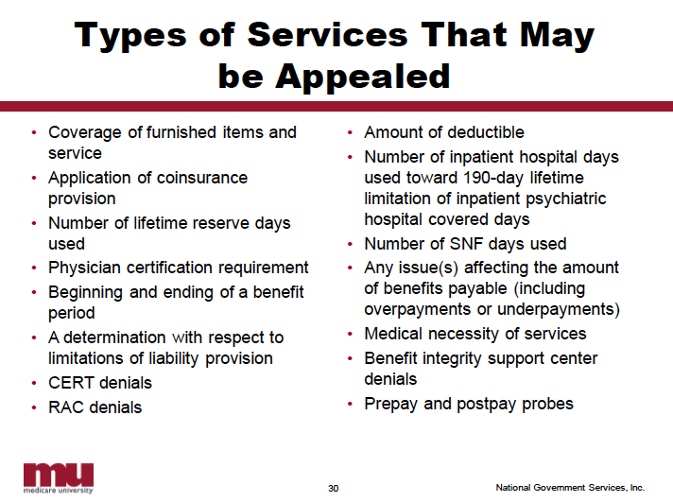

From NGS Medicare

Slide 64
CALCULATING TIME FRAMES
Time frames are generally calculated from date of receipt of notice
5 days added to notice date
Time frames sometimes extended for good cause, examples include:
Serious illness
Death in family
Records destroyed by fire/flood, etc
Did not receive notice
Wrong information from contractor
Sent request in good faith but it did not arrive

Slide 65
Medicare Appeals – Parts A & B - Standard Appeals
Appeal deadline – 120 days from date MSN* sent (will be listed on last page of MSN)
1st level of appeal – redetermination to Medicare Administrative Contractor (MAC)
2nd level – reconsideration to the QIC (deadline 180 days from the decision by the MAC)
3rd level – ALJ hearing
  Use form OMHA-100* to request
  Standard appeals may take a long time to have an ALJ hearing scheduled
4th level - MAC
5th level - Federal court
CMS information on Original Medicare appeals: https://www.cms.gov/index.php/Medicare/Appeals-and-Grievances/OrgMedFFSAppeals/index

Slide 66
Medicare Appeals – Part C
Medicare Part C – aka Medicare Replacement – Medicare Advantage Plans
Medicare Advantage plans limit services through prior authorization, network restrictions, and other cost containment methods, so the Medicare Advantage plan often denies coverage before patient receives services.
Standard appeals
Before service
After service
Expedited appeals
Before service
Care is ending
Beneficiary will not receive an MSN

Slide 67
Medicare Appeals – Part C – Standard appeals
Before a beneficiary can appeal, plan must issue an organization determination
Pre-service determination (like a prior authorization)
Post-service determination – will receive a denial after receiving the service
  Notice of Denial of Medical Coverage, EOB, or insert with EOB mailing
Similar appeals process, just different timelines to get decisions
CMS information on Medicare Managed Care appeals: https://www.cms.gov/index.php/Medicare/Appeals-and-Grievances/MMCAG/index

Slide 68
Medicare Appeals – Part C – Standard appeals
1st level of appeal – plan reconsideration
Plan reviews appeal and reconsiders whether it will cover the service or item Should issue decision within 30 days (60 for post-service appeals)
Two outcomes
Favorable decision: Plan should cover service or item
Unfavorable decision: Plan auto-forwards appeal to the second level (IRE)
1

Slide 69
Medicare Appeals – Part C – Standard appeals
2
2nd level of appeal - Independent Review Entity (IRE)
Reviews plan’s decision and reconsiders whether it will cover the service or item
Should issue decision within 30 days (60 days for post-service appeals)
Two outcomes
Favorable decision: Plan should cover service or item
Unfavorable decision: Beneficiary can choose to move to the next level of appeal

Slide 70
Medicare Appeals – Part C – Standard appeals
3rd level of appeal – ALJ Hearing. Steps:
Beneficiary requests Administrative Law Judge (ALJ) hearing within 60 days of receiving the unfavorable reconsideration notice - OMHA-100* form
ALJ receives request and sets time and place for hearing
Beneficiary receives Notice of Hearing 20 days before hearing
ALJ notifies beneficiary of decision by mail
Should issue decision within 90 days of hearing request
3

Slide 71
Medicare Appeals – Part C – Standard appeals
4th level of appeal – Medicare Appeals Council
Beneficiary requests MAC Review within 60 days of receiving unfavorable ALJ decision
MAC reviews ALJ’s decision
  No new hearing. Only reviews evidence from ALJ hearing.
Can issue favorable, unfavorable, or remand decision
5th (final) level of appeal – Federal Court
No timeline for decision
4
5

Slide 72
Medicare Appeals – Part C – expedited appeals
Before service – beneficiary requests prior approval for a service (similar to standard appeal), but if denied, doctor requests expedited appeal because beneficiary’s health would be at risk
Appeal steps are the same as a standard appeal, just the timeframe is different
Doctor requests expedited prior approval – plan has 72 hours to issue organization determination
If denied, doctor requests expedited appeal – plan has 72 hours to issue decision (level 1)
If denied, IRE has 72 hours to issue decision (level 2)
Levels 3, 4, & 5 - Same steps (ALJ, MAC, Federal Court) and appeal deadlines as standard appeal

Slide 73
Medicare Appeals – Part C – expedited appeals
Care is ending – hospital, SNF, home health, hospice or other care is ending
Same process as expedited original Medicare appeal
Important Message From Medicare* (hospital) or Notice of Medicare Non-coverage* (non-hospital)
Appeal to BFCC-QIO
Appeal to (QIC)
ALJ hearing
MAC appeal
Federal Court review

Slide 74
Medicare Appeals – TIPS
Build your case
Look up the coverage criteria
LCD/NCD database: https://www.cms.gov/medicare-coverage-database/overview-and-quick-search.aspx
Medicare Benefit Policy Manual: https://www.cms.gov/Regulations-and-Guidance/Guidance/Manuals/Internet-Only-Manuals-IOMs-Items/CMS012673
Get the facts/story
Collect relevant documents
Doctor’s letters
Medical records
MSNs
ABNs
NOMNC
Provider billing statements
EVIDENCE OF COVERAGE (advantage plans)
Coverage criteria for advantage plans (Part C is the same as Medicare because they must cover at least what Medicare covers, but may cover more. Must obtain EVIDENCE OF COVERAGE, which is the plan’s document stating if/what they cover above and beyond what Medicare covers.

Slide 75
Medicare Appeals – Part D
Part B and Part D both cover outpatient prescription drugs
Part B drugs: administered by doctor
Part D: self-administered
Part B and Part D drug denials do not use same appeal process
  Part B drug denials - Appeal using Original Medicare or Medicare Advantage appeal process
  Part D drug denials - Appeal using Part D appeal process
Possible coverage problems > Part B drug billed to Part D
Note: LIS/Extra Help and Late Enrollment penalty appeals go through the Social Security Administration (SSA)

Slide 76
Medicare Appeals – Part D
Two situations:
Beneficiary goes to pharmacy and learns plan will not cover prescription
  Possible reasons for non-coverage
    Refill requested too soon
    Drug is not on plan’s formulary
    Drug is subject to utilization management tools
      Prior authorization, step therapy, quantity limits
    Drug is excluded from coverage for any Part D plan
      E.g., over-the-counter drugs, medications for weight loss and gain, drugs that treat cold symptoms etc.
Beneficiary goes to pharmacy and finds drug is too expensive
  Higher tier

Slide 77
Medicare Appeals – Part D
Next steps (before filing an appeal)
Beneficiary contacts plan to find out reason it will not cover drug
Beneficiary files formal coverage request or an exception request to Part D plan:
  Standard: Should issue decision within 72 hours
  Expedited: Should issue decision within 24 hours
Beneficiary receives coverage determination. If unfavorable decision, beneficiary can begin appeal.

Slide 78
Medicare Appeals – Part D
CMS information about exception requests: https://www.cms.gov/Medicare/Appeals-and-Grievances/MedPrescriptDrugApplGriev/Exceptions
  A tiering exception - requested to obtain a non-preferred drug at the lower cost-sharing terms of a low tier.
  A formulary exception - requested to obtain a Part D drug that is not included on a plan’s formulary, or to request to have a utilization management requirement waived (e.g., step therapy, prior authorization, quantity limit) for a formulary drug.
CMS information about coverage determinations: https://www.cms.gov/Medicare/Appeals-and-Grievances/MedPrescriptDrugApplGriev/CoverageDeterminations-

Slide 79
Medicare Appeals – Part D
Next step - beneficiary files an appeal.
Appeal process is similar to other parts of Medicare:
Plan redetermination > IRE reconsideration > ALJ Hearing > MAC appeal > Federal court

Slide 80
PART D GRIEVANCE PROCESS
Each drug plan must have a separate grievance process to address issues that are not appeals
01
May be filed orally /in writing w/i 60 days
02
Plans must resolve grievances
03
w/i 30 days generally
w/i 24 hrs if arise from decision not to expedite coverage determination or redetermination

