Slide 1
Thyme Care
NJSOM Meeting
June 26 2026

Slide 2
Review Thyme Care Value Prop
Share some stories
Where we are headed
Questions
Todays Goals

Slide 3



Overview
Thyme Care partners with risk bearing entities to deliver a better experience for members with cancer while lowering the total cost of care.
Thyme Care and risk bearing entity execute a partnership to enhance the management of members with cancer while lowering costs.
Thyme Care serves Commercial and Medicare Advantage segments today
Partnerships
Member Engagement
Thyme Care deploys a tech- enabled, virtual oncology care team to provide 24/7 wraparound cancer support to all eligible members, irrespective of setting or treating oncologist.
Oncologist Integration
Thyme Care coordinates care with oncologists across all settings and engages select providers to become a Thyme Care Oncology Partner (TCOP), unlocking further integration and value drivers.
~100K
Members on active cancer treatment
9/10
Member satisfaction
~1.4K
Partnered oncologists
14
Payer partnerships, national and regional
20%
Reduction in acute care utilization
60%
Oncologist adherence to recommended drug interventions

Slide 4









Thyme Care Leadership Team
Robin Shah
Co-Founder & CEO
Bobby Green, MD
Co-Founder, President & CMO
Brad Diephuis, MD
President & COO
Julia Ivanova
SVP, Payer Partnerships
Mark Lombardi, DSc
SVP, Provider Partnerships
Brian Dorsey, MD
Medical Director
Ashley Patton
VP, Thyme Care Oncology Partners
Jeff Lovesy
SVP/GM, Commercial Partnerships
Julia Frydman, MD MS
Sr. Medical Director, Palliative Care
Notes:
Bobby. Oncologist in the trenches… flatiron… tech enabled services… wanted to be closer to patient,, and solve a bunch of problems…

Slide 5
Thyme Care Value Proposition
A value-based model built to lower costs and raise the bar on cancer care.
01 · TOTAL COST OF CARE
02 · CLINICAL EXTENSION
Lower total cost of care while improving outcomes.
Extend and enhance the oncology care team.
Our value-based model reduces costs through coordinated, tech-enabled support for patients in active treatment.
A 24/7, fully employed clinical team works alongside any oncologist to proactively manage symptoms, remove barriers, and deliver high-touch, wraparound care with 9/10 member satisfaction.
03 · FINANCIAL OPTIMIZATION
04 · NATIONAL SCALE
Optimize the financial side of cancer care.
Scale value-based oncology with national reach and no downside risk.
Integrated clinical and financial programs improve drug affordability , reduce waste, streamline billing, and minimize patient financial toxicity across the care journey.
Partnerships with major payers enable practices to participate in value-based care confidently.

Slide 6






















Thyme Care Core Partners
Thyme Care is the trusted oncology partner to payers, oncology MSOs, and other providers, and our partner list continues to grow rapidly.
Thyme Care has value based contracts with many MA and commercial payers today, and we are launching several more payers in 2026.
To support our payer contracts, Thyme Care partners with the 3 major oncology MSOs, has JVs with leading oncology practices and is expanding our health system partnerships.
Launching in Q1 2026

Slide 7
Thyme Care Oncology Partners (TCOP) Overview
Our clinical model applies to all members, agnostic of the treating oncologist, and with select oncologists, we form deeper, integrated partnerships to drive more value.
Thyme Care engages with ALL members on active treatment across all oncology providers and settings
Thyme Care’s fully employed oncology care team delivers 24/7 wraparound cancer care support to address all member needs in between clinic visits, in coordination with the member’s oncologist.
Members at Non-Thyme Care Oncology Partners
Members at Thyme Care Oncology Partners
Thyme Care coordinates with the member’s treating oncologist to ensure continuity of care and shares back relevant information with the oncologist.
With select oncologists that become a Thyme Care Oncology Partner, Thyme Care forms a deeper level of care integration and deploys incentive programs to drive further value.
7

Slide 8
Thyme Care Oncologist Partnership Models
Practices partner with Thyme Care through a core agreement with optional programs to expand impact
Base Agreement
Optional Programs
Thyme Care works alongside your existing care team to support care navigation and coordination for your patients.
Optional Programs
Drug Interventions
Reduce patient financial burden and improve access to therapy
Identify and execute high-impact interventions to lower total cost of care
What this includes:
Longitudinal care navigation and clinical support between visits
Bi-directional coordination with your oncologists and care team
Patient identification, PCP referral workflows, and EHR integration
Reduced administrative burden on practice staff
Patient identification & enrollment
Identify eligible patients and support enrollment
Design workflows and support practice teams
Programs and partnership structure are tailored based on practice goals and market context.
8
Notes:
Speaker: Bobby

Slide 9
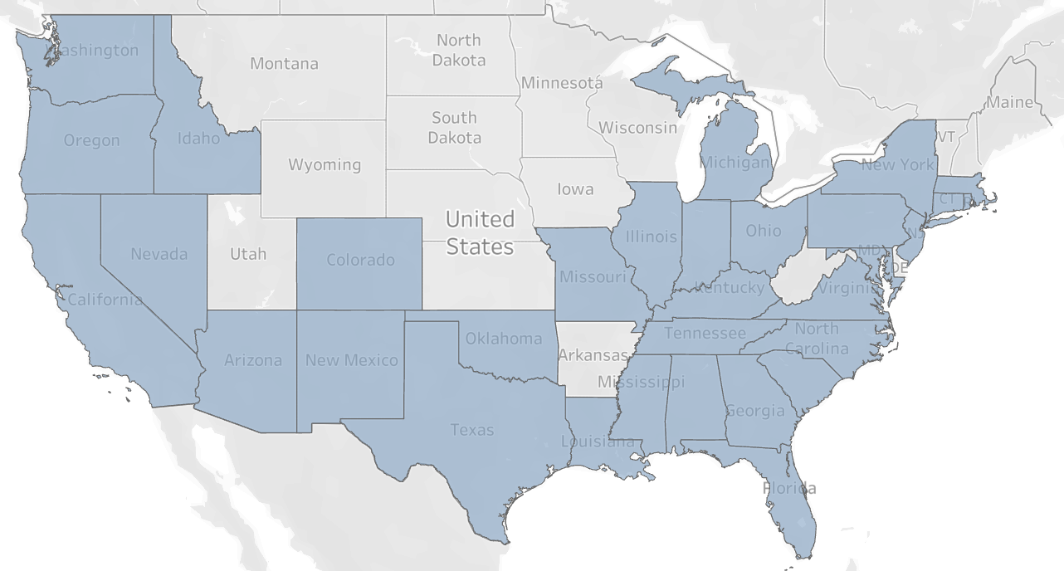
Thyme Care Payer Footprint
Thyme Care is live across most U.S. markets with growing multi-payer coverage
In most active markets, Thyme Care supports patients across multiple major payers
33
States with live payer contracts
~100k
Members attributed to our payers
~700
Practice
Locations
Active Markets (April 2026)
Payer Coverage in New Jersey
Aetna: 3,485 covered lives
Humana: 865 Covered lives
Oak Street: 12 covered lives
Clover: 2,850 covered lives
Coverage includes at least one active payer
9

Slide 10






Expert Care Team
Thyme Care’s fully employed oncology care team provides 24/7 virtual support for all clinical and non-clinical needs that arise in-between oncology appointments.
Multi-disciplinary oncology-trained team, with small panel sizes per care pod
No cost, 24/7 between-visit support provided by Thyme Care’s fully employed oncology-trained care team, comprised of 500+ members.
Members form a trusted, longitudinal relationship with a consistent care team.
Thyme Care provides patient support from symptom management to reducing the social barriers to care.
Thyme Care works in collaboration with the member’s oncology practice to ensure visibility, continuity of care, and reduce administrative burden on practices.
Oncology Nurse
Clinical education, support, symptom management and chronic conditions management
Medical Director
Clinical case review and complex case management
Nurse Practitioner
Support Care Team in complex medical decision making
Social Worker
Addresses emotional and psychosocial challenges and connects members with needed support resources
Member and Oncologist
Care Partner
Member advocate addressing whole-person needs and care coordination support

Slide 11





Member-Facing Services: Core Interventions
Thyme Care core member-facing interventions focus on proactive, patient-centered strategies to drive meaningful outcomes.
Core Interventions:
Monitoring & Triage
Transitions of Care
Advanced Illness Program
Integrated Social Support
Comorbid Support
Proactive patient-reported outcome surveys (ePROs) identify and address symptoms before ED escalation based on member needs.
Data feeds provide real-time admission and discharge information, enabling timely support to help patients avoid readmission.
Early interventions ensure goal-concordant care throughout treatment, with referrals to palliative care and/or hospice, as appropriate.
Structured assessments identify SDOH needs. We provide direct support and connect members to local resources to address barriers & close loops.
Identification of the root cause of the poor control and coordination with primary care and specialists to develop action plans.
Impact:
Reduced ED visits, readmissions, and inpatient admissions
Reduced chemotherapy at end of life
Higher patient satisfaction
Notes:
Speaker: Dorsey

Slide 12
Thyme Care Oncologist-Partnered Drug Interventions
Thyme Care oncologist-partnered drug interventions span five categories and focus on high value drug opportunities that are challenging to address through traditional UM.
Thyme Care Oncologist-Partnered Drug Intervention Categories
Drug Waste Minimization
Adjust drug administration protocols from fixed dosing to weight-based dosing when indicated
Thyme Care’s drug interventions address oncology decisions beyond the reach of traditional Utilization Management.
Our drug interventions use a drug list curated by Thyme Care based on highest-cost drugs with most savings opportunity, not a payer-mandated list
Drug Benefit Optimization
Shift billing from Part B to D when it reduces patient OOP costs and decreases payment lag
Reduction of Lower Value Drugs
Therapeutic / formulary interchanges for specific drugs, maintaining treatment efficacy
Free Drug Program
Identify and complete applications with patients for manufacturer assistance programs
Biosimilar / 505(b)(2) Substitutions
Drive adoption of lower cost biosimilars, including switching from expensive 505(b)(2) products
12

Slide 13

Thank You!
Cancer care, reimagined.
Extending the reach of high-quality cancer care by creating a better experience, improved outcomes, and lower costs.
Thyme Care Medical, PLLC, (Thyme Care Provider) is a health care provider offering clinical cancer support services to its patients. Thyme Care Provider does not direct diagnosis or prescribing of medication for cancer treatment. Thyme Care, Inc. provides management support services to Thyme Care Provider or cancer support services to its members.
2026 Thyme Care, Inc - Proprietary & Confidential

