Slide 1
Title Layout alternate
NJSOM Spring Conference
Capitol Hill Update and Election Impact on Health Care Policy
Ted Okon
Executive Director
March 21, 2025

Slide 2
Broad Overview
Title, Text Layout
It’s still wait-and-see as to what is in store for CMS policy from the Trump Administration, although indiscriminate firings (and resignations) are a bit disturbing
  We have some indications from RFK Jr., now installed as HHS Secretary, and confirmation hearing of Dr. Mehmet Oz for CMS administrator of what may happen
    Dr. Oz likes Medicare Advantage but thinks it needs reform
    Supposedly, Medicare drug “negotiations” still scheduled to continue
  Unclear how staff exodus at NIH, FDA, and CMS/CMMI will impact those agencies
Seismic shift from total focus on pharma to pharmacy benefit managers (PBMs) and hospitals, especially 340B, still holding
More bipartisan agreement on the need for PBM reform, and even the need to address 340B, but Congress can’t get this over the goal line because it was “Musked”
Fixing Medicare physician payments is another bipartisan issue that should have been fixed but was not because it also was “Musked”
It’s a brave (bizarre) new world in DC!!!

Slide 3
The D.C. Climate and Action
Title, Text Layout
Worse than what you hear on the news or read
  Not only are Rs and Ds at each other’s throats, but Ds are warring with Ds
    Intense anger at Minority Leader Schumer (he’s wounded)
  Lots of animosity over CR to keep the government running till fiscal year-end (end of September)
    Passed the House on party line vote with no D input
    At it again in September
  President Trump has complete (and I mean complete) control of the R-majority Congress
Trump has taken the election as a HUGE mandate to radically change (and downsize) the federal government
Congress has virtually done nothing other than keep the government open
Trump has signed close to 100 executive orders already (and more are coming)
Next up is “reconciliation” bill on immigration, taxes, and possibly health care (doc fix)

Slide 4
Same Top Issues Facing Oncology
Restricting oncology practices from delivering drugs to patients
Medicare physician pay cuts
PBM/insurer issues too long to list, but here are some of the most pronounced:
  Spike in prior authorizations, especially in Medicare Advantage plans
  Low-ball Part D reimbursements
  Restricting biosimilar use
  Mandatory mail order and white bagging
Increasing cost of hospital care
  Push for site-neutral payments
  Address 340B abuses
IRA and Medicare negotiating drug prices

Slide 5
What’s Up Next for Congress?
Extension of telehealth waivers were taken care of in CR to keep the government running
Still some debate if one or two reconciliation bills
  Taxes, immigration, and health care (?)
    Speaker Johnson promised Rep. Dr. Murphy that Medicare doc fix would be included in reconciliation
Congress did have a bipartisan CR bill in December that included doc fix and anti-PBM measures
  President/Vice President Musk “Musked” that bill
Senate Ranking Member Wyden just tried to fast track (UC) PBM bill but was stopped by Senator Scott
  Not clear what happens next
  Reconciliation (?)
Health care issues contained in a fall package or CR (?)

Slide 6
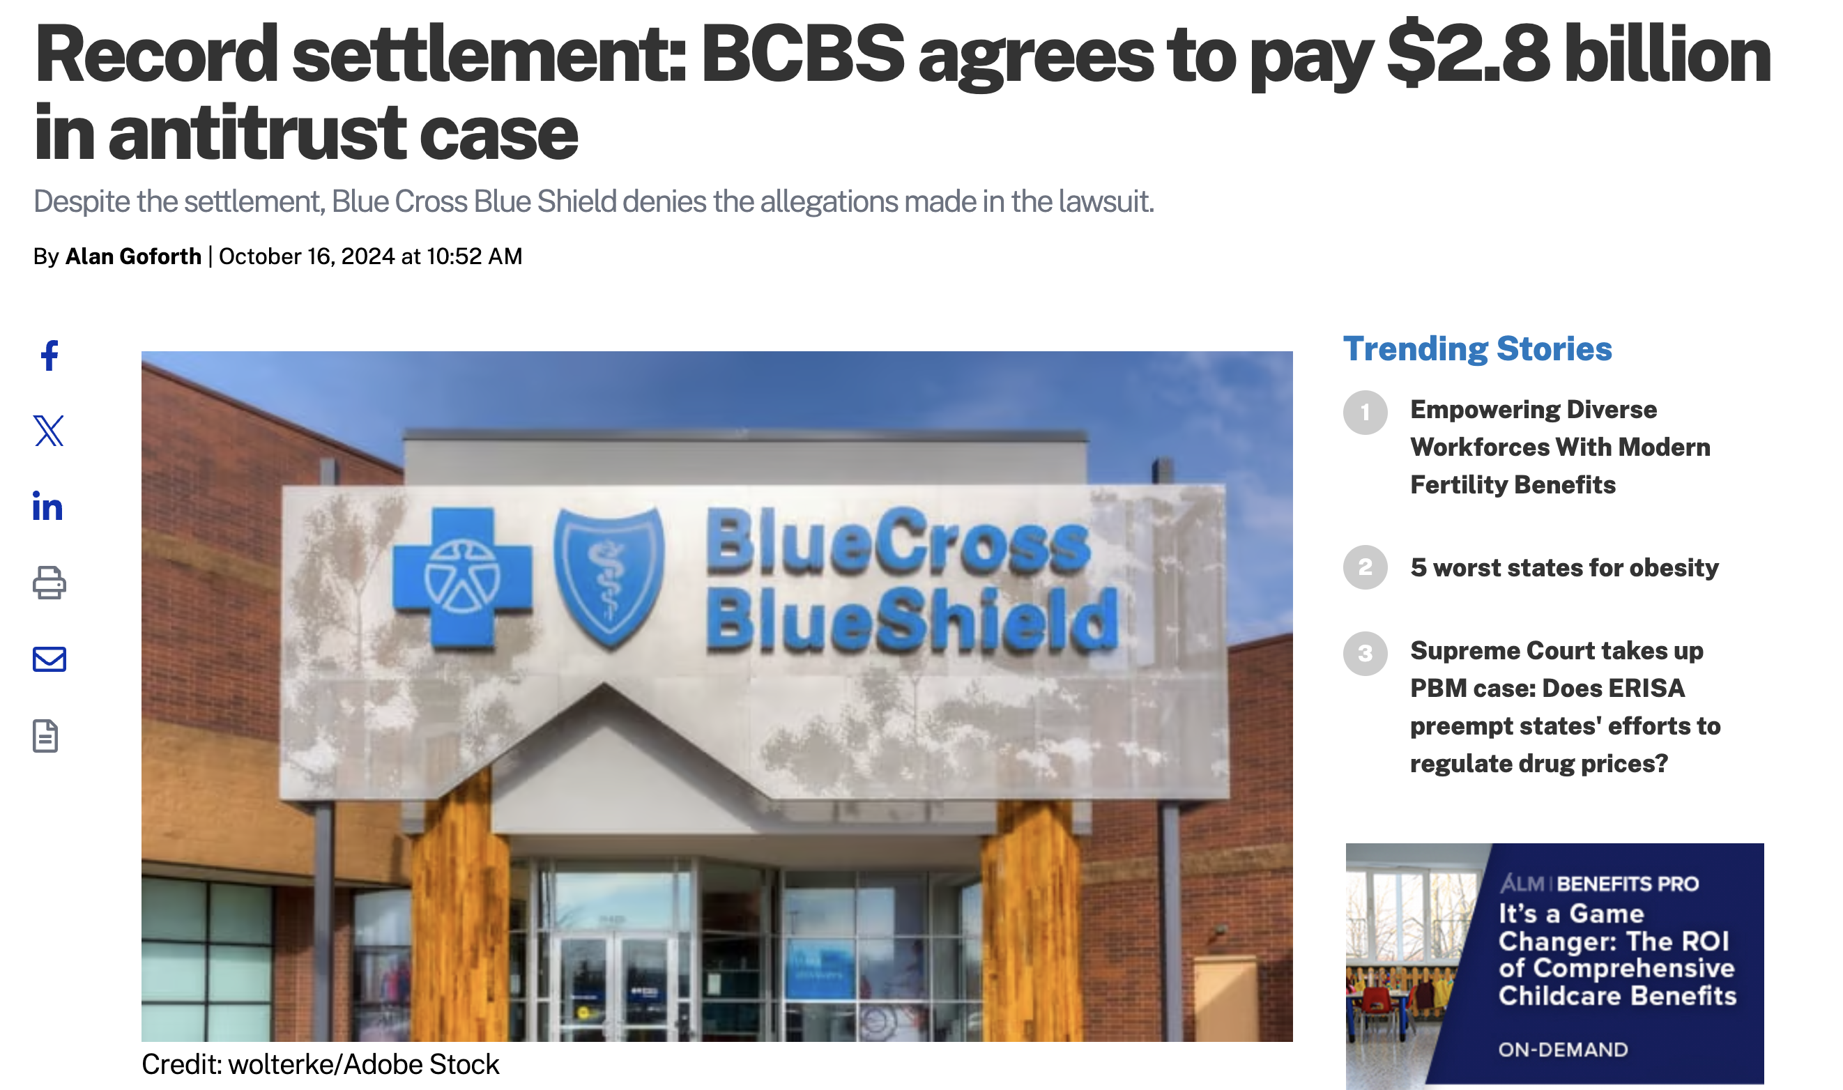

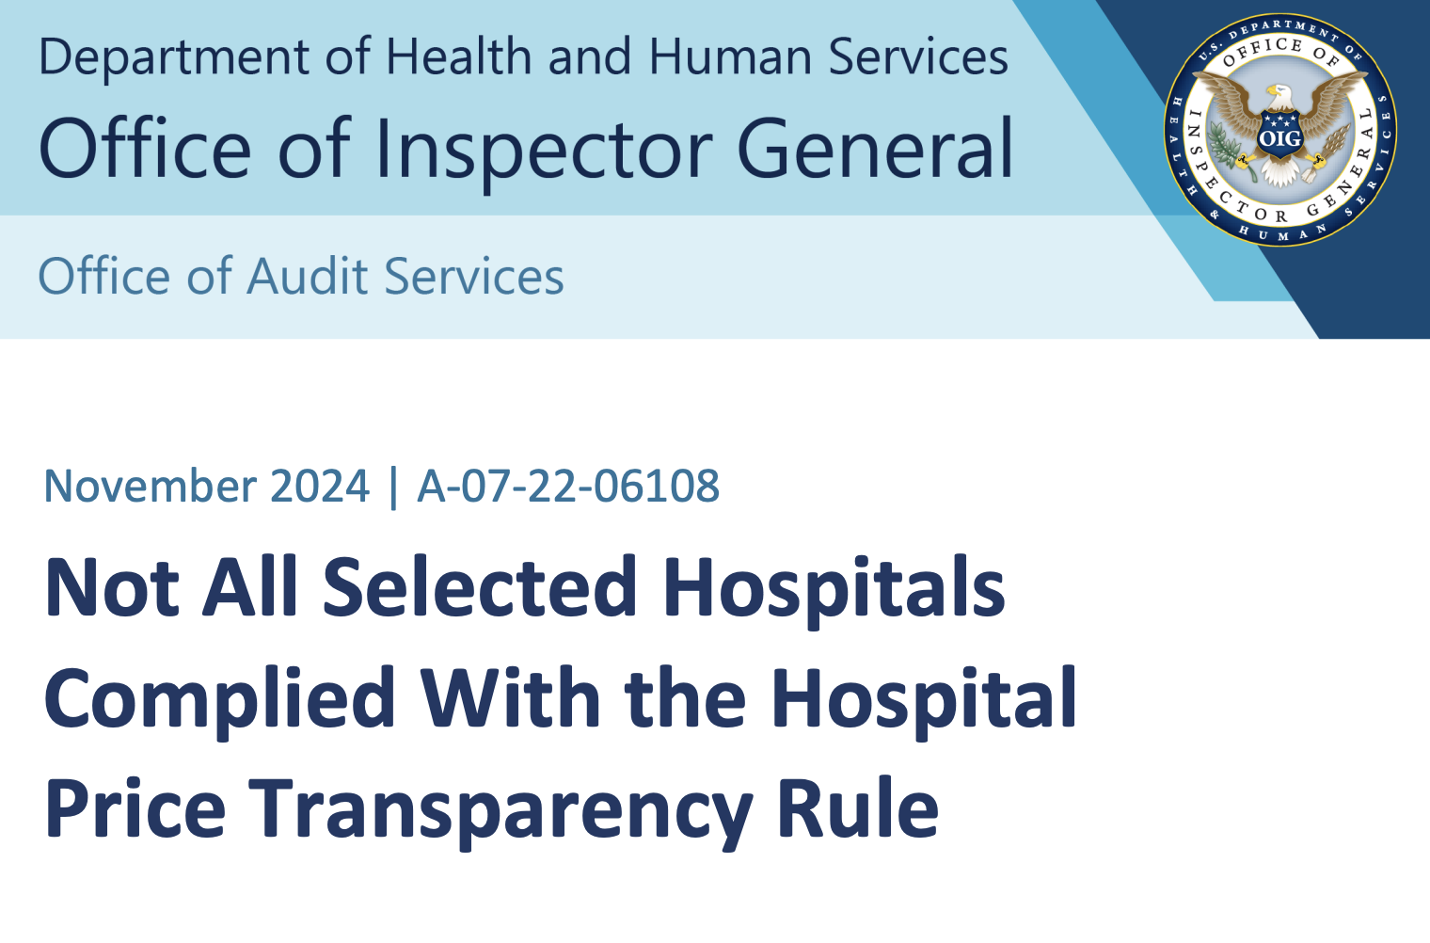
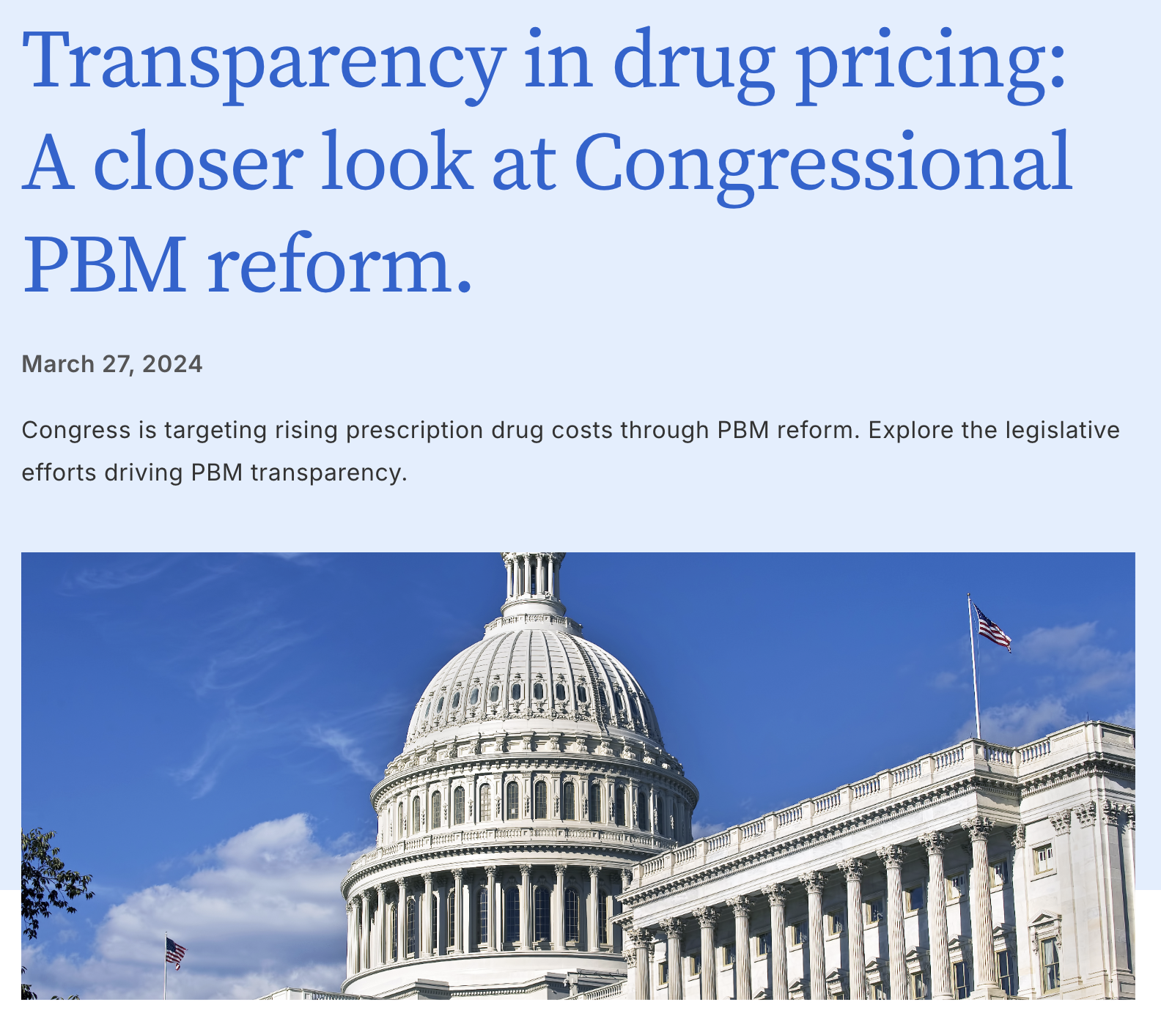
Two ”Themes” That Still Have Traction
Consolidation
  Insurers & PBMs
  Hospital Systems
  Others
Transparency
  Hospital pricing
  PBM rebates
  340B discounts
  Insurance contracts

Slide 7
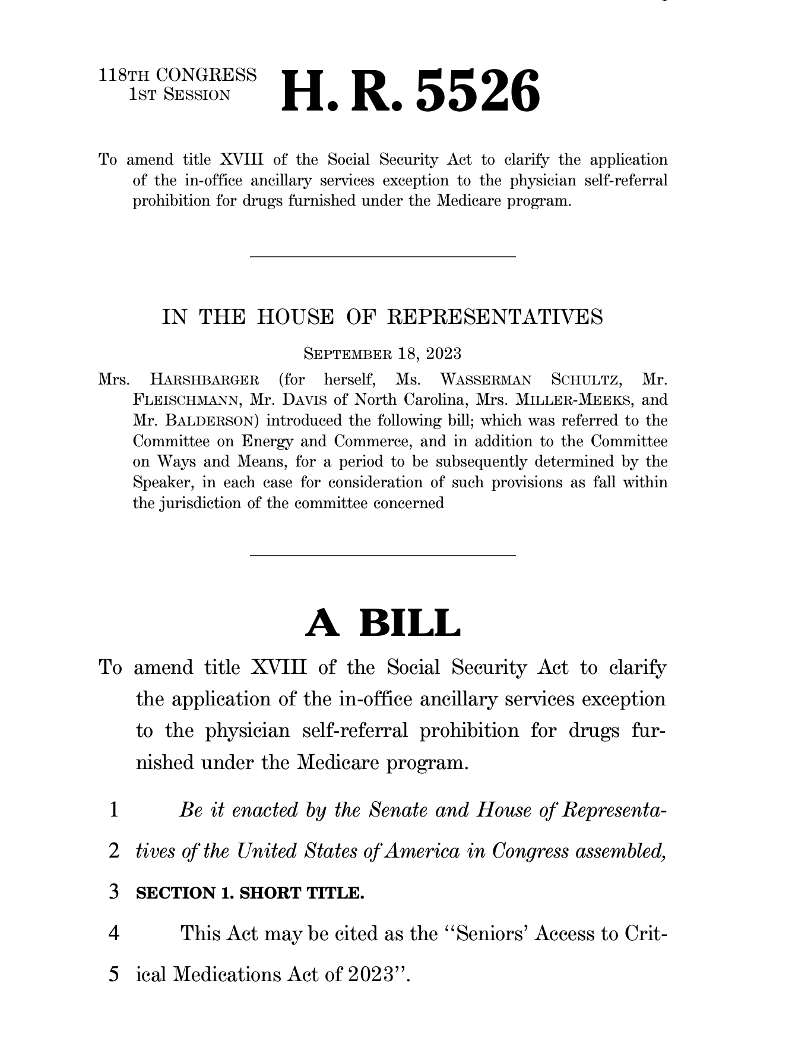
Update: The Stark Issue
CMS using the Stark law to stop practices from delivering drugs (or even caregivers from picking up drugs for patients)
COA working hard with Congress to get legislation advanced to stop CMS
  H.R. 5526 passed by the full House in 118th Congress
  Working to get new version introduced in this (119th) Congress and passed by the House
  Working on Senate companion bill
Reaching out to “new” CMS to fix this problem
FOIA request to uncover what prompted CMS to issue Stark FAQ
  Totally ignored by CMS, so now in the court to force CMS to respond
NASP and NACDS lobbying this fix
  Why…

Slide 8
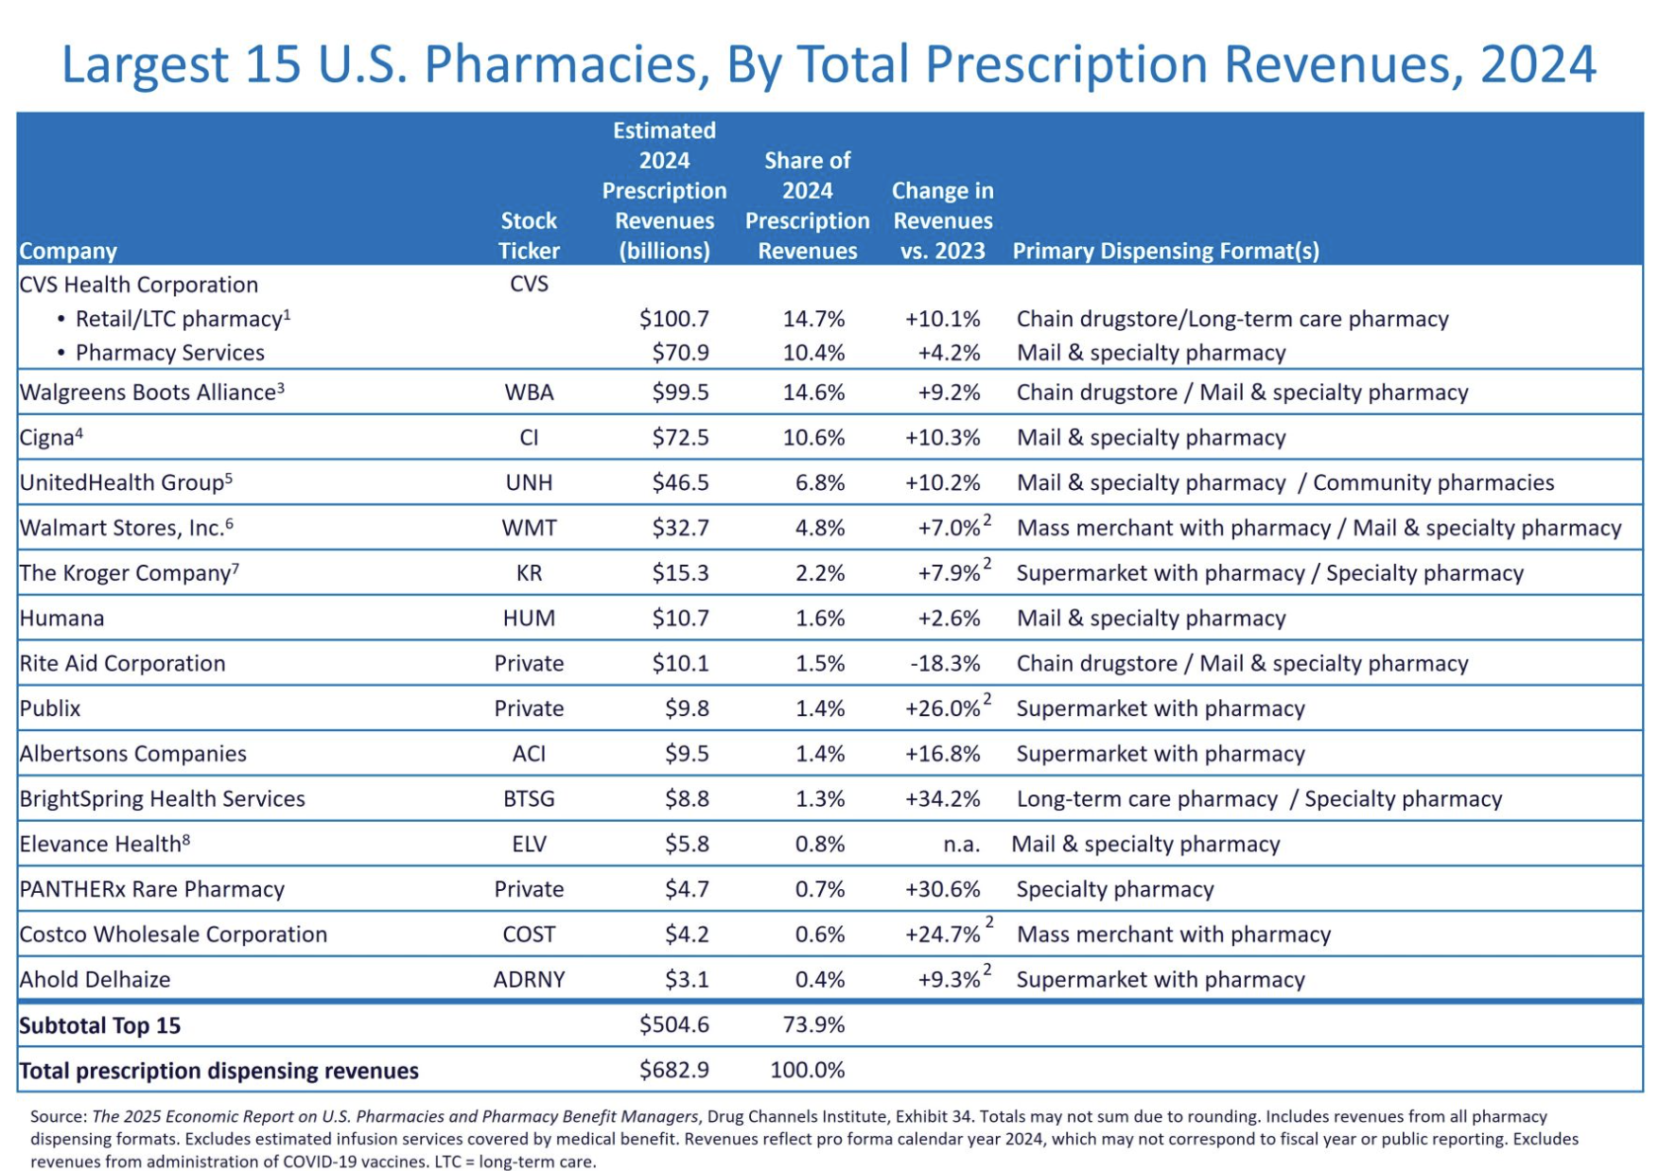
The War Over Who Dispenses Oral Cancer Drugs

Slide 9
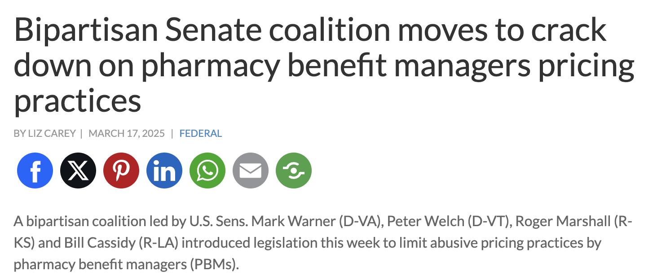
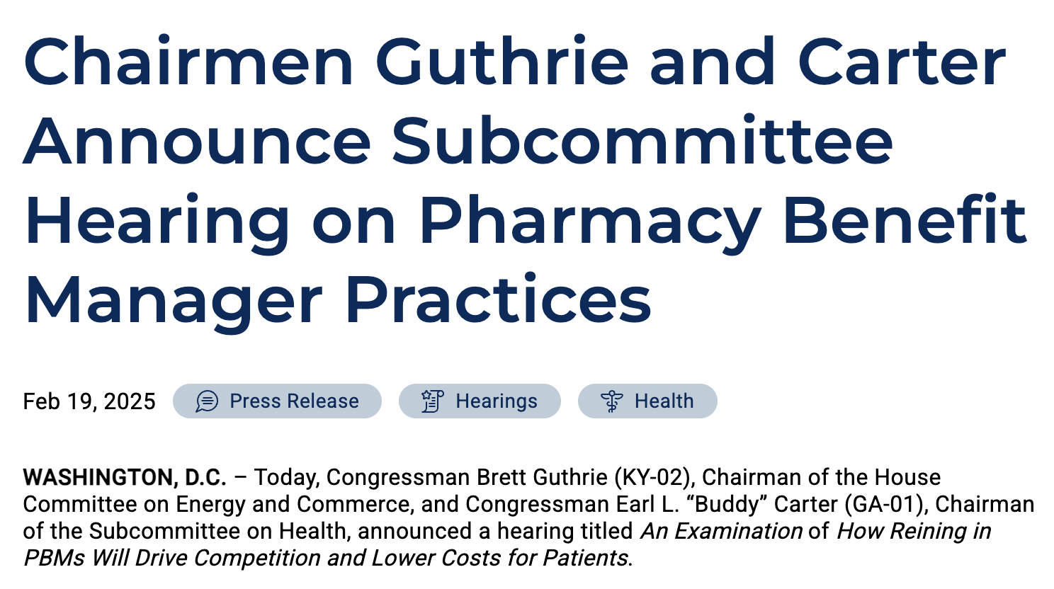
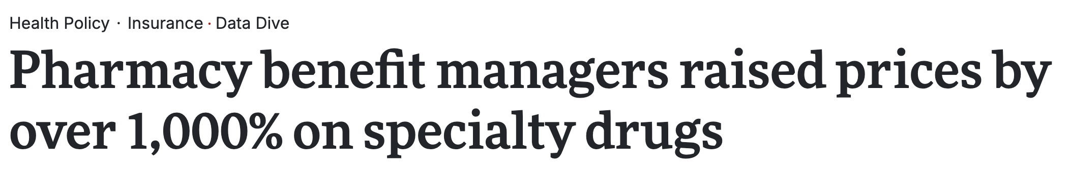
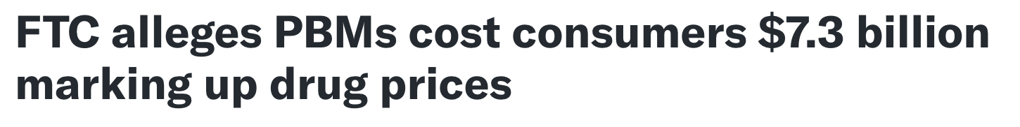
PBMs Still Under Intense Fire

Slide 10

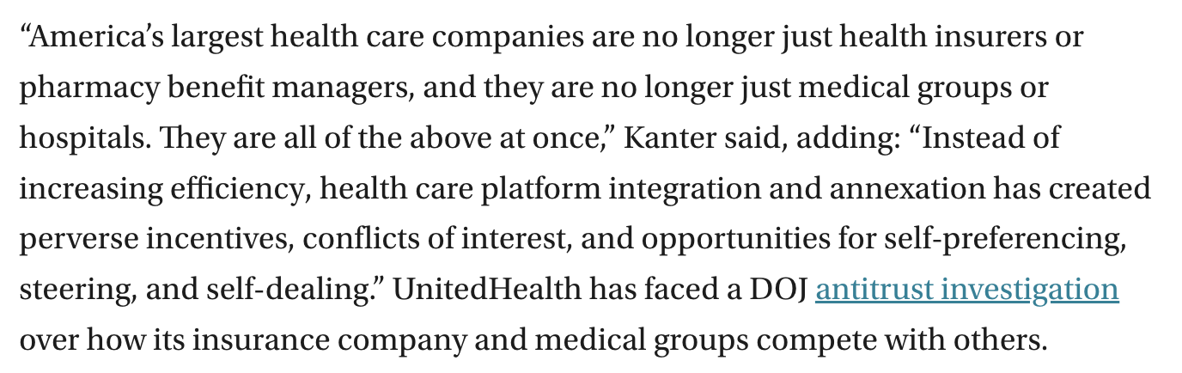
… As Are Insurers

Slide 11
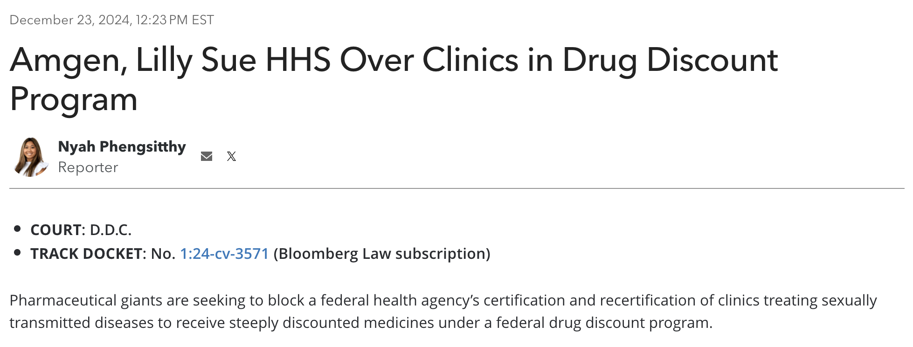
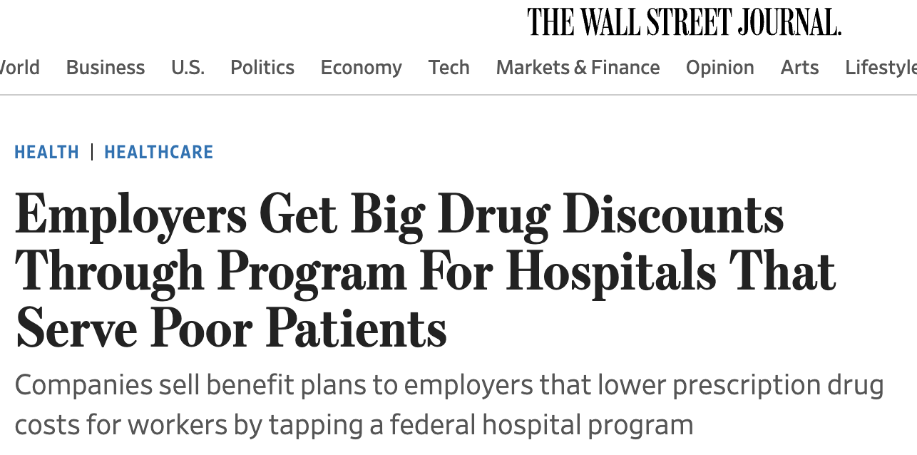
340B Schemes Getting More Brazen!

Slide 12
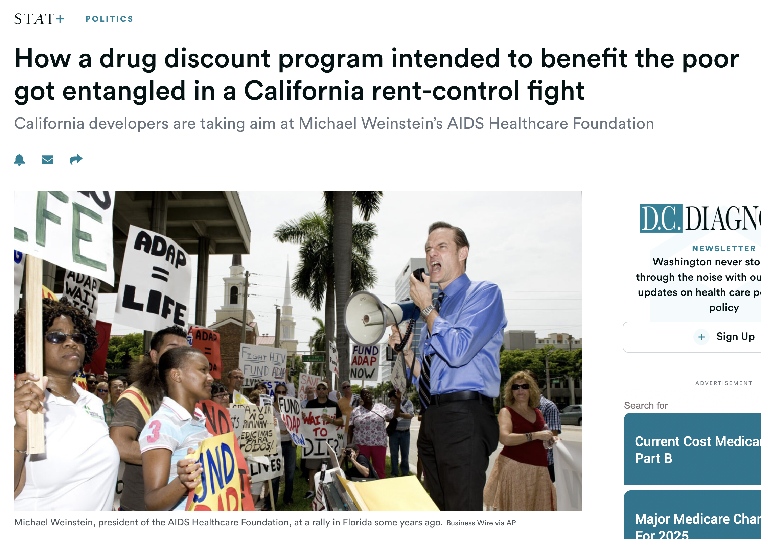
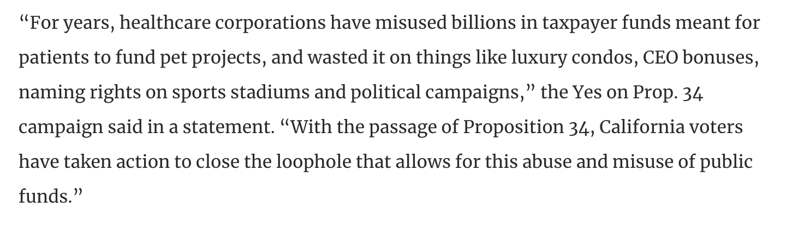
And Even Downright Bizarre!

Slide 13
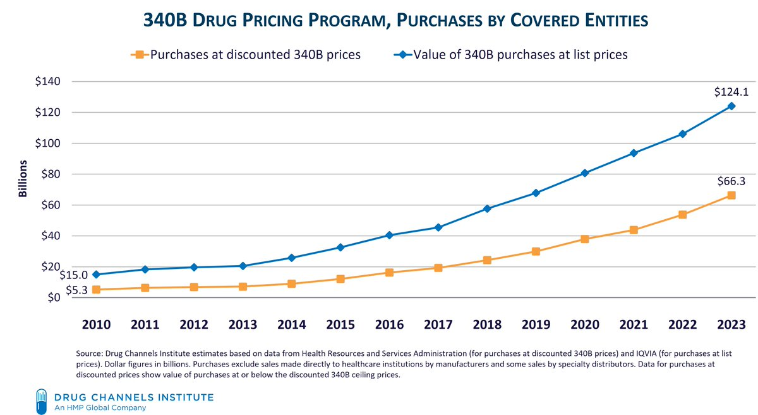
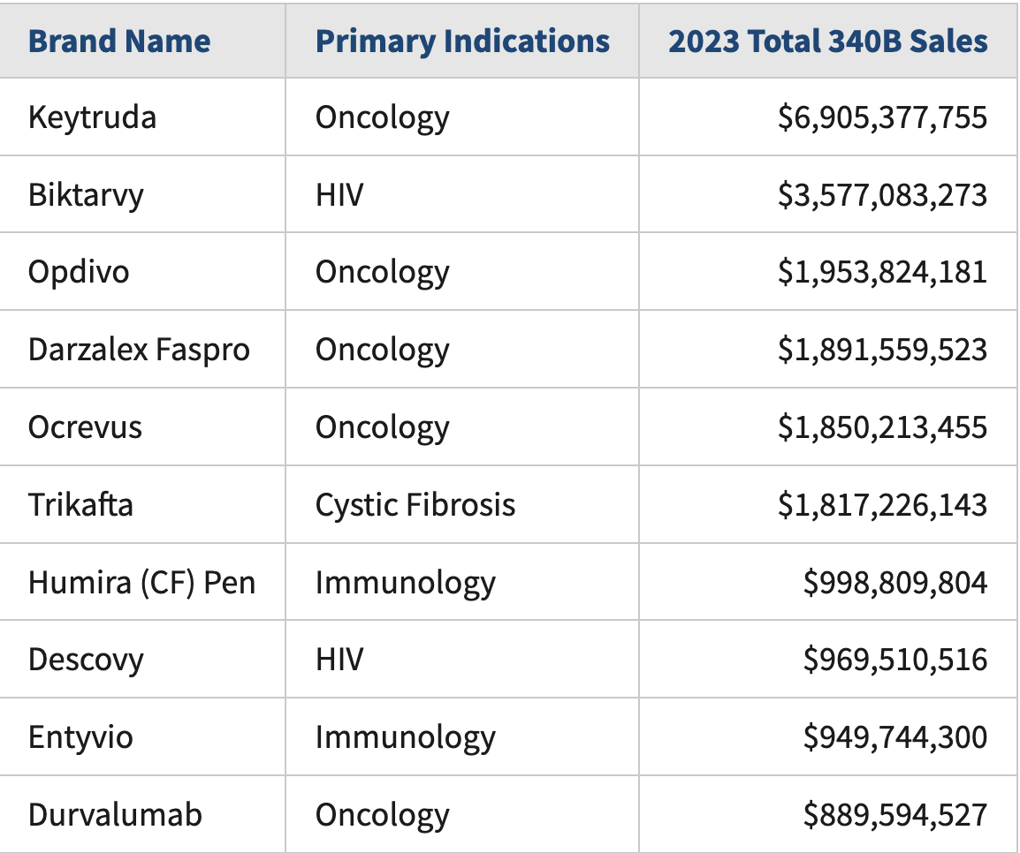
340B Growth Unchecked
DSH hospitals accounted for 78% of 340B sales
10 drugs accounted for approximately one-third of 340B sales
  Oncology drugs 20%

Slide 14
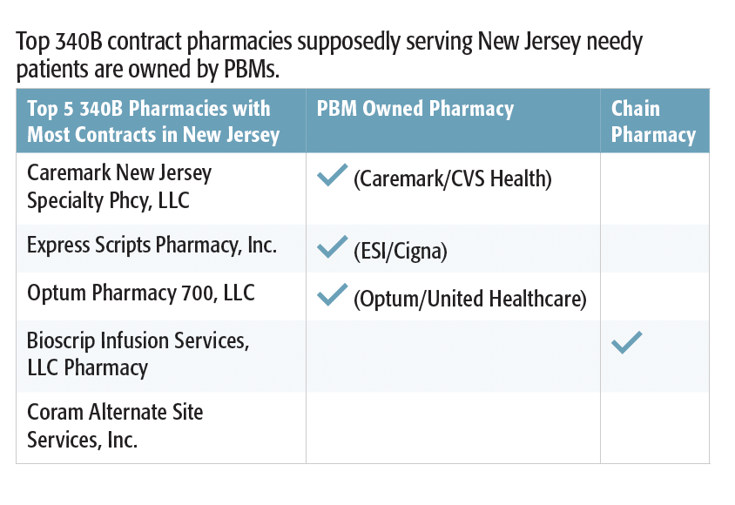
340B Contract Pharmacies

Slide 15
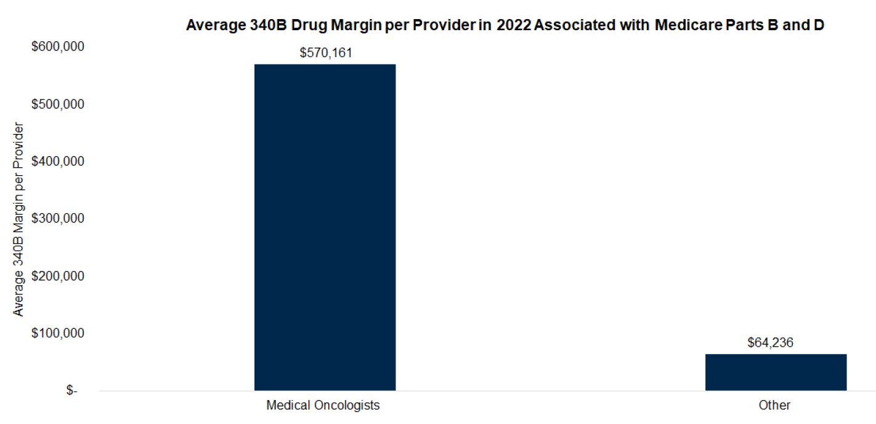
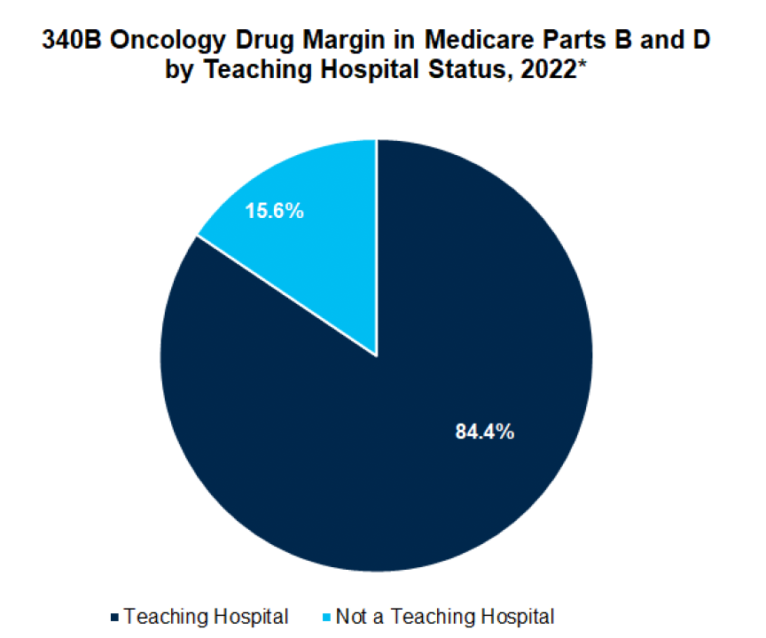
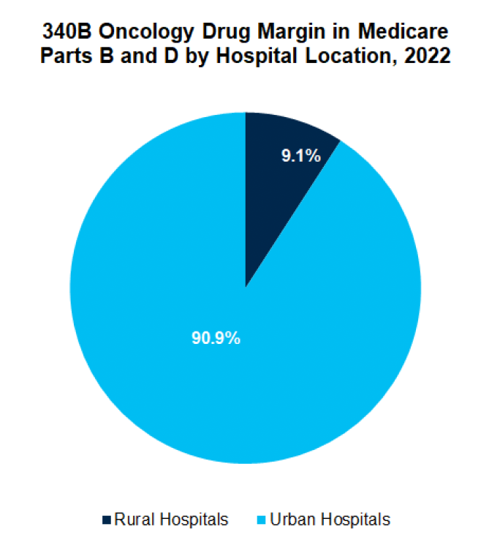
Even ACS CAN Has Stepped Up!

Slide 16
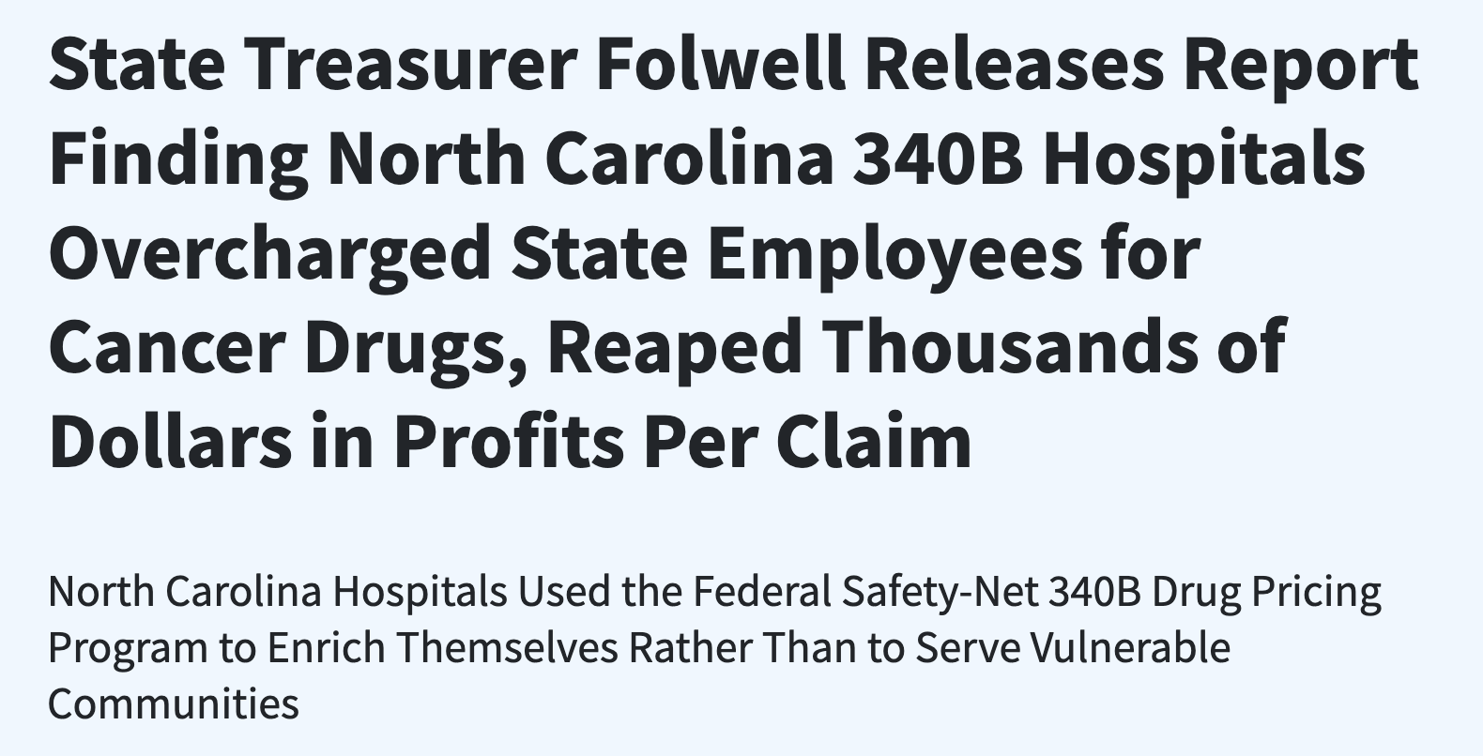
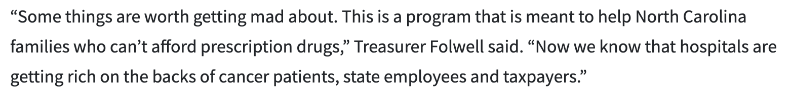
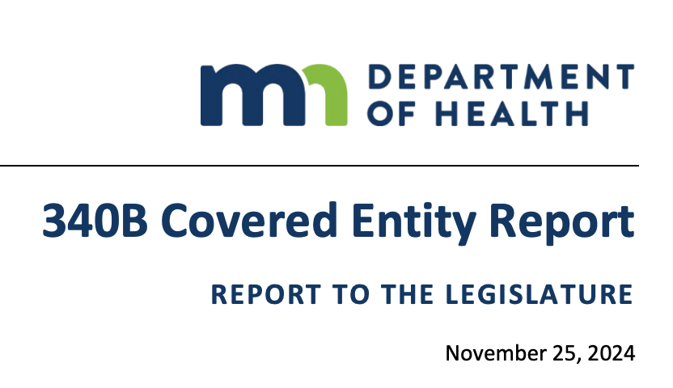
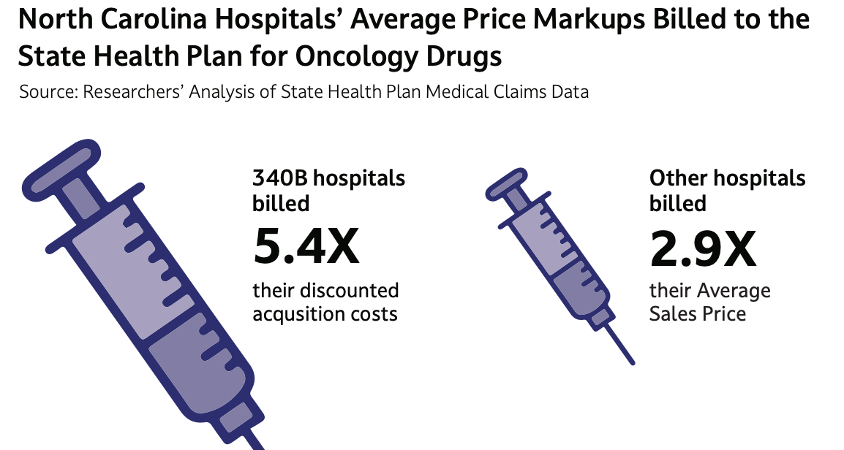
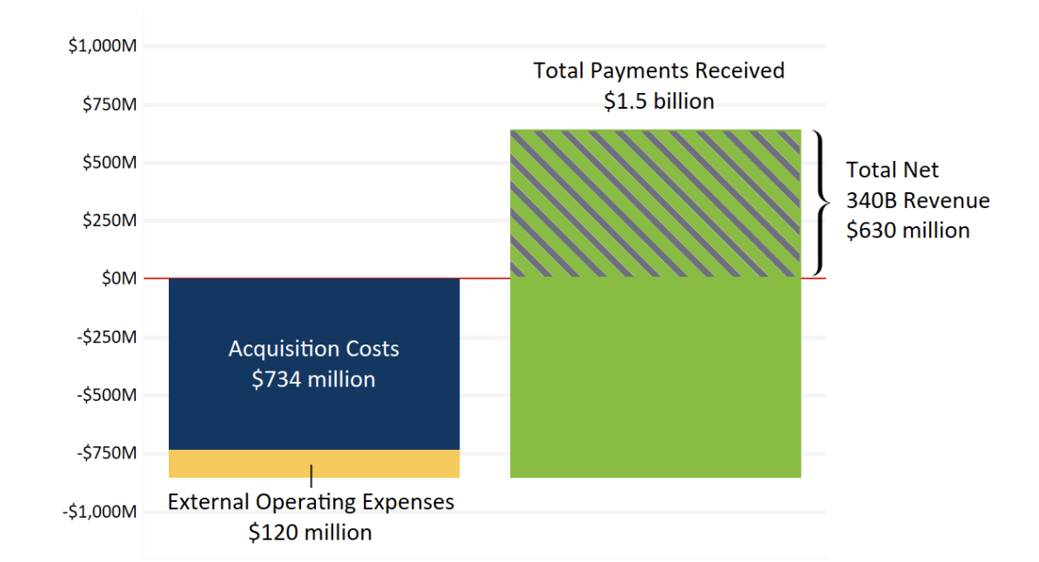
States Going After 340B

Slide 17
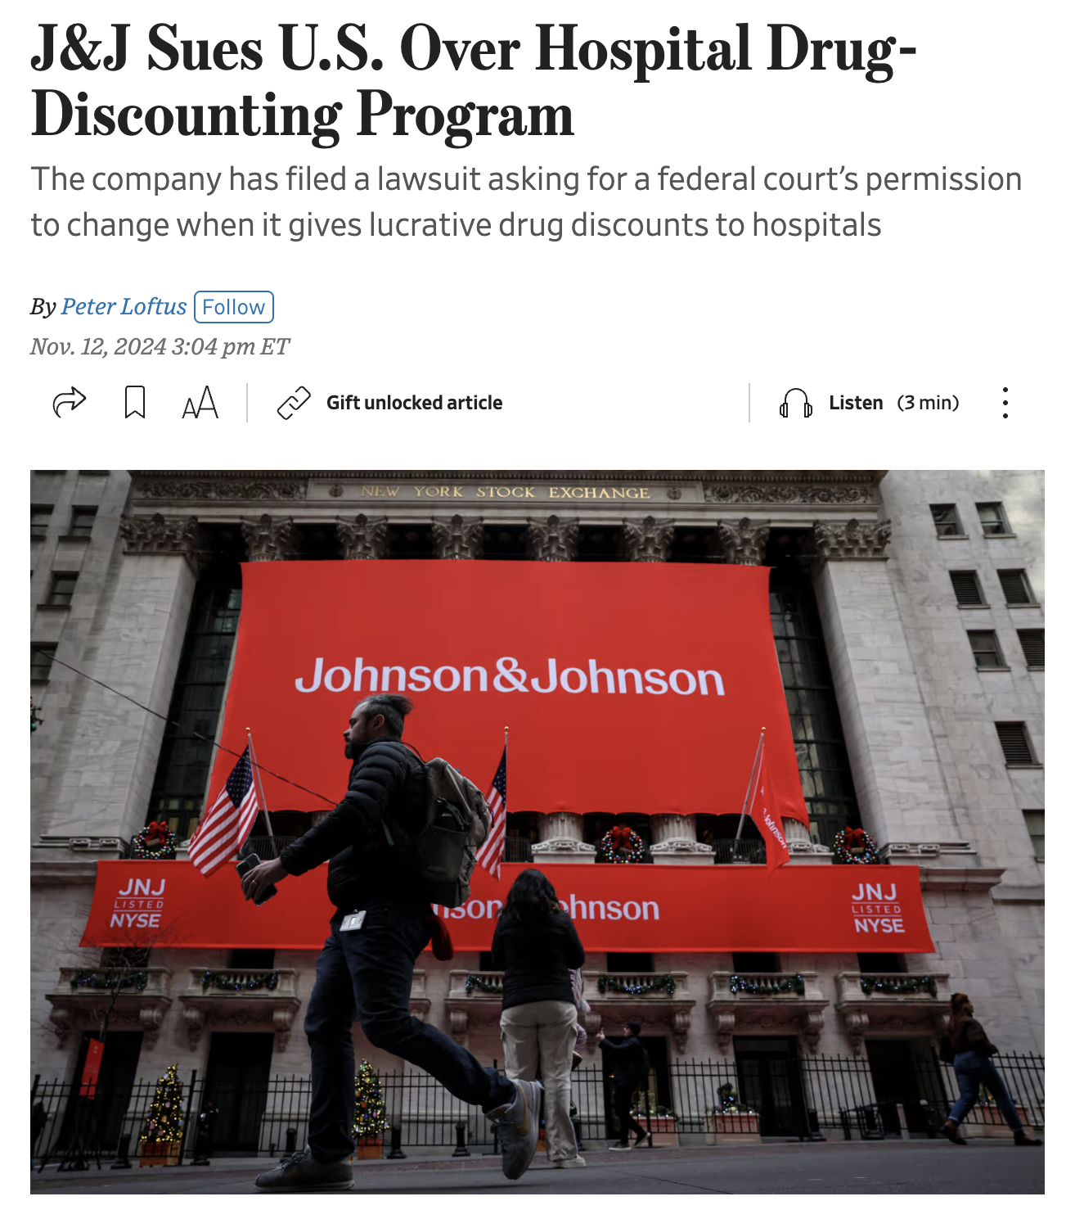
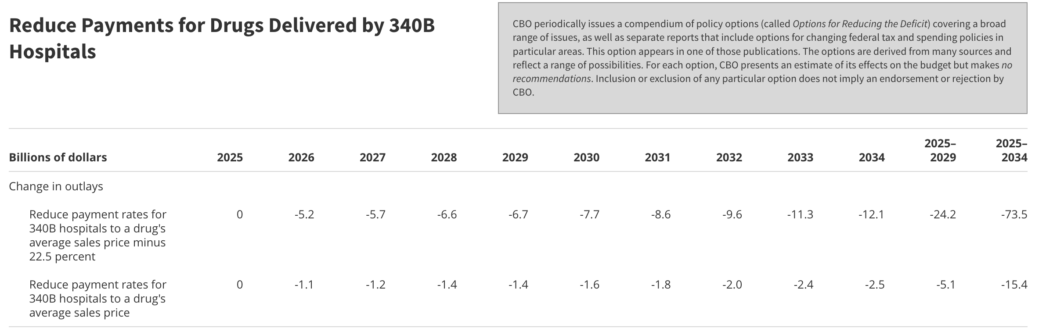
Latest on 340B
Pharma wants to use 340B rebates, rather than blanket discounts, to better track 340B
Lots of money in regulating 340B
  Trump HHS/CMS may once again try to lower 340B reimbursement
Expect pharma to keep pushing on contract pharmacy restrictions and rebates (versus discounts)
CBO scores 340B savings as $74 billion!

Slide 18
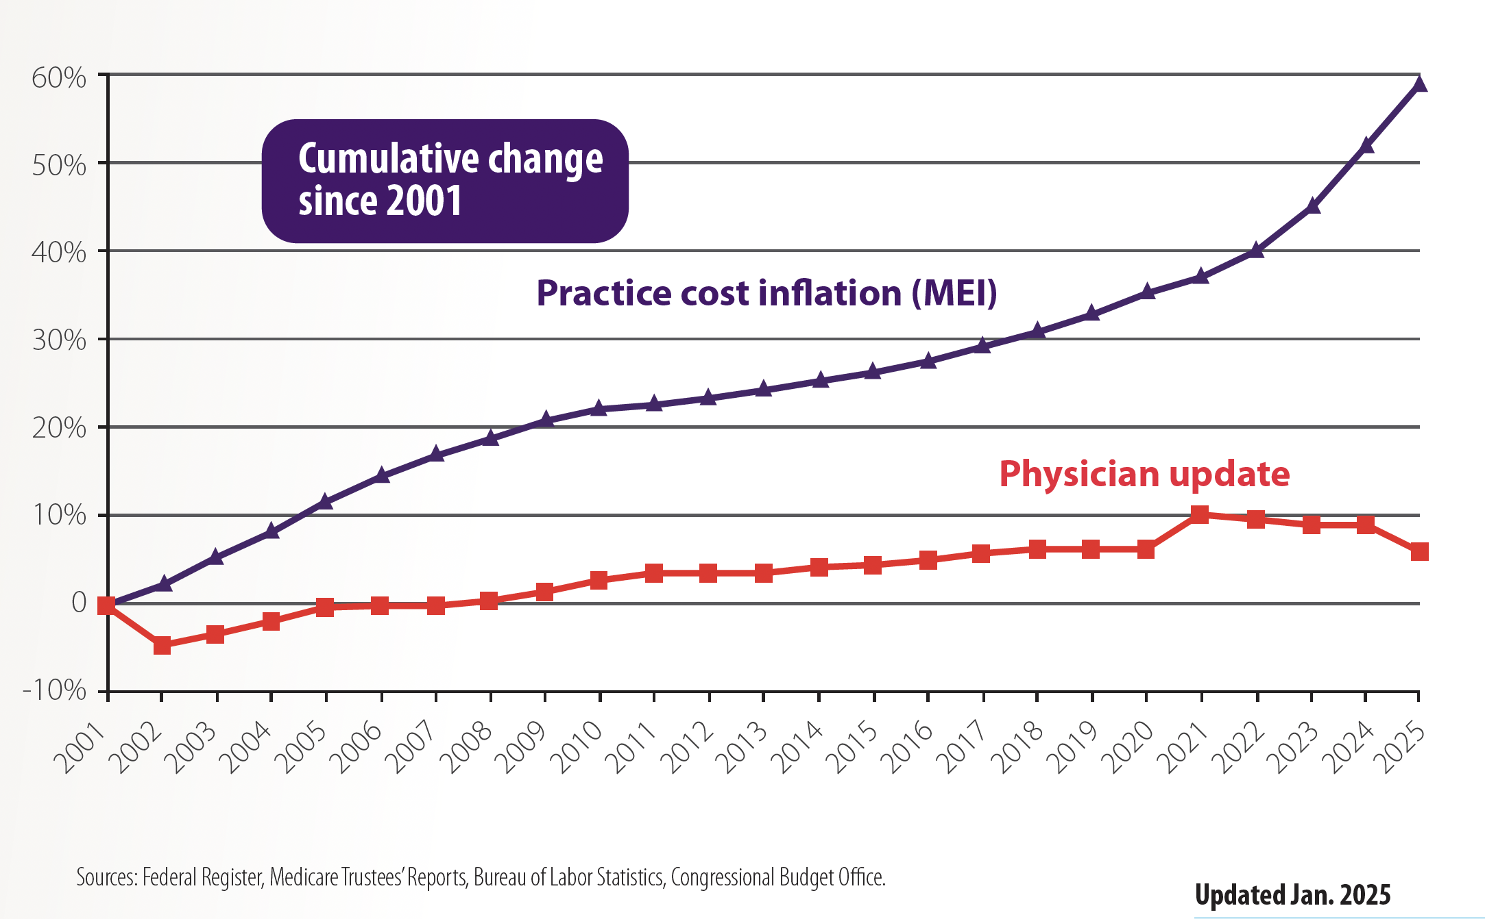
Physician Pay Cuts Worsening
Physician reimbursement has declined 33% (adjusted for inflation) from 2001 to 2025

Slide 19
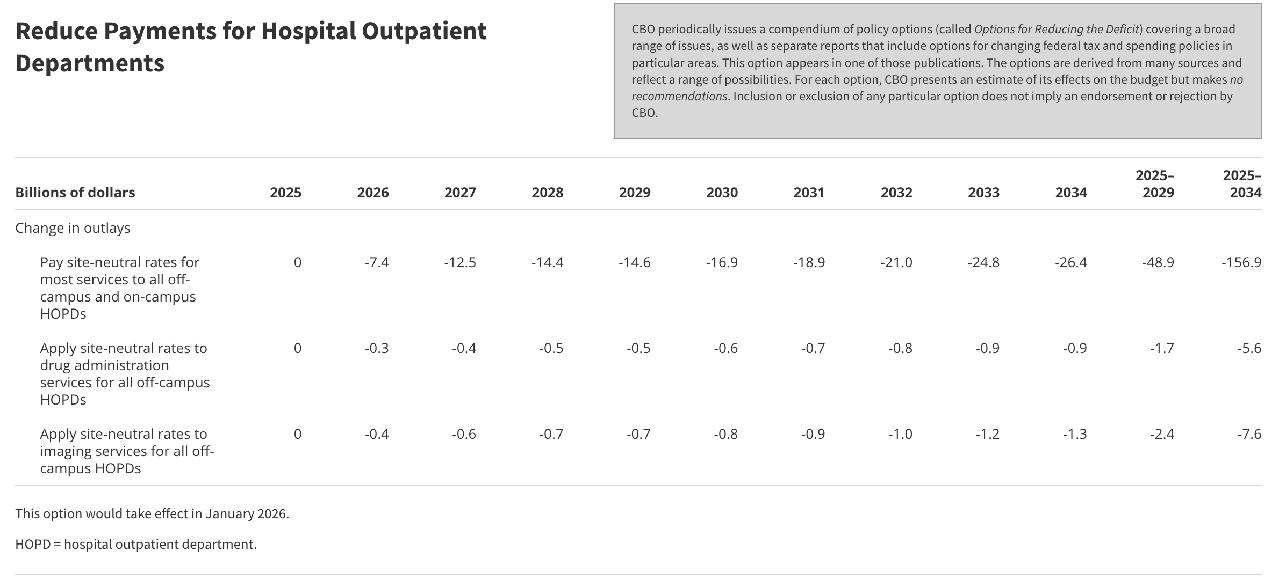
Fixing Pay Cuts With Site Neutrality?

Slide 20
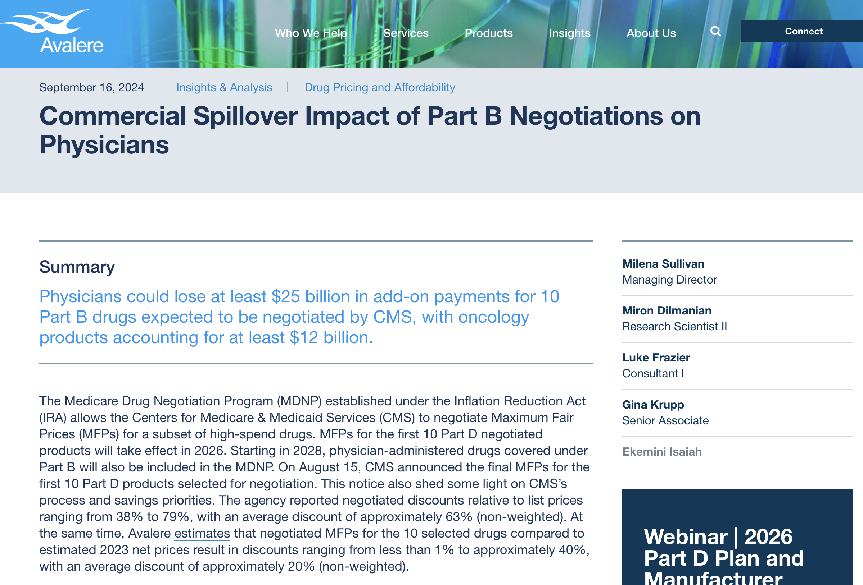
Problems with IRA Drug Price “Negotiations”
Unclear how Part D IRA “negotiated” prices will play out in rebates to pharmacy providers
  Concerns that pharmacy providers will have to float the discounts until rebated
  Pharmacy pushing back
Part B maximum fair price (MFP) will artificially lower average sales price (ASP) and cause reimbursement headaches
Will likely curb investments in additional cancer drug indications, especially pediatric indications
Unclear if less research of small molecules

Slide 21
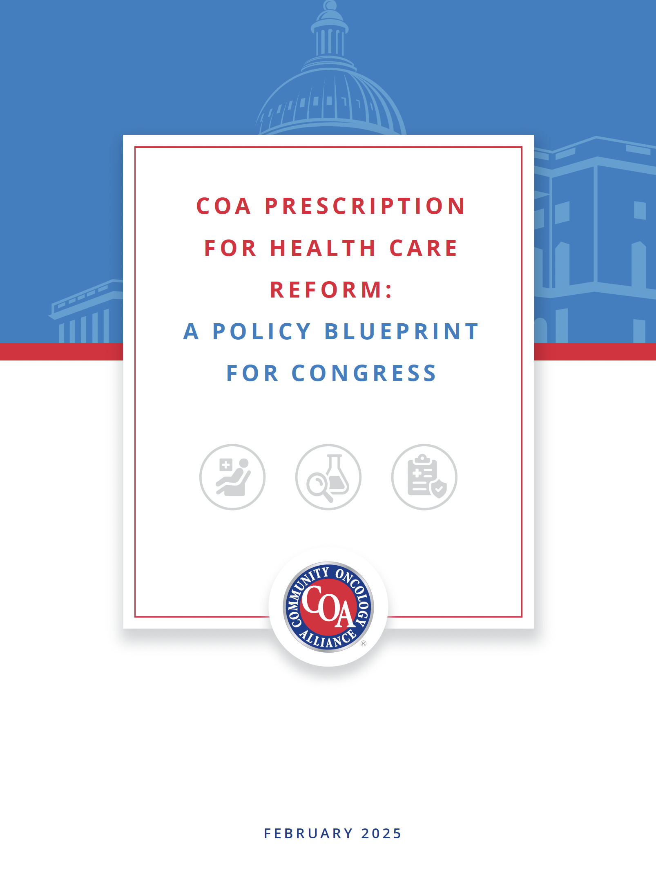
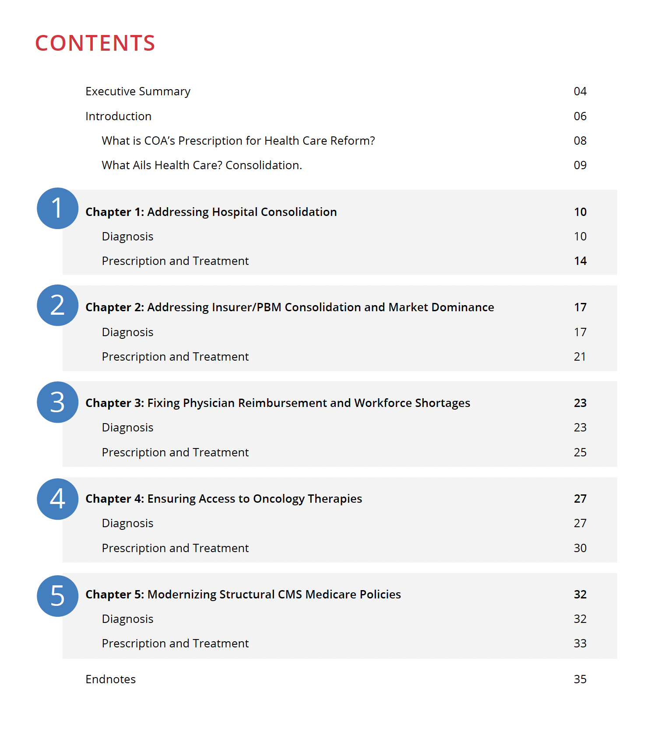
The COA Prescription on Health Care Reform
What is it broadly?
  A five-point plan for the 119th Congress and beyond to address the growing, and threatening, problems with the country’s health care system
  From the perspective of oncology but relevant to all other areas of medical care
  Fixing health care goes beyond the scope of Congress, but the federal government has the leverage and clout
Why?
  There are a ton of issues that are impacting oncology, and all medical care, that are now linked
    e.g., 340B and PBMs
  There needs to be a broader, but specific on details, blueprint
  Bottom line: It’s getting to be now or never!

Slide 22
A Tipping Point for the Nation’s Health Care System
We’re In A Consolidation Crisis
  Hospitals have mutated into mega health systems driving up costs with enhancement of patient well-being and outcomes
  Insurers have consolidated; PBMs have consolidated; and insurers and PBMs have consolidated
    In the process, owning all types of pharmacies and even physicians
Congress has done very little to date, and CMS has poured fuel on the consolidation fires
  Despite clear evidence and rising concerns of a worsening crisis, Congress has failed to act so far
  One would believe that CMS wants consolidation
    Non-policing of Medicare Part D expanding the pharmacy deserts across the country
    Medicare reimbursement cuts to independent physicians; increases to hospitals, especially 340B
Independent medical practices are under pressure from consolidation like never before
  Creates a circular feeding of mega health systems
Patients Suffer
  Rising costs, care delays, and worsening health outcomes
  Access issues as pharmacy and now medical deserts expand across the country

Slide 23
The COA Prescription for Health Care Reform
A comprehensive blueprint “diagnosing” the fundamental challenges facing our health care system, outlines the consequences, and presents actionable “prescriptions” for “treatments”
Targeted “Treatments” for Congress
  Immediate Action for the 119th Congress
    Practical, actionable solutions Congress can implement today to address urgent health care challenges
  Ongoing recommendations for the 120th Congress and beyond: Next steps to stabilize and modernize the U.S. health care system
Structured for Action
  Each section of the 38-page document includes data/evidence
    Diagnosis: Identifies the root causes of systemic issues impacting health care delivery and patient outcomes.
    Prescription & Treatment: Outlines detailed legislative solutions tailored to address the challenges imperiling health care
Built Off Existing Legislation and Ideas
  Every policy recommendation is built off existing policy proposals from past sessions of Congress, advisory committees, and think tanks
  Most have legislative language already drafted and ”ready to go”

Slide 24
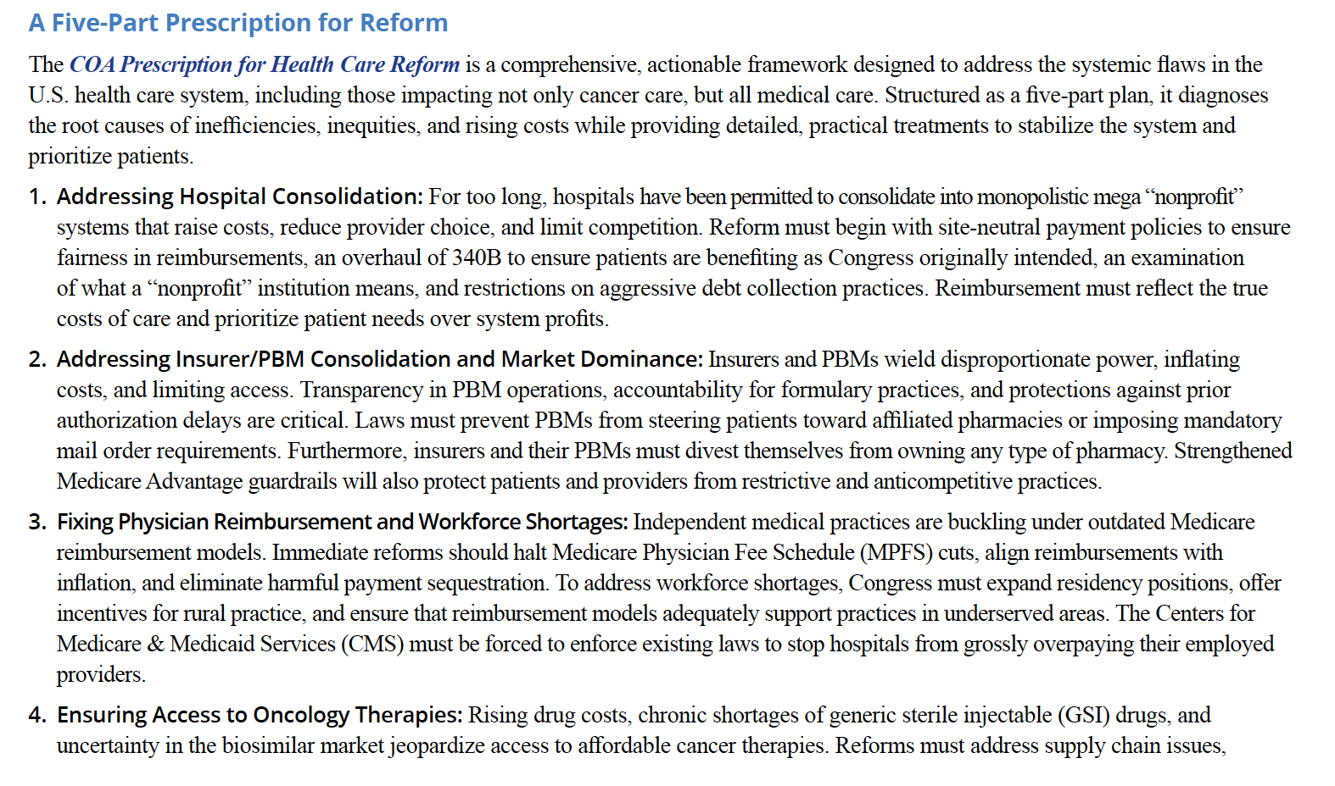
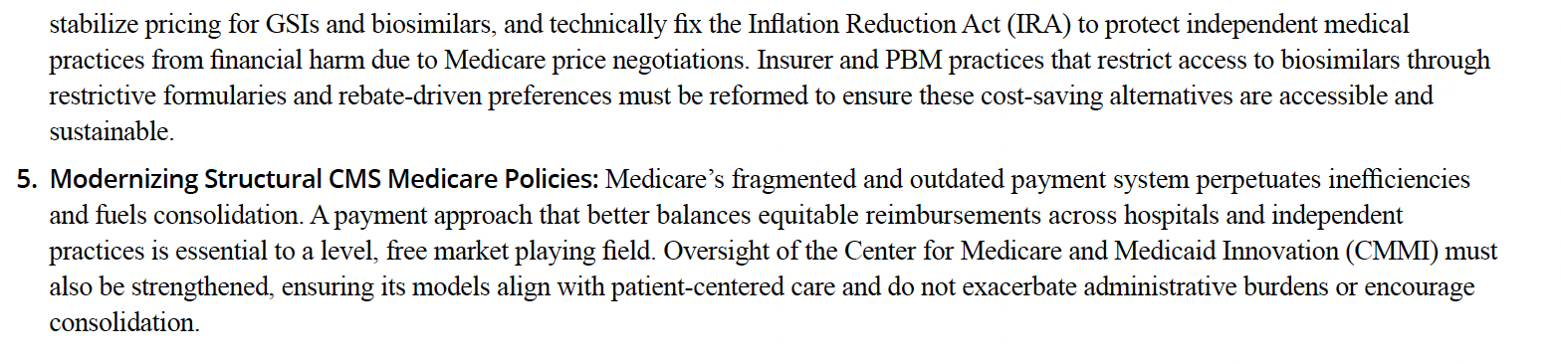
5-Part “Prescription” for Systematic Reform
Addressing Hospital Consolidation
Addressing Insurance/PBM Consolidation and Market Dominance
Fixing Physician Reimbursement and Workforce Shortages
Ensuring Access to Oncology Therapies
Modernizing Structural CMS Medicare Policies

Slide 25
Addressing Hospital Consolidation: Diagnosis
Trend
  Hospital consolidation has surged over the last 30 years
  Mega health systems prioritize “profits” over clinical objectives and patient wellbeing
  Growing differential between hospital payments and those to independent physicians
Patient Impact
  Increased costs
    Higher insurance and out-of-pocket costs
  Restrictive access to providers and clinic locations
    Medical care deserts in rural and underserved areas
  Focused shifted from personalized, community-based care to one-size-fits-all depersonalized model
  Failure to enhance the quality of care

Slide 26
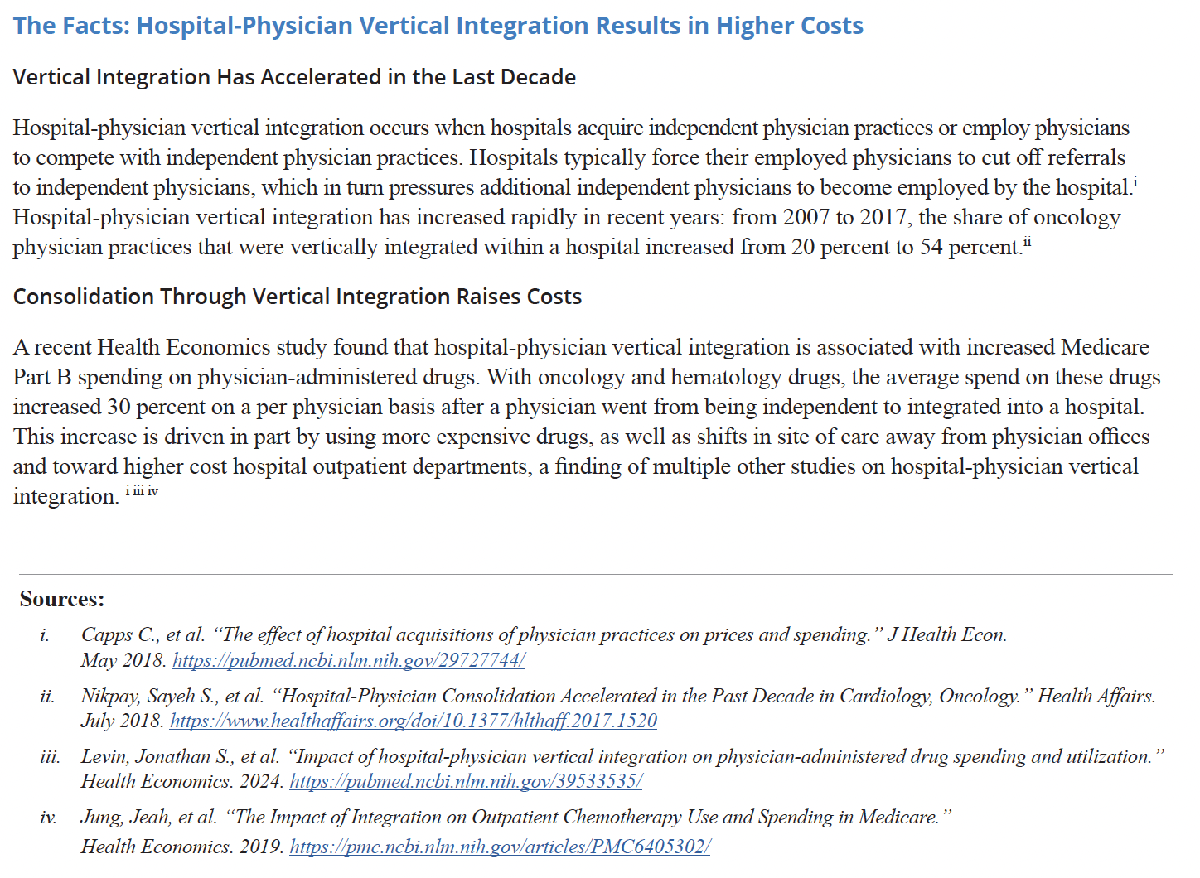
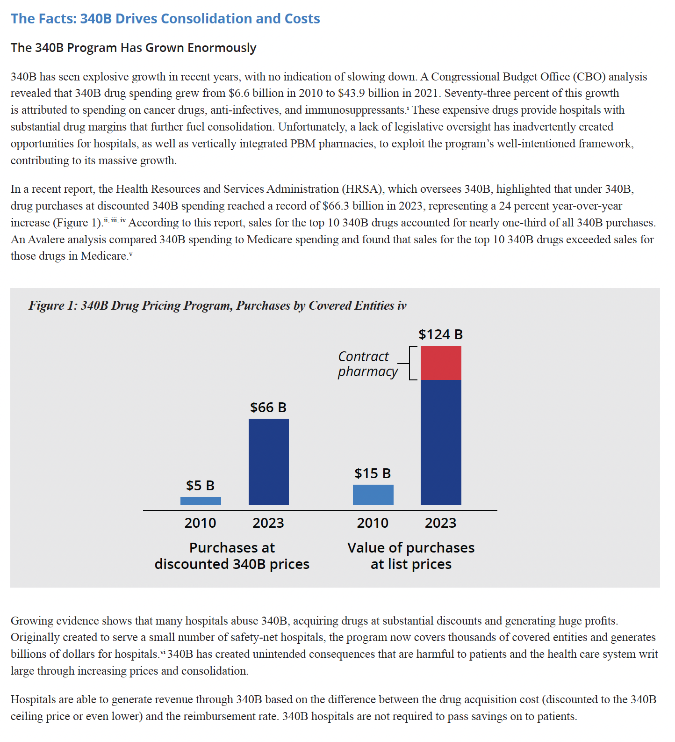
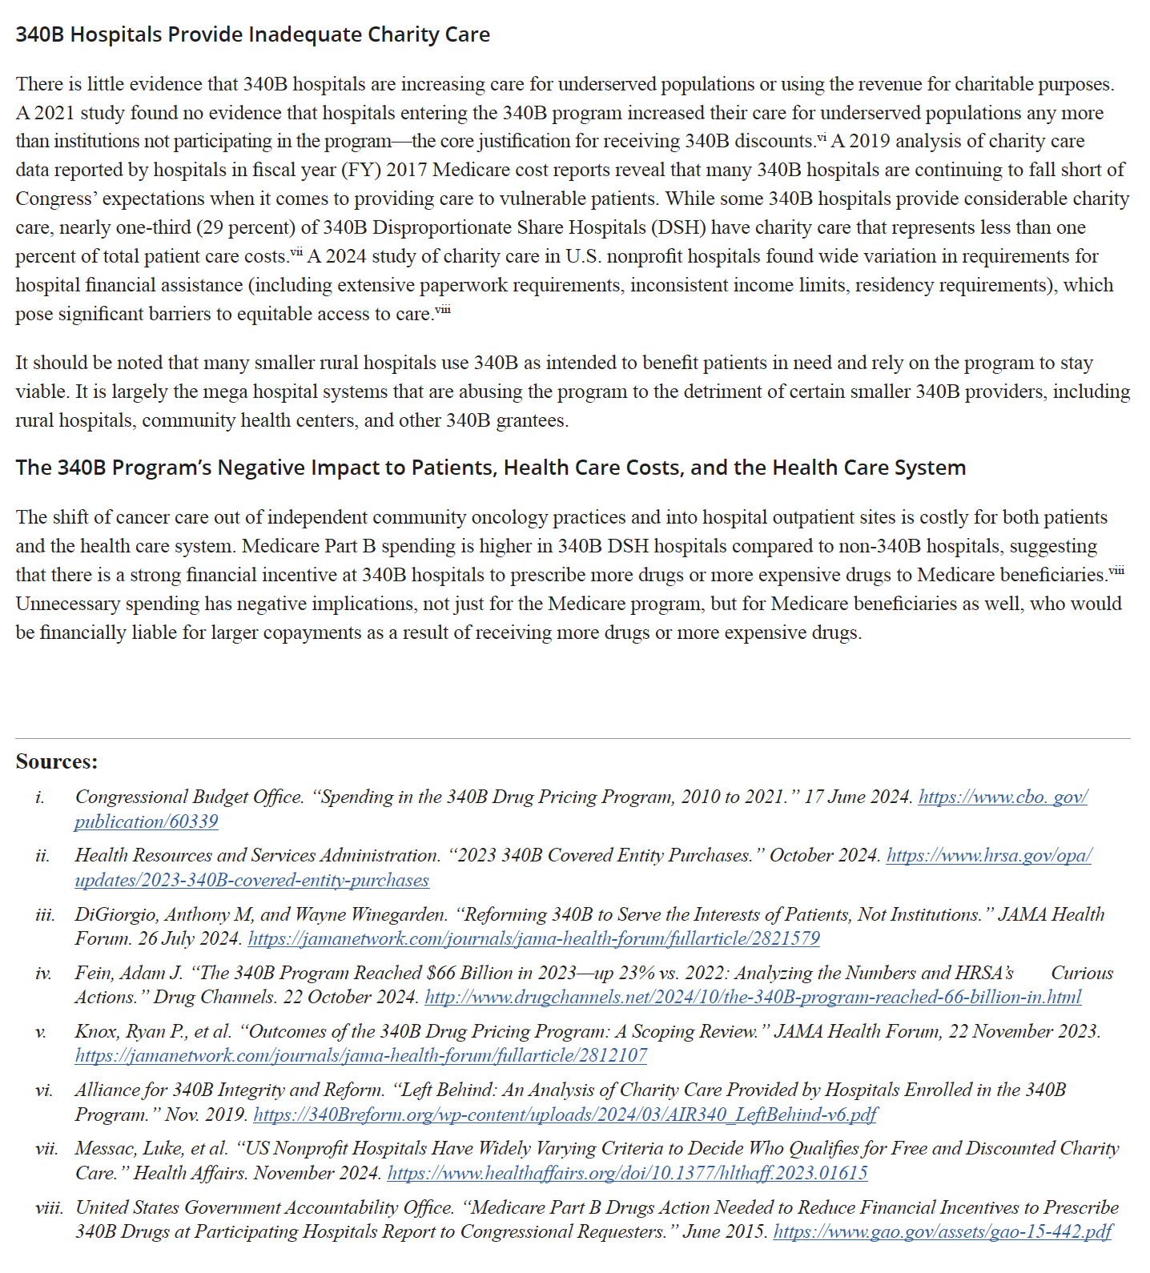
Addressing Hospital Consolidation: Facts
Vertical integration has accelerated in the last decade
Consolidation through vertical integration raises costs
The 340B Program has grown enormously
340B hospitals provide inadequate charity care

Slide 27
Addressing Hospital Consolidation: Treatment
119th Congress
  Implement Site-Neutral Payment Policies
  Implement Site-Neutral Payment Policies
  Strengthen 340B Participation Requirements
  Require Transparency and Reporting in 340B
  Reimburse 340B Hospitals Based on Surveyed Acquisition Cost Prices
  Restrict Aggressive Debt Collection Practices by 340B Hospitals
120th Congress and Beyond
  Curb Unrestrained 340B Growth
  Restrict Anticompetitive or Punitive Hospital Actions Against Independent Providers
  Support Rural Providers
  Expand Site-Neutral Payment Policies

Slide 28
Addressing Insurer/PBM Consolidation and Market Dominance: Diagnosis
Trend
  Top PBMs control 80% of the prescription drug market
  Drugs top PBMs ”promote” are ones most profitable to them
  Fueling an arms race between mega health systems and insurers/PBMs
  Corporate practice of medicine increasing
Patient Impact
  Profits prioritized over clinical decisions and patient wellbeing
  Patients paying more out-of-pocket
  Utilization management like “fail first” step therapy are increasingly leading to more delays and denials
  Pharmacy access problems, especially in rural areas, as pharmacy deserts broaden

Slide 29
Addressing Insurer/PBM Consolidation and Market Dominance: Facts
Formulary Exclusions Are Increasingly Common in Oncology
The Burden of Prior Authorization Impacts People with Cancer, Caregivers, Doctors, and Staff, and Can Lead to Delayed or Denied Treatment
Lower Reimbursement and Exclusions from Insurance Networks Threatens Independent Pharmacies and Fuels Consolidation

Slide 30
Addressing Insurer/PBM Consolidation and Market Dominance: Treatment
119th Congress
  Require PBM Transparency
  Prohibit Insurers/PBMs from Owning Pharmacies
  Mandate PBM Rebate Reform
  Prohibit Insurers/PBMs From Owning Physician Practices
  Address Prior Authorization Challenges
  Mandate Formulary Transparency and Accountability•
  Create Patient-Oriented Solutions
  Curb Insurance/PBM Consolidation
  Implement Medicare Guardrails
120th Congress and Beyond
  Create Federal Policies That Make Physicians, not Administrators, the Decision Makers•
  Amend ERISA to Require PBM’s to Follow ERISA Fiduciary Duties

Slide 31
Fixing Physician Reimbursement and Workforce Shortages: Diagnosis
Trend
  Inflation, reimbursement payment cuts, and increasing bureaucratic barriers are accelerating physician burnout
  Physicians being driven out of independent practices
  With Medicare reimbursement cuts on top of the sequester payments lag inflation by 28% over the last decade
  Unsustainable environment for independent physicians
Patient Impact
  Patients forced into hospitals and large health systems facing much higher costs
  Fewer physicians leading to longer wait times and delays in treatment
  Rural areas disproportionately impacted with travel burdens
  Medical deserts popping up

Slide 32
Fixing Physician Reimbursement and Workforce Shortages: Facts
Physician Reimbursement Has Not Kept Pace With Inflation
Chemotherapy Reimbursement Diverges Over Time Based on Setting of Care

Slide 33
Fixing Physician Reimbursement and Workforce Shortages: Treatment
119th Congress
  Fix Physician Reimbursement
  Address Workforce Shortages
  Increase Rural Reimbursement Rates
120th Congress and Beyond
  Address Workforce Shortages

Slide 34
Ensuring Access to Oncology Therapies: Diagnosis
Trend
  Oncology drug market under immense pressures
    Rising drug costs
    Chronic shortages of generic sterile injectables
    Increasing influence of insurers/PBMS
  Market distortions, such as 340B and growing mandatory rebates/discounts, contribute to:
    Higher launch prices
    Increased drug shortages
    Threaten biosimilar market
  Reimbursement is simply unrealistic and pressures the entire system
  IRA exacerbates the challenges by putting providers in the middle of industry and government price negotiations
  IRA threatens availability of new pediatric cancer drugs

Slide 35
Ensuring Access to Oncology Therapies: Diagnosis (continued)
Patient Impact
  Delayed treatments and higher out-of-pocket costs
  Shortages of potentially life-saving generics
    Higher cost alternatives
  Access issues as pressures mount on independent practices due to the IRA
    May have problems accessing drugs that have been “negotiated” by the government

Slide 36
Ensuring Access to Oncology Therapies: Facts
IRA Medicare Drug Negotiation Will Slash Oncology Reimbursement
IRA Implications on Treatments for Pediatric and Rare Cancers
  Under the IRA, small-molecule drugs are subject to government price negotiations nine years after their Food and Drug Administration (FDA) approval date. In contrast, biologics have a 13-year window
  The IRA exempts certain orphan drugs used to treat only one rare disease or condition for which the only approved indication (or indications) is for such disease or condition

Slide 37
Ensuring Access to Oncology Therapies: Treatment
119th Congress
  Address GSI Drug Shortages
  Stabilize the Biosimilar Market
  Fix IRA’s Unintended Consequences
120th Congress and Beyond
  Incentivize Domestic Drug Supply
  Address GSI Drug Shortages
  Establish Payment Parity for Radiopharmaceuticals
  Ensure Clinical Trial Diversity

Slide 38
Modernizing Structural CMS Medicare Policies: Diagnosis
Trend
  Medicare’s structure woefully outdated
    Has not adapted to the evolving health care landscape
    Lagging behind shifts in care delivery
    Fueling hospital consolidation
  Medicare costs have increased both for Medicare and its beneficiaries
  The siloed nature of Medicare hinders holistic global payment initiatives
  The Innovation Center (CMMI) needs significant restructuring
  CMS refuses to “police” Medicare Part D
    PBMs can do whatever they want!

Slide 39
Modernizing Structural CMS Medicare Policies: Diagnosis (continued)
Patient Impact
  Reduced access to medical care and increased costs
  Patients forced into more expensive hospitals
    Increased costs
    Affects the quality and timeliness of care
      Poorer outcomes
      Exacerbates health disparities
  Of particular note, CMS blocking patients from having their drugs delivered puts a real strain and threatens outcomes for patients too sick to travel or without reliable transportation

Slide 40
Modernizing Structural CMS Medicare Policies: Treatment
119th Congress
  Protect Physician Practices’ Ability to Deliver Oral Drugs to Patients
  Improve CMS Oversight of Medicare Part D
  Fix Physician Payment
  Fix Unintended Consequences of the IRA
  Critically Evaluate CMMI
120th Congress and Beyond
  Completely Restructure Medicare

Slide 41
The Time to Act is Now!
The nation’s health care system is at an extreme tipping point
Delays in reform will further entrench systemic inefficiencies and inequities
The COA Prescription for Health Care Reform provides a roadmap to protect patients, support independent practices, and restore competition, leading to enhanced outcomes and lower costs
Message to Congress:
It is time to enact bold, meaningful health care reforms
to stabilize the system and prioritize patient-centered care
delivered by the highest quality,
most affordable providers close to home

Slide 42
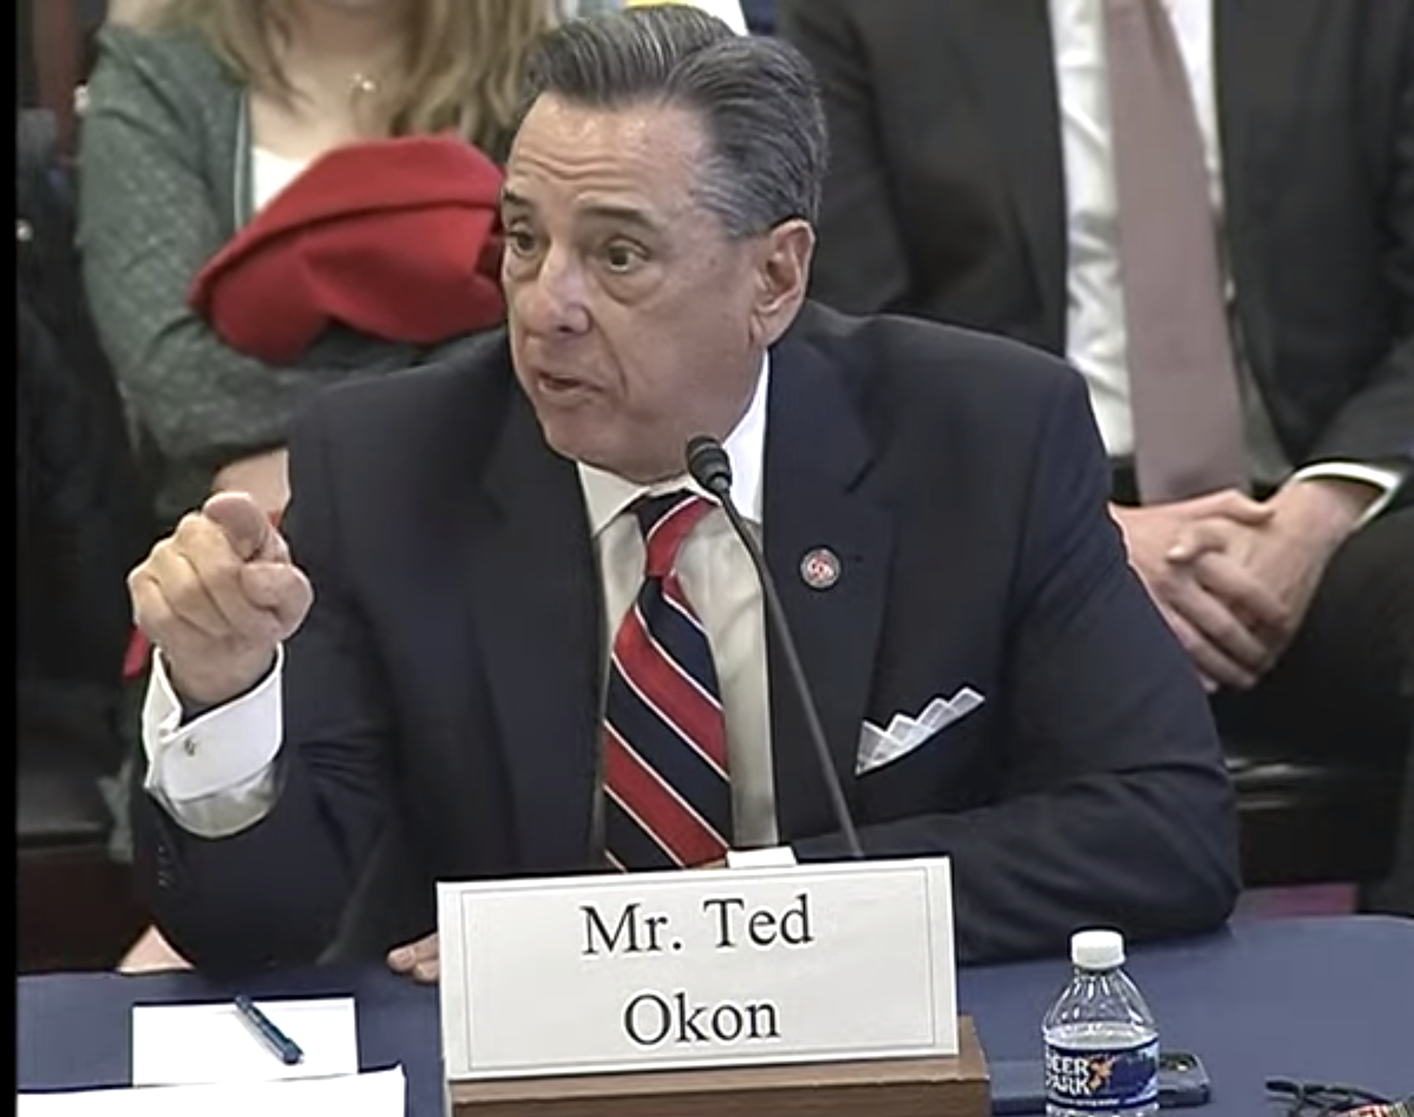
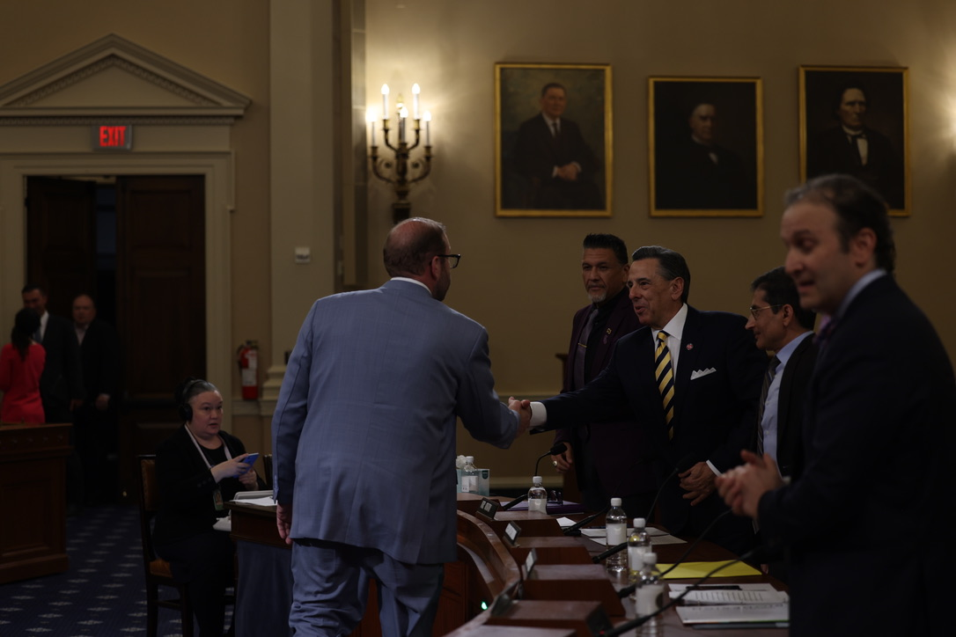


Questions?
Ted Okon
Email: tokon@COAcancer.org
Web: www.CommunityOncology.org
Twitter: @TedOkonCOA

