Slide 1

Insurance Advocacy in New Jersey
Oncology: Provider Rights and Effective Practices
Presented by: Michelle Weiss, CHONC
Weiss Oncology Consulting
May 2, 2024

Slide 2

Disclaimer
The information in this presentation is not intended to provide reimbursement, legal or financial advice; it is for informational purposes only. Participants will need to do their own research and make their own decisions when seeking reimbursement.
Regulations and policies concerning payer reimbursement are a rapidly changing area of the law. While we have made every effort to be current as of the issue date, the information may not be current or comprehensive when you review it or may contain inaccuracies or typographical errors.
Please watch for announcements from CMS and private payers directly and be sure to consult with your legal counsel for any specific reimbursement information and advice.

Slide 3

CPT® is a Trademark of the American Medical Association
Current Procedural Terminology (CPT) is
copyright American Medical Association
All Rights Reserved
No fee schedules, basic units, relative values, or related listings are included in CPT
The AMA assumes no liability for the data contained herein
Attendees can purchase AMA CPT or CPT Assistant by
calling 800-621-8335 or online at
www.ama-assn.org/cpt/online

Slide 4
Know Your Payers
Staying on top of changes is more difficult than ever
Form a relationship!
Approximately 4 – 5 payers makes up 80% of your business…..
Can you name your top five?
Do you know the Leadership team…
President, VP, CFO
Medical Director & Pharmacy Director
Manager of Claims
Provider Outreach
Recognize people at the end of the phone line
Request to meet regularly (no less than monthly) and review all outstanding claims and claim issues

Slide 5

Wrongful Denials –
Steps to Resolve
First and foremost
  Make sure you are 100% right and have proof/REFERENCES
Administration Coding Accuracy…
    DOCUMENTATION & Watch outs:
      Everything billed must have an ORDER!
      Nurses services MUST match doctor’s orders
      Bill one initial code per day
      15 minutes or less = push
      >30 minutes to bill for add’l hour (medically necessary)
      Concurrent therapeutic coding (96368) should be obvious in medical record
      Fluid used to administer drug should not be billed (supply)
      Bill hydration when electrolytes are given for hydration
        Bill therapeutic infusion when electrolytes are used to prevent or treat a condition
      SIGNATURES! “(CMS) …requires that any Medicare service provided or ordered must be authenticated by the author”

Slide 6
Wrongful Denials
  New Codes/New Indications
    Expect an initial denial!
      Upload the information with the claim!
        Review the PWK Process with CMS!
        Link to Novitas UPDATED instructions:
          https://www.novitas-solutions.com/webcenter/portal/MedicareJL/pagebyid?contentId=00004552
    Other Common Denials
      Medically Unlikely Edits for Drugs
        Weight based doses on a heavy patient will fall outside of the MUE allowed for the drug
          KEEP YOUR 1st level appeal SIMPLE and to the point!
          CMS MUST PAY THIS CLAIM!
            Sadly – you will have to appeal each treatment
MUE Table Download:
https://www.cms.gov/medicare/coding-billing/national-correct-coding-initiative-ncci-edits/medicare-ncci-medically-unlikely-edits

Slide 7
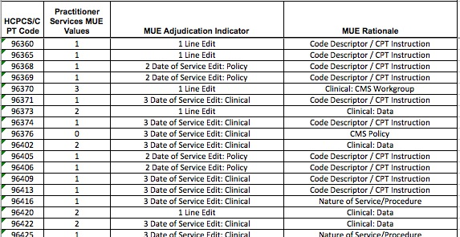
MUE Example – Admin Codes
Example of 1 initial code per day!

Slide 8
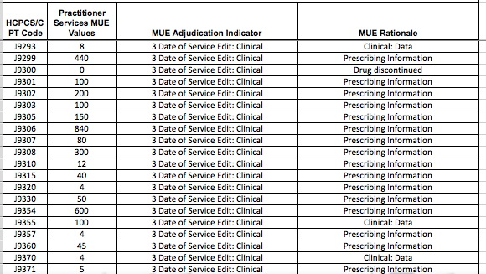
MUE Example – Drugs

Slide 9

Wrongful Denials
Prior Authorization Denials
  Obtained - but they say it isn’t
  Obtained - but now they deny for medical necessity
  Not obtained - because you were told you don’t need one
  Not obtained - because you were only allowed 3 service dates and you forgot to reach back on the 4^{tth,} 5th, 6th treatment
  FIGHT!
    Use your State Laws
      We review that in a few minutes!!

Slide 10
Know Your Payers
Track Issues by Payer
    Both problems and what works well!
    Track Contacts!
      What value based projects are you doing that may help negotiate a better contract?
        Can you get exceptions on Prior Auths?
          FREQUENTLY – done under contract negotiations!
    Review website & alerts monthly
      SIGN UP FOR ALERTS!!
If they are in YOUR top 5, your not to small to request additional attention!

Slide 11

Addressing Payer Issues
Don’t let them get away with it!!
Don’t just rebill – rebill – rebill
Don’t keep asking on the phone to fix your issue
Hold them accountable, like they do you!

Slide 12

How To Push Up…
Where you go for resolution depends on who they are!
  Federal Programs including Medicare, Medicare Advantage, Medicaid & Managed Medicaid
        Go through Government Process
          We will review this in detail
          **of note: Medicaid is also managed by individual States
  Commercial Insurance (including marketplace plans)
    Go through the State Department of insurance
      Or say you are going to!!!
  Employer Groups – ERISA
    Go through the Department of Labor or Employee Human Resources Department
    **Often look like commercial plans

Slide 13

Know the Laws and
Use Them!

Slide 14

CMS Policy Hierarchy
    Medicare – Laws, Manual, National Coverage Determination (NCD), Local Coverage Determination (LCD), National Correct Coding Initiative Edits (NCCI)
Final Rules
Interpre-tation
Develop Regula- tions
Publish In CMS Manuals
MAC Interpretation and further policy explanation

Slide 15

Fight the Fight RIGHT
CMS Appeals
  There are five levels in the Medicare Part A and Part B appeals process. The levels are:
    First Level of Appeal: Redetermination by a Medicare carrier, fiscal intermediary (FI), or Medicare Administrative Contractor (MAC).
    Second Level of Appeal: Reconsideration by a Qualified Independent Contractor (QIC)
    Third Level of Appeal: Hearing by an Administrative Law Judge (ALJ) in the Office of Medicare Hearings and Appeals
    Fourth Level of Appeal: Review by the Medicare Appeals Council
    Fifth Level of Appeal: Judicial Review in Federal District Court

Slide 16
Medicare Advantage REMINDER
  Managed Medicare –
    Beneficiary MUST have at least the same benefit as traditional Medicare
      Advantage plan….
        Can have requirements such as pre-authorizations
        Can reimburse differently than traditional Medicare
        Step-edit regulations for biosimilars are a bit more relaxed but regulations still exist!
          Can’t switch a patient’s existing therapy!
Reference: https://www.cms.gov/newsroom/fact-sheets/medicare-advantage-prior-authorization-and-step-therapy-part-b-drugs

Slide 17
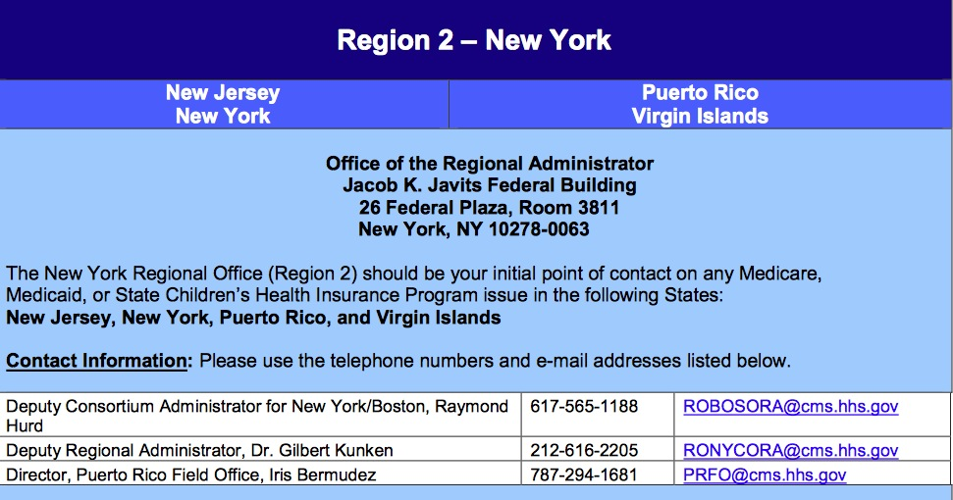

Fight the Fight RIGHT
Federal Program Coverage Violations
  CMS Regional Office
https://edit.cms.gov/About-CMS/Agency-Information/RegionalOffices/Downloads/NewYorkRegionalOffice.pdf

Slide 18
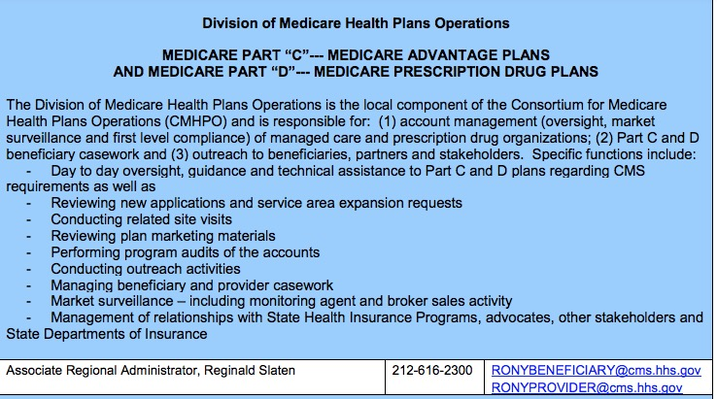
Fight the Fight RIGHT

Slide 19
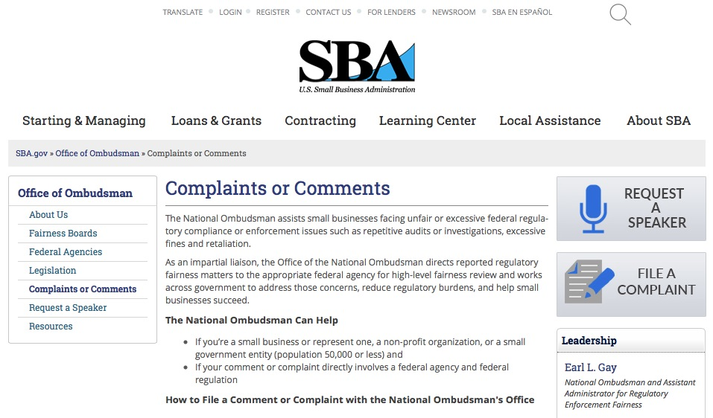
Fight the Fight RIGHT
Federal Program Coverage Violations
Report to Office of the National Ombudsman, Small Business Administration
ONLINE & EASY
Excellent results!
https://www.sba.gov/ombudsman/comments

Slide 20

SBA Ombudsman
Submit Form
  You will immediately receive receipt
  Within about 2 weeks you will receive acknowledgement w/case number assigned
  IF you stated you had additional information to submit, you will receive an email allowing you to submit additional information
  You will email any supportive information to substantiate your complaint/comment
  They will contact the payer and work out the issue
  Usually within about 30 – 45 days from time of additional data submission, you will receive a final determination by email and by snail mail
I have had 100% success rate with Medicare Advantage Plans
Medicaid plans continue to be a challenge because of State budgets – but some success
I recommend sending a copy of your complaint to the payer
  BEFORE – ”If we do not hear back by xx date (1 week) – we are filing a formal complaint.
  They will often correct the problem as soon as they are aware they have been reported!

Slide 21

Know Your State Laws
Hold Private Payers Accountable
  They an determine what they will and won’t pay for based on their own policies
    But some things are regulated by the state policy and overrides
    Watch policies closely & If you don’t know… ASK!
      And document the response!
State Laws can help……
  But do not work on ERISA (self employed) plans

Slide 22
New Jersey Prompt Pay
Law
Clean Claim
30 days
10% Interest!
  FIRST - DEFINE A CLEAN CLAIM
    CLEAN CLAIM is a claim that….
      Identifies the provider
      Identifies the patient or health plan subscriber
      Is for an eligible person
      Substantiates the medical necessity or the service
      Identifies the service rendered using service or procedure codes
      Establishes (if necessary) that prior auth was obtained
      Shows the date and place of service and
      Includes additional documentation for services “as reasonably required by the health plan”

Slide 23
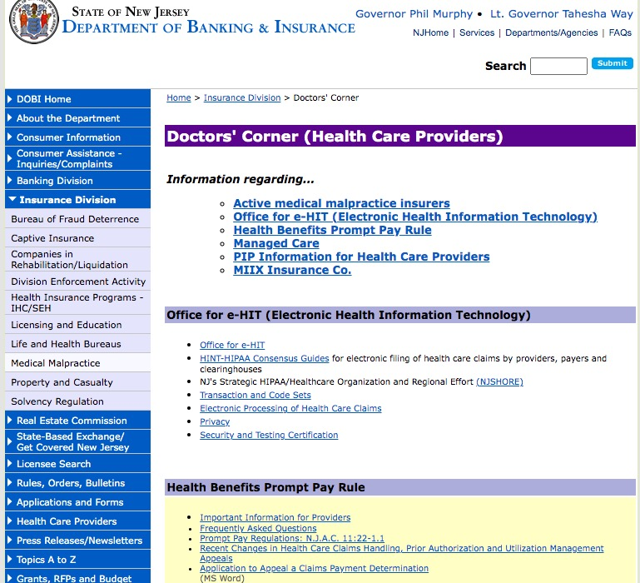
New Jersey Department of Insurance

Slide 24
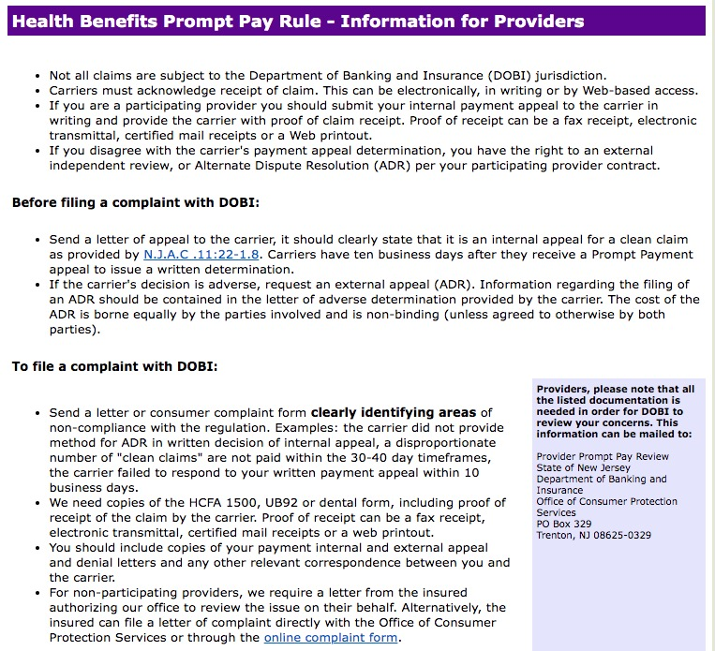

Slide 25
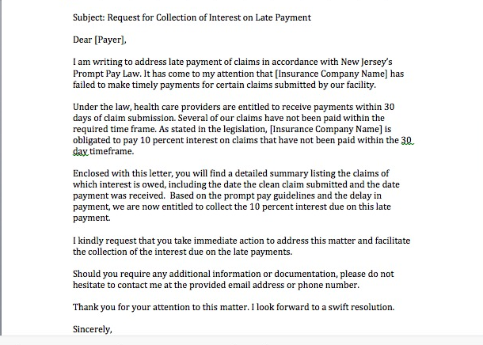
Attempt to Collect From The Payer FIRST!
Example:

Slide 26
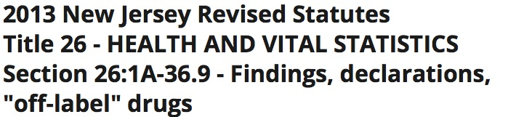
New Jersey Also Has An Off Label Law
Often used to fight for labeled indications!!
This law requires Medicaid agencies to pay for off label use of drugs for Medicaid patients!
New Jersey Revised Statutes Title 17B:27-46.1g requires group health insurance policies to provide benefits for "off-label" drugs.

Slide 27
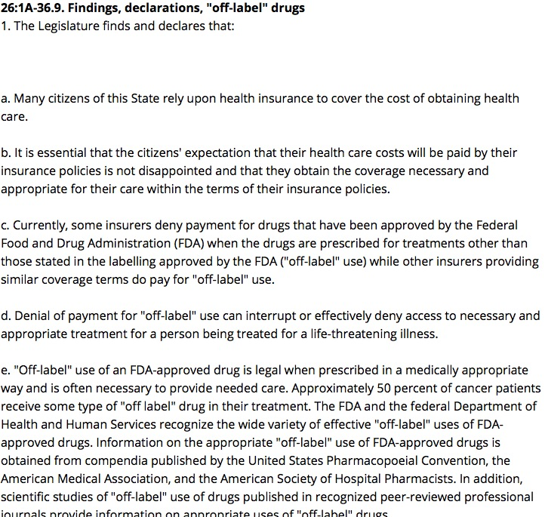

Slide 28

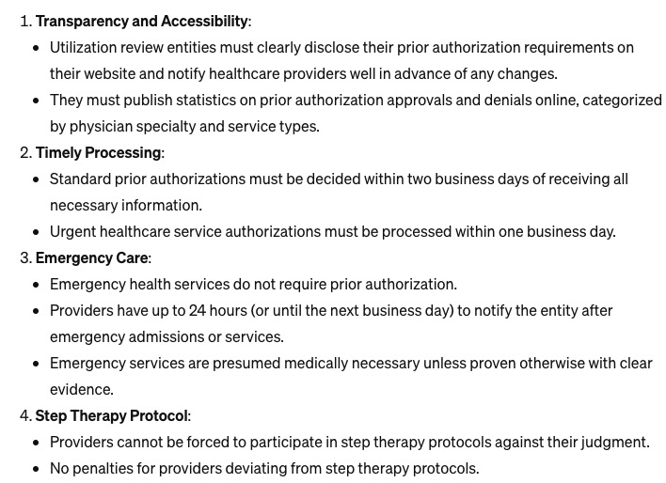
New Jersey Prior Authorization Law
Ensuring
Transparency in
Prior Authorization Act
  Passed 1/16/24
  Effective 1/1/25
Creates standards that ensure physicians who review prior authorization requests or denial appeals have a background in the treatment a physician is requesting and the condition for which the treatment would address.

Slide 29
Overpayment Recovery Law
NJ Payers CANNOT take back money if it is after 18 months!
Statute: C.178:30-48 Chapter 352
18 months
No payer shall seek reimbursement for overpayment of a claim previously paid pursuant to this section later than 18 months after the date the first payment on the claim was made.
  With the exception of claims that were submitted fraudulently or submitted by health care providers that have a pattern of inappropriate billing or claims that were subject to coordination of benefits,
Reference: https://pub.njleg.gov/bills/2004/PL05/352_.HTM

Slide 30
Conclusion
Stay Informed and Adaptive
Be proactive in monitoring changes in reimbursement regulations and policies. Adapt quickly to stay compliant and maximize reimbursement.
Documentation Best Practices
Emphasize the importance of detailed and accurate documentation to support claims and demonstrate medical necessity.
Addressing Denials Effectively
Provide guidance on steps to resolve wrongful denials, including the importance of thorough appeals and leveraging legal support.
Utilize State Resources
Encourage attendees to utilize state-specific resources like the New Jersey Department of Insurance for advocacy and support.
Network and Share Experiences
Highlight the value of networking with peers to share experiences, strategies, and successful negotiation tactics.
Continuing Education
Stress the importance of continuous education and training to navigate complex payer policies and procedures effectively.
Advocate with Confidence
Empower providers to advocate confidently for their rights and fair reimbursement, leveraging state laws and resources.

Slide 31

Questions??
Contact:
  Michelle Weiss
  Weiss Oncology Consulting
  www.weissconsulting.org
  Email: michelle@weissconsulting.org

