Slide 1



2024 PFS Fee Schedule for Oncology
Maximize. “TOP 10”
May 2, 2024
By, Michelle Weiss, CHONC
Weiss Oncology Consulting

Slide 2
Disclaimer
This presentation provides general information and is not intended to provide reimbursement or legal advice. Furthermore, it is not intended to increase or maximize payment by any payer. Because laws, regulations and coverage policies are complex and are updated frequently, you should check with your Medicare contractor and payers often. Information and/or references within this presentation may be outdated or incorrect.
Nothing in this presentation shall be construed as a guarantee by Michelle Weiss or the New Jersey Society of Oncology Managers Society regarding levels of payer policy, reimbursement, payment or charge or that reimbursement will be received. The ultimate responsibility for proper claim submission and obtaining reimbursement lies with the physician, provider, or patient.
Please consult with your legal counsel or reimbursement specialist for any specific reimbursement or billing questions.

Slide 3

2024 PFS Top Ten!!!

Slide 4

2024 PFS Top 10
Well, not great, but better !
#10 PPFS Conversion Factor

Slide 5
PFS Conversion Factor
2024 Final Rule
  Included a 3.27% reduction in the conversion factor
    CF turns Relative Value Units (RVUs) into dollars
March 9 – Consolidated Appropriations Act of 2024
  Included a +1.68% adjustment
    ONLY for services from 3/9 – 12/31/24

Slide 6


2024 PFS Top 10
#9 Split Shared Visits

Slide 7
PFS - Split Shared Visits
History
Substantive portion = Billing Provider
Update
CMS proposed TIME to determine billing provider
Current
CMS defined substantive portion
"substantive portion" is defined as one of the three key components (history, exam, or medical decision-making), or more than half of the total time spent by the physician and nonphysician practitioner (NPP) performing the split/shared visit.
more than half of the total time spent OR
Substantive part of the Medical Decision Making

Slide 8
PFS - Split Shared Visits
REMINDER
  Physician & NPP Share Visit
    Billing Provider….
      Physician = 100% PFS Payment
      NPP = 85% of PFS Payment
  NO split shared in non-facility setting
    See page 468 of PFS Final Rule
  Remember to utilize the FS modifier

Slide 9
PFS - Split Shared Visits
REMINDER
  ONE practitioner must have a face to face with the patient
    CMS STATES – it DOES NOT have to be the practitioner who performs the substantive portion of the visit
      Below is an excerpt from the Medicare online manual;
      “For all split (or shared) visits, one of the practitioners must have face-to-face (in-person) contact with the patient, but it does not necessarily have to be the physician, nor the practitioner who performs the substantive portion and bills for the visit.”

Slide 10
PFS - Split Shared Visits
EXAMPLE
  NPP
    Sees new/established patient in the hospital & performs and documents history, exam and MDM
  Physician
    From HOME discusses the patient with the NPP, reviews their documentation, performs and documents the MDM and signs the medical record
  This claim can be billed by the NPP or the Physician!!

Slide 11

2024 PFS Top 10
We have 3 vials, the last one had waste…We’re billing by HCPCS and NDC…What the heck!
#8 Modifiers

Slide 12
Modifiers
No oncology modifier changes in the PFS Final Rule
  Reminder
    JW = Waste (separate line)
    JZ = No Waste – Single Dose
      (do not count overfill or waste less than the billing unit)
    You must utilize the smallest vial available
      “JW Modifier Denials”
Link to Novitas Instructions:
https://www.novitas-solutions.com/webcenter/portal/MedicareJH/pagebyid?contentId=00142500

Slide 13
Modifiers
Unrelated Modifier Tidbit…
  Ever try to obtain a rejection from Medicare for off label use – to apply for free drug – but based on the diagnosis code Medicare will reimburse anyway?
What do you do???
USE MODIFIER GZ!
  Medicare must deny service!
    Link to modifier GZ: https://www.hhs.gov/guidance/document/auto-denial-claims-submitted-gz-modifier

Slide 14
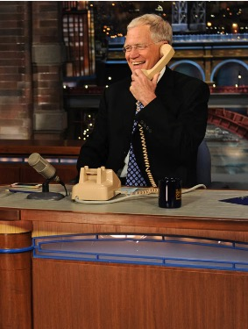
2024 PFS Top 10
Yes doctor, I’m feeling GREAT!
#7 Telehealth

Slide 15

2024 Telehealth
Expanded the scope of originating sites for services furnished via telehealth to include
  any site where the beneficiary is located at the time of the service
  including the patient’s home

Slide 16
2024 Telehealth
Place of Service: CMS requires POS to be the place where the patient is located
  POS “02”-
    Telehealth Provided Other Than in Patient’s Home (facility rate)
  POS “10”-
    Telehealth Provided in Patient’s Home (non-facility rate – ie: higher)
          No more modifier 95
          (see page 1767 PFS Final Rule)

Slide 17
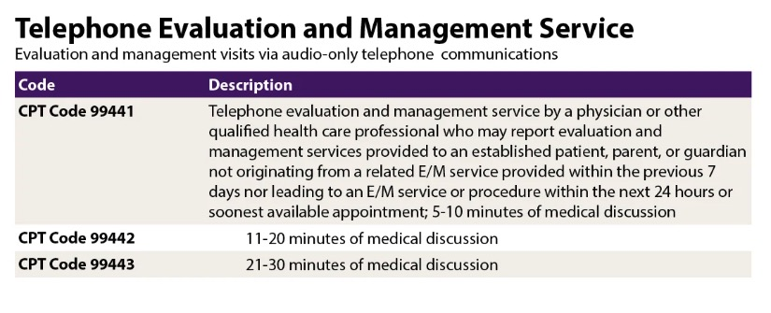
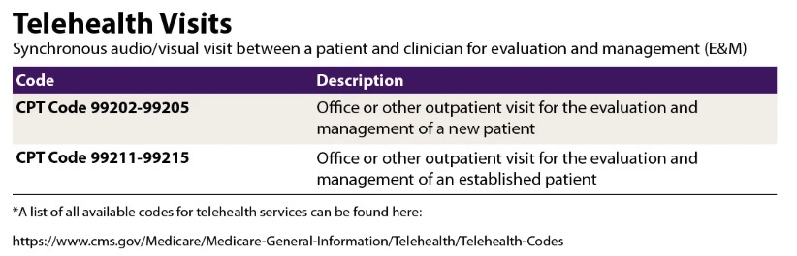
2024 Telehealth

Slide 18
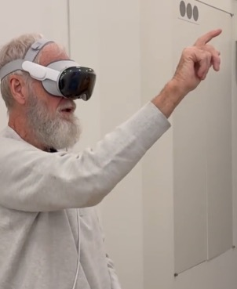
2024 PFS Top 10
#6 Remote Patient Monitoring

Slide 19
Remote Patient Monitoring
Clarification - CPT 98980 (1st 20 min) and 98981 (each add’l 20 min)
  Reimbursement approx. $47/38
  “Remote therapeutic monitoring treatment management services, physician or other qualified health care professional time in a calendar month requiring at least one interactive communication with the patient or caregiver during the calendar month”
2024 (Post COVID) – must be and established patient with a treatment plan in place
Can be utilized during a “global period” as long as you are not the global biller
Read the PFS Rule in Federal Register – beginning on page 178

Slide 20

2024 PFS Top 10
WHAT?
The doctor is on facetime when I’m at the office?
#5 Supervision

Slide 21
Supervision
Finalized a continuation of the “Revised Direct Supervision Policy”
  to permit the presence and immediate availability of the supervising practitioner through real-time audio and visual interactive telecommunications through the end of this year
So, if physician is sick at home but on face time in the clinic – it would still constitute “incident to”

Slide 22


2024 PFS Top 10
Seems like a no-brainer !!
Only document History and Physical When Needed
#4 Evaluation and Management – E/M visits

Slide 23
Evaluation and Management
PFS Final Rule – No changes for oncology however…. AMA CPT – 2024
  Once again, no changes to administration code section!!
  Defined “Substantive Portion” of Split Shared E & M
  Added additional instructions including reporting hospital inpatient or observation care and admit/discharge over 2 calendar days
  ALSO - E & M – BIG CHANGE!!
        Removed the time ranges for visits!

Slide 24
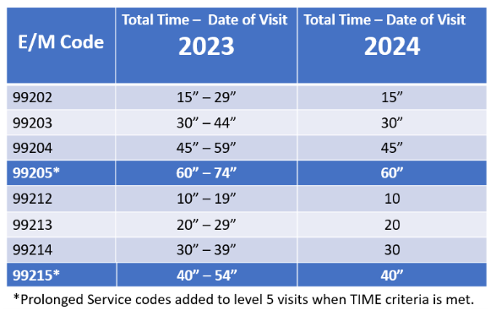
Evaluation and Management

Slide 25
Evaluation and Management
Reminder – Time Includes;
  Preparing to see the patient (e.g., review of tests).
  Obtaining and/or reviewing separately obtained history.
  Performing a medically appropriate examination and/or evaluation.
  Counseling and educating the patient/family/caregiver.
  Ordering medications, tests, or procedures.
  Referring and communicating with other health care professionals (when not separately reported).
  Documenting clinical information in the electronic or other health record.
  Independently interpreting results (not separately reported) and communicating results to the patient/family/caregiver.
  Care coordination (not separately reported).

Slide 26

2024 PFS Top 10
#3 G2211 – E/M Visit Complexity Add On Code

Slide 27
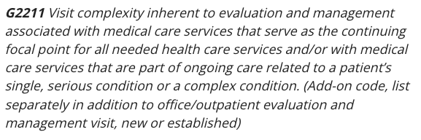
G2211 – E/M Visit
Complexity Add On Code
From PFS Final Rule
  Begin on page 431 and don’t miss pgs 437 & 438!

Slide 28
G2211 – E/M Visit
Complexity Add On Code
Primarily used for ongoing care for serious condition
  Requires longitudinal relationship with patient
Reimbursement approx. $15
Use with office and outpatient E/M visits
  99202-99205, 99212-99211-99215
Applicable for telehealth services
Coinsurance and deductibles apply
Cannot be billed with Modifier 25
Can be billed with care management codes
References: MM13473, Transmittal 12461 & CR13473

Slide 29

2024 PFS Top 10
#2 Prolonged Visits

Slide 30
Prolonged Visits
Add on codes to E/M visits selected on TIME
To be added to the highest-level code in the category
Full 15 minutes of time must be met to utilize code
Time can include both face to face and non face to face time

Slide 31
Prolonged Visits
But – there are some differences by payer
  Different codes
    CPT 99417 - 15 min
    HCPCS (Medicare) G2212 – 15 min
  CPT has non face to face prolonged codes (99358 & 99359) but Medicare does not pay for them

Slide 32
Prolonged Visits
Other Codes to Remember (not new)
  99417 (like Medicare G2212) = 15 minutes of prolonged care, done on the same day as office/outpatient codes 99205 and 99215
  99415 – 99416 = Prolonged clinical staff time (incident to the physician)
  ***When your clinical staff is spending time with the patient beyond the office visit!
  99418, G0316: Prolonged inpatient or observation service by the physician or QHP

Slide 33

Reimbursement Top 10
#1 Health Equity Services

Slide 34
Health Equity Services
SDoH – Social Determinants of Health
  HCPCS Code - G0136 - Administration of a standardized, evidence-based Social Determinants of Health Risk Assessment tool, 5-15 minutes (reimbursement approx. $17)
  Must use standardized, evidenced-based assessment tool
  Must be billed with E & M Visit
  Must be documented in the medical record w/Z-codes (Z55-Z65)
  Not more often than every 6 months
Read the Rule in Federal Register – pages 119 &
345 - 360

Slide 35
Health Equity Services
CHI – Community Health Integration
G0019 – 60 min G0022 – add’l 30 min
**BE CAREFUL – MANY SPECIFIC RULES ON THE UTILIZATION
CHI services focus on addressing the particular SDOH needs that interfere with, or present a barrier to, diagnosis or treatment of the patient's problem(s) addressed in the CHI initiating visit.
CHI services can be performed by certified or trained auxiliary personnel, “including a community health worker” which may include community health workers or others who are external to, and under contract with, the practitioner or the practitioner's practice, such as through a community-based organization.

Slide 36
Health Equity Services
PIN – Principal Illness Navigation
G0023 (60 min per calendar month) (reimbursement approx. $75)
G0024 add’l 30 min (reimbursement approx. $47)
    Principal Illness Navigation services by certified or trained auxiliary personnel under the direction of a physician or other practitioner, including a patient navigator or certified peer specialist;
DO NOT USE
G0140 & G0146 – Principal Illness Navigation – Peer Support by certified or trained auxiliary personnel under the direction of a physician or other practitioner, including a certified peer specialist;
  ***Used specifically for behavioral health!
Read the Rule in Federal Register – beginning on page 361!
Specific to Cancer!

Slide 37
Health Equity Services
PIN – Principal Illness Navigation, continued…
  By Certified or trained auxiliary personnel including patient navigator
  Disease expected to last 3 months or more
  Expected to be utilized by Oncology
  Used when helping patient NAVIGATE their treatment!
Note: Can be billed with Principal Care Management Code!
  “The rule finalizes a new reimbursement code for patient navigation services focused on patients with serious illnesses such as cancer.”
  "This ruling is a game changer, wherein all boats rise through enhancing access to oncology navigation services," said Dr. Karen E. Knudsen, CEO of the American Cancer Society and the American Cancer Society Cancer Action Network. "Patient navigation increases understanding of cancer care plans, improves patient outcomes, reduces unnecessary treatment cost, and increases patient satisfaction."

Slide 38
Health Equity Services
PIN – Principal Illness Navigation, continued…
  Where do we get “certified training” for our financial navigators?
    American Cancer Society. $495.00
    OR
    FREE – Through GW Cancer Center and Susan G. Komen – and meets CMS requirements
      Read March 2024 article….
      https://www.jons-online.com/issue-archive/online-first/5030-cms-payment-for-principal-illness-navigation-how-do-i-credential-my-navigators

Slide 39
Health Equity Services
WARNING – Final Rule Pg 288
“caregiver training services under a therapy plan of care established by a PT, OT, SLP (speech therapy)
Caregiver Support
Individual – CPT 97550, 97551
Group CPT 96202, 96203, or 97552
CMS will pay for certain caregiver training services in specified circumstances, so that practitioners are paid for engaging with caregivers to support people with Medicare and their caregivers in carrying out their treatment plans.
CMS finalized a definition of caregiver to be;
“an adult family member or other individual who has a significant relationship with, and who provides a broad range of assistance to, an individual with a chronic or other health condition, disability, or functional limitation” and “a family member, friend, or neighbor who provides unpaid assistance to a person with a chronic illness or disabling condition”

Slide 40
Don’t Miss Coding Opportunities
Chronic Care Management and Principal Care Management
      99424 (1st 30 min – about $98) & 99425 (add’l 30 min – about $70) – Provider codes
      99426 (1st 30 min – about $70) & 99427 (add’l 30 min – about $50) – Clinical Staff
      PCM predicted to be highly utilized in Oncology
        Report total time per month - Phone calls, updating the care plan, portal messages, discussing the case with other providers, overseeing transitions of care
        “10 hours a week of PCM services provided by a physician, NP, or PA could generate more than $5,000 per month in revenue”
          And you are probably already doing this but are not reimbursed for the work

Slide 41
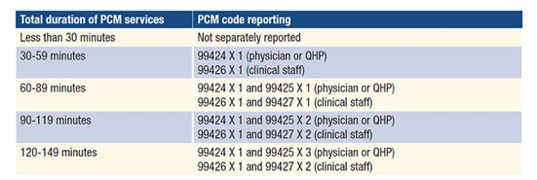
Principal Care Management

Slide 42
Don’t Miss Coding Opportunities
  Transitional Care Management Codes
    Contact with the patient within 2 business days from discharge
      99495 – face to face within 14 days
      99496 – face to face within 7 days
      A little easier now: “The date of service you report should be the date of the required face-to-face visit. You may submit the claim once the face-to-face visit is furnished and need not hold the claim until the end of the service period”
MLN Brochure on Transitional Care Management Services
https://www.cms.gov/files/document/mln908628-transitional-care-management-services.pdf

Slide 43
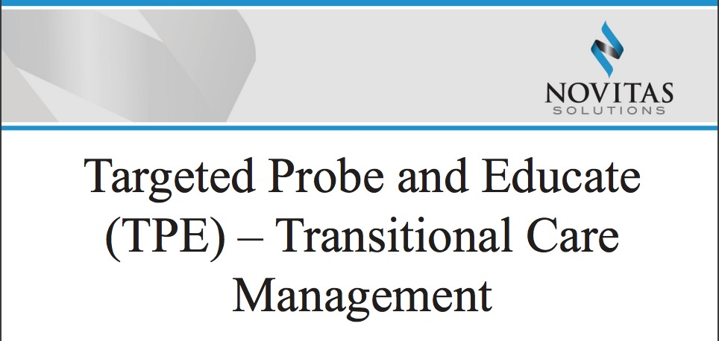
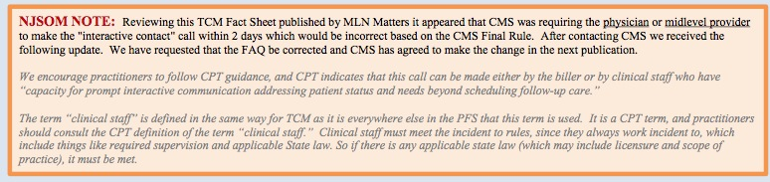
https://www.novitas-solutions.com/webcenter/content/conn/UCM_Repository/uuid/dDocName:0018491
4

Slide 44
Don’t Miss Coding Opportunities
Advanced Care Planning (Underutilized)
  CPT Code 99497- Advance care planning including the explanation and discussion of advance directives such as standard forms (with completion of such forms, when performed), by the physician or other qualified health care professional; first 30 minutes, face-to-face with the patient, family member(s), and/or surrogate
  CPT Code 99498- each additional 30 minutes (List separately in addition to code for primary procedure)
Services can be provided by
  reference from CMS that will allow “other staff under the order and medical management of the beneficiary’s treating physician.”
    services can be provided through a team approach by both physicians and non- physician practitioners and other staff. If the physician is billing and non-physicians or staff are providing the service, traditional “incident to” rules apply such that the billing physician must manage, participate and meaningfully contribute and provide direct supervision.
https://www.cms.gov/Medicare/Medicare-Fee-for-Service-Payment/PhysicianFeeSched/Downloads/FAQ-Advance-Care-Planning.pdf

Slide 45
Don’t Miss Coding Opportunities
Prolonged Services – CPT 99415 & 99416
    99415 Prolonged clinical staff service
      (the service beyond the typical service time) during an evaluation and management service in the office or outpatient setting, direct patient contact with physician supervision; first hour
      (List separately in addition to code for outpatient Evaluation and Management service)
    +99416 each additional 30 minutes
      (List separately in addition to code for prolonged service)
Clinical staff are medical assistants, licensed practical nurses, registered nurses, technicians, and others who work under the supervision of a physician or Qualified Healthcare Professional (QHP)

Slide 46
Don’t Miss Coding Opportunities
Smoking Cessation
  Counseling to Prevent Tobacco Use
  HCPCS/CPT Codes:
    99406 – Smoking and tobacco-use cessation counseling visit; intermediate, greater than 3 minutes up to 10 minutes
    99407 – Smoking and tobacco-use cessation counseling visit; intensive, greater than 10 minutes
Frequency
  Two cessation attempts per year, each attempt may include a maximum of 4 intermediate or intensive sessions.
  Total annual benefit covering up to 8 sessions per year.
Deductible and coinsurance waived.
https://www.cms.gov/Regulations-and-Guidance/Guidance/Manuals/Downloads/ncd103c1_Part4.pdf

Slide 47




So, times are changing….
Good or bad?
Only time will tell….
And it so hard to stay on top of everything!

Slide 48


Questions? michelle@weissconsulting.org
Not that anyone knows the answers to some of our questions!!
Geeze, listening to all of this makes hosting a talk show seem like a walk in the park!!
GOOD LUCK!!
Hang in there!

