Slide 1
Pharmacy Provider Reimbursement Update and DIR Fees
Presented by:
Steven L. Bennet, Esq.

Slide 2
Disclaimer
The materials and information provided in this presentation are for informational purposes only and not for the purpose of providing legal advice. The information contained in this presentation is a brief overview and should not be construed as legal advice or exhaustive coverage of the topics. You should contact your attorney to obtain advice with respect to any particular issue or problem. Statements, opinions and descriptions contained herein are based on general experience of Frier Levitt attorneys practicing in pharmacy law and are not meant to be relied upon by anyone. Use of and access to this presentation or any of the materials or information contained within this presentation do not create an attorney-client relationship between Frier & Levitt, LLC (or any of its attorneys) and the user or viewer.
All attendees have represented that they have a contract with Caremark and are subject to all Caremark terms and conditions. This presentation will not be shared with entities not contracted with Caremark
All product and company names are trademarks™ or registered ® trademarks of their respective holders. Any use of such marks is for educational purposes and does not imply any affiliation with or endorsement by them.

Slide 3

About Frier Levitt
Frier Levitt, established in 2000, is a national boutique law firm focused exclusively on Healthcare and Life Sciences. The firm draws on its experience representing stakeholders across the entire healthcare spectrum. Frier Levitt Life Sciences attorneys represent pharmacies of all kinds and assist with regulatory, transactional and litigation matters. Our Healthcare clients include large physician group practices, hospitals, hospital medical staffs, ambulatory surgery centers, laboratory companies, as well as the complete panoply of ancillary service providers.
We collaborate with our clinician attorneys, including multiple pharmacists and a podiatrist. Frier Levitt attorneys are licensed in many states and admitted in multiple federal courts throughout the country. We have offices in Pine Brook, NJ and New York, NY.
www.frierlevitt.com
© 2024 Frier Levitt. All rights reserved.

Slide 4
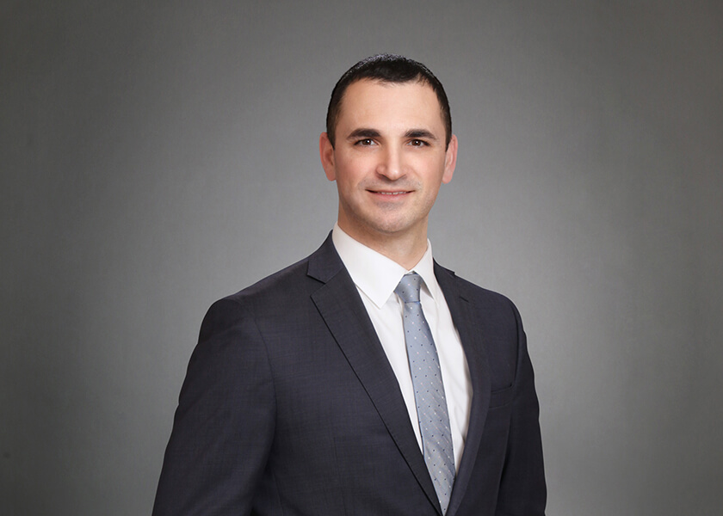
About Our Presenter
Steven L. Bennet, Esq. | Partner
sbennet@frierlevitt.com | (973) 852-8372
Steven is a Partner in Frier Levitt’s Healthcare Litigation Practice Group and works on litigation matters for healthcare professionals. Steven represents clients in a diverse range of disputes including insurance and Pharmacy Benefits Manager (PBM) network terminations, wrongful exclusion from networks, PBM audits, Board of Pharmacy actions, Board of Medical Examiners actions, other governmental investigations, and commercial disputes. Through these representative matters, Steven has developed a comprehensive knowledge of federal and state laws and regulations, including Anti-Kickback laws and other fraud, waste and abuse regulations. Steven routinely advises clients on strategies and best practices to avoid litigation risk.
Notes:
Harini

Slide 5
Learning Objectives
Below Water Reimbursement: Gain insights into the challenges of reimbursement rates that do not cover acquisition costs or operating expenses and discover actionable legal strategies.
DIR and GER Fees: Explore the intricacies of post point-of-sale fees, the impact on pharmacy operations, and mitigation strategies.

Slide 6
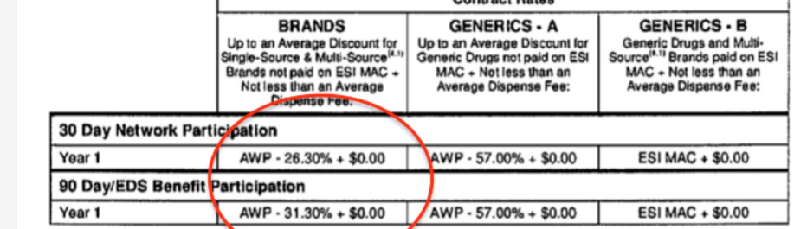
ESI Below Water Reimbursement Rate
In a post-DIR Fee era, Express Scripts prices reimbursement below acquisition cost
  Publicly available contracts have been seen with rates as poor as AWP-26.3%
  Reimbursement rates do vary among provides as Frier Levitt has seen other contracts that offer different reimbursement rates
  Express Scripts’ contract has additional fundamental issues
The contract fails to provide clear and definitive terms
ESI’s contract allows for a “reimbursement” of “up to an average” discount off of AWP. This average includes not only the reimbursement to a single provider, but for a network of providers over an entire year, allowing for payments to one provider to be better than another, even with the same contract.
Publicly Available: https://www.thebignewsletter.com/p/the-red-wedding-for-rural-pharmacies

Slide 7
ESI Below Water Reimbursement Rate
Express Scripts states that it will “managed to the overall annual effective rate guarantee…on an aggregate basis for its applicable book of business” or the AWP discount that is included in its contract with providers.
Publicly Available: https://www.sec.gov/Archives/edgar/data/1402479/000162828020013237/exhibit1023-sx4xpharma.htm
If Express Scripts is managing the reimbursement rate on an aggregate basis, not on a per claim or per provider basis, it creates a significant ambiguity about what each provider can expect to be reimbursed for each claim.
This ambiguity creates a scenario where an individual provider can be paid less than the “contracted rate” so long as Express Scripts manages the aggregate basis across its whole book of business.
  This creates liability for Express Scripts if a provider initiates litigation and seeks discovery as to whether Express Scripts is “properly” managing the reimbursement rate and whether these terms and conditions comply with Missouri law.

Slide 8
ESI Below Water Reimbursement Rate
ESI has selected Missouri as its “choice of law”
Missouri law requires that contracts have a clear and definite contract terms in order to form a binding contract.
  Trubridge, LLC v. Ozarks Med. Ctr., No. 6:21-CV-03147-MDH, 2023 WL 2145552, at *2 (W.D. Mo. Feb. 21, 2023) (A contract term is indefinite or ambiguous when it leaves the parties’ obligations and liabilities unclear and is susceptible to more than one reasonable interpretation)
We believe Express Scripts’ contract does not meet these obligations and the court can toss or reform the contract consistent with applicable law.
  Providers challenging Express Scripts reimbursement rates can assert a number of additional legal claims against Express Scripts and its plan sponsor clients based on contract and tort claims.

Slide 9
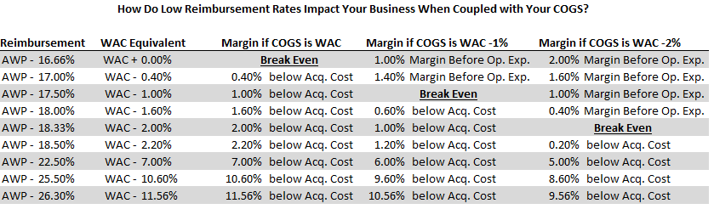
ESI Below Water Reimbursement Rate
What is a reasonable reimbursement rate?
At AWP-26.3%, providers would need to purchase drugs at WAC-11.56%, just to break even.
Providers also need to be reimbursed a sufficient sum to cover reasonable operating expenses and some profit margin.
In a litigation, we can seek to uncover what Express Scripts is paying its own specialty pharmacy.
  A provider would likely need to engage with an expert to support an argument as to what is a reasonable reimbursement rate

Slide 10
Is PBM Power Limitless?
• Federal Any Willing Provider Law (AWPL)
NO!
Numerous federal and state laws limit PBM behavior.
• Administrative Procedure Act (APA)
• Prompt Payment Laws
• MAC Transparency Laws
• State Any Willing Provider Laws
• State Minimum Reimbursement Laws
•State Unfair Trade Practices Act
• Fair Audit Protection
• ERISA
• CMS Guidance
• Anti-Mandatory White Bagging Laws

Slide 11
Medicare Part D Any Willing Provider Law
The Medicare Part D Any Willing Provider Law (“AWPL”) is established by a Federal Statute, Regulations, and CMS Guidance
Federal Statute: a Medicare Part D “prescription drug plan shall permit the participation of any pharmacy that meets the terms and conditions under the plan.”
  42 U.S.C. §1395w-104(b)(1)(A)
Federal Regulations:
  Require that these “terms and conditions” offered for participation be “reasonable and relevant”
    A Part D plan must agree to have “a standard contract with reasonable and relevant terms and conditions of participation whereby any willing pharmacy may access the standard contract as a network pharmacy.”
      42 C.F.R. § 423.505(b)(18)

Slide 12
CMS Guidance – Medicare Prescription Drug Benefit Manual
CMS states that the AWPL requires “Part D sponsors must offer reasonable and relevant reimbursement terms for all Part D drugs”
“Offering pharmacies unreasonably low reimbursement rates for certain ‘specialty’ drugs may not be used to subvert the convenient access standards. In other words, Part D sponsors must offer reasonable and relevant reimbursement terms for all Part D drugs as required by the [AWPL]”.

Slide 13
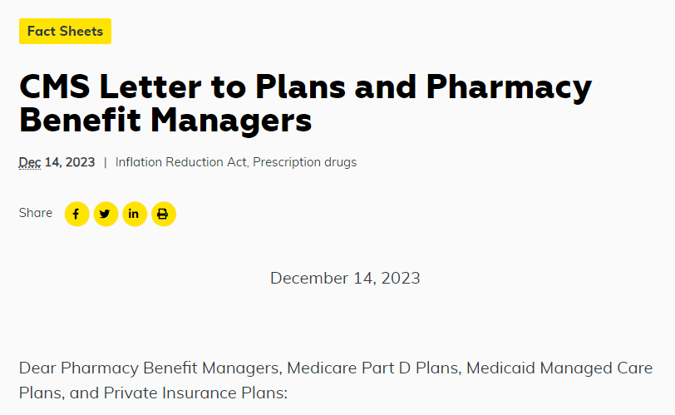
CMS Letter to Plans & PBMs
“we know that the increasing level of vertical integration that is occurring among plans, PBMs, and their own pharmacies has the potential to result in anticompetitive behavior and place independent pharmacies at a disadvantage. We urge plans and PBMs to engage in sustainable and fair practices with all pharmacies – not just pharmacies owned by PBMs – and we are closely monitoring plan compliance with CMS network adequacy standards and other requirements.

Slide 14
How Do PBMs Seek to Avoid the AWPL?
PBMs argue that the Medicare Part D AWPL does not contain an express private right of action for aggrieved providers.
According to PBMs, without a private right of action, providers have no “standing” to hold them accountable to the Medicare Part D AWPL
PBMs argue that the AWPL does not apply to them, as PBMs.
However, the AWPL does apply and PBMs are required to incorporate the AWPL as a contractual obligation with Providers!

Slide 15
Medicare Part D "Flow Down" Provision
PBMs argue that the AWPL does not apply to them. PBMs are wrong.
Federal law requires: “[e]ach and every contract governing Part D sponsors and first tier, downstream, and related entities, must contain…a provision requiring that any services or other activity performed by a first tier, downstream, and related entity in accordance with a contract are consistent and comply with the Part D sponsor’s contractual obligations.”
  42 C.F.R. §423.505(i)(3)(iii)
  PBMs are all “first tier” entities and contract with “downstream entities” like pharmacies.
CMS further requires that: “[e]ach and every contract must specify that first tier, downstream, and related entities must comply with all applicable Federal laws, regulations, and CMS instructions.”
  42 C.F.R. §423.505(i)(3)(iv)

Slide 16
Some PBMs Are Violating the Medicare
Part D “Flow Down” Requirements
Certain PBMs have never incorporated express requirements for the PBM to “comply with applicable law” into contracts with providers
Certain other PBMs historically incorporated requirements for the PBM to “comply with applicable law” into contracts, but have since amended contracts to remove such requirements in recent years
Is this legal? No. PBM failure to incorporate contractual requirements to comply with applicable federal law, state law, and CMS guidance is contrary to the requirements of the Medicare Flow Down provision

Slide 17
Recommendations and Next Steps
All providers facing unreason reimbursement rates should initiate a dispute against Express Scripts and contemplate direct legal action if the good faith dispute process does not yield results
Providers should also file a complaint with CMS directly requesting that it investigate PBM practices, enforce existing AWPL
  CMS’s December 14, 2023 letter to PBMs and plan sponsors was not sufficient to effectuate change
  CMS should also enforce the “flow down” provisions which require each PBM to include in their contract with providers a contractual obligation to comply with applicable law
Providers should pursue an APA claim against CMS if they fail to act after receipt of one or more complaint letters
Providers should take further efforts to inform legislature and the FTC about PBM wrongful conduct.

Slide 18
ESI “Bonus” Program
January 2023 Amendment to ESI’s Provider Agreement “National Performance Network”
ESI collects up to a $0.75 “Bonus Fee” on every claim.
Bonus Fees go into a pool for the entire network.
Providers “earn back” their collected fees by scoring an average of 4 stars or higher on metrics, which include adherence in the following categories:
  Proportion of Days Covered (PDC) for Diabetes - Adherence for Diabetes Medications
  PDC for Hypertension - Adherence for Hypertension (RAS Antagonists)
  PDC for Cholesterol - Adherence for Cholesterol (Statins)
  Statin Use in Persons with Diabetes – SUPD
Providers that do not dispense the above categories are not eligible to receive back any portion of their Bonus Fee. In other words, oncoloyg practices are charged these fees mandatorily but have no ability to earn them back.
  Frier Levitt’s analysis is that these fees violate CMS Rules (42 C.F.R. 423.100 and .104) requiring Plans to report the “negotiated price” of drugs inclusive of all pharmacy price concessions as part of their Part D Bid.
These fees are essentially DIR fees under a different name.

Slide 19
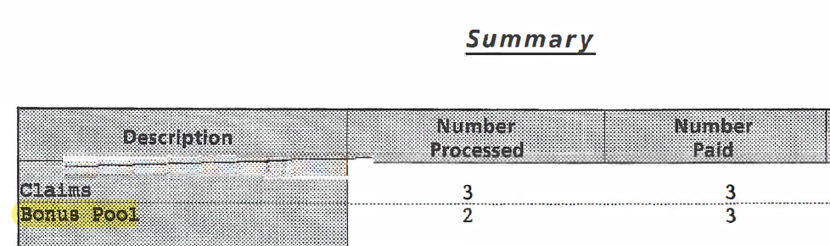

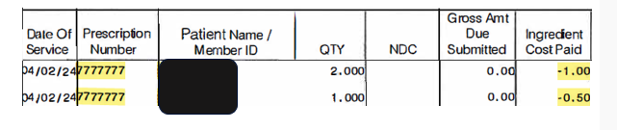
Practices can Determine Bonus Fee Assessments through 835s

Slide 20
Industry Call to Action for CMS
Providers play a critical role in ensuring CMS is notified of instances where Plan Sponsors and PBMs fail to meet their obligations under Medicare Part D
CMS has indicated a receptiveness to provider and patient “complaints”
Frier Levitt, LLC has prepared forms that can be used to file patient complaints. The complaints needs to be filled in with accurate facts that are compiled in good faith against PBMs.

Slide 21

DIR Fees

Slide 22
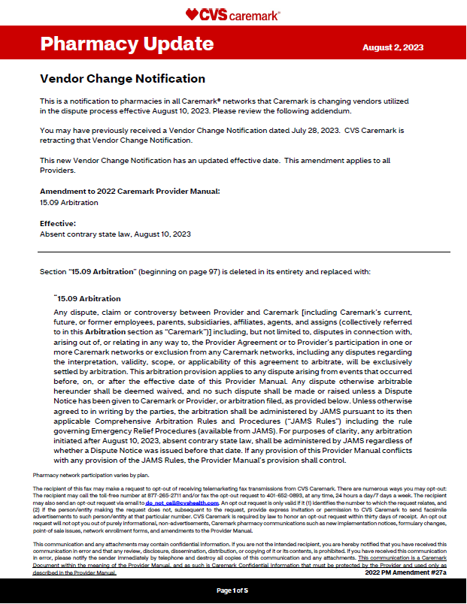
Caremark Contract Changes for Arbitration
  Amendment dated August 2, 2023, with an effective date of August 10, 2023
  Changes from AAA to JAMS
    Caremark wants to avoid their AAA losing streak and obtain rights to appeal.
  Significant limits to discovery
  Providers can challenge amendment under the law to attempt to avoid changes

Slide 23
$21M Award in 2023: NYCBS v. Caremark
1.“Claimant proved Caremark's bad faith or reckless indifference that their [MPR] methodologies and actions with respect to oncology medications were not tenable."
2.“Caremark misrepresented the contractual terms" [as to MPR methodology]..."knowing full well that it would not fulfill its contractual promises." Caremark took advantage of oncology providers' "ignorance regarding how [MPR] performance would be measured".
3.Caremark “mechanically penalized" oncology providers' choice of [oncology] medication "without allowing for provider informed judgement [to discontinue therapy]." The evidence presented "demonstrates how this approach [to MPR] was seriously and willfully misguided"
Link to the Final Award: https://www.frierlevitt.com/wp-content/uploads/2023/12/Ex.-23-Interim-and-Final-Award-Frier-Levitt.pdf

Slide 24
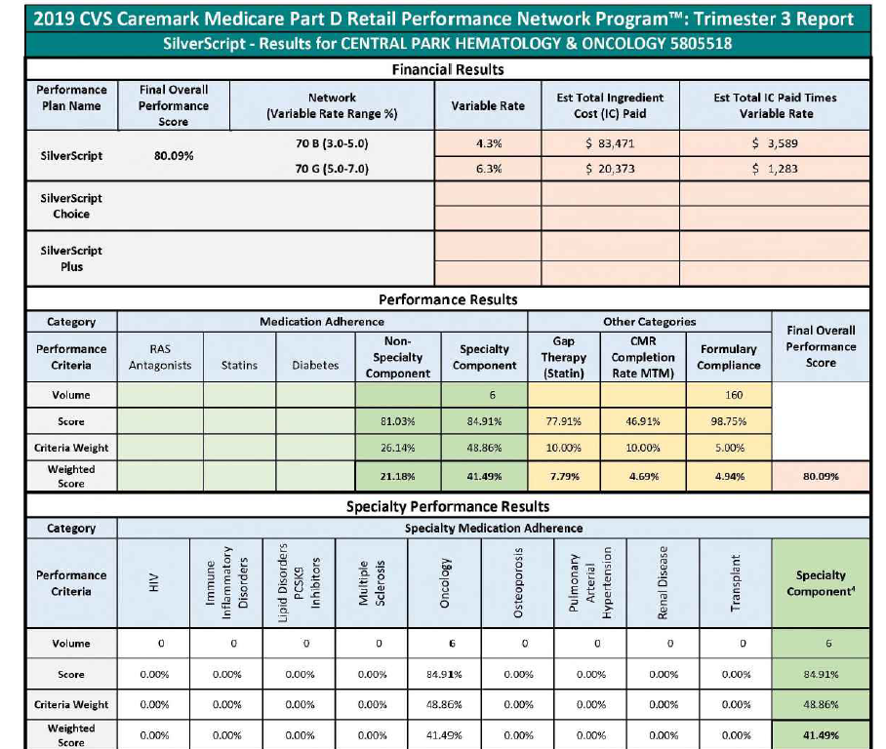
Publicly Available Trimester Report
B- “Performance Score” of 80.09% yet in the bottom half of providers.
46.4% Mean Imputation
Incorrect Oncology Adherence Score of 84.91%
www.frierlevitt.com

Slide 25
Caremark Calculates Oncology DIR/MPR Wrong
Jane is being treated for colon cancer. The physician prescribed a treatment regimen of Stivarga. In calendar year 2020, the provider dispensed 5 fills of Stivarga. The first fill was on January 27th and the 5th fill was on May 14th. Jane was monitored for elevated liver function tests (LFT) or hepatocellular necrosis in accordance with the FDA label. In June 2020, Jane had a high LFT. The physician discontinued Stivarga. Jane’s total treatment period was 140 days (5 fills * 28 days/fill).
From January 27th through June 15, 2020, Jane’s adherence and MPR should have been 100%. The physician discontinued because of her medical judgment and compliance with the FDA label.
How did Caremark calculate adherence for Jane? MPR is a ratio, with a numerator and denominator. Despite the physician’s appropriate medical judgment, Caremark's MPR score was 41.18%. Caremark's numerator was correct, 140 days. However, Caremark's denominator measured through the end of the calendar year. Caremark measured Jane's adherence incorrectly.

Slide 26
Jane Doe – Caremark Incorrectly
Measured MPR as 41.18% for Stivarga
Definition from Contract:
“Performance period” ends on 1/1/21 – a full year.
Total days of Medication Possession was 140, but evaluation period was 340, resulting in a low MPR.
First fill was 1/27/20
Last fill was 5/14/20

Slide 27
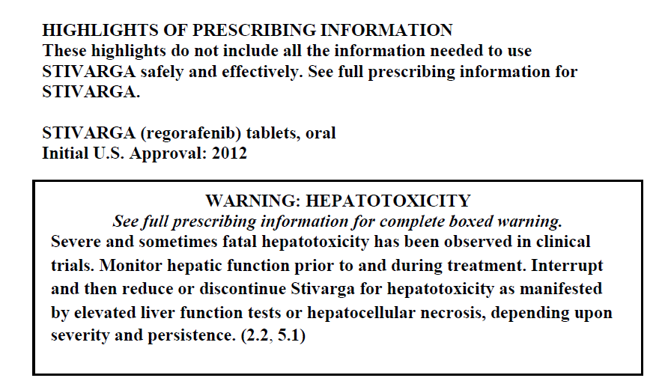


Stivarga FDA Label

Slide 28
RESULTS:
Other Unsealed DIR Fee Case Victories
Senderra Rx Partners, LLC v. CVS Health Corporation et al., No. 2:19-cv-05816 (D. Ariz.)
  $3.1 million award returning DIR Fees to the pharmacy, along with attorneys’ fees, interest, and costs
Caremark et al. v. AIDS Healthcare Foundation, No. 2:21-cv-01913 (D. Ariz.)
  $23 million award including 100% of DIR Fees, reasonable attorneys’ fees and costs
Mission Wellness Pharmacy, LLC v. Caremark, LLC et al., No. 2:22-cv-00967 (D. Ariz.)
  $3.6 million award including 100% of DIR Fees, pre-judgement interest, attorneys’ fees and costs
PBMs employ a variety of tactics to suppress any effort to hold them accountable:
  Confidential arbitrations
  Prohibitions on class, coordinated, consolidated or even multiparty actions
  Fee shifting provisions (including requirement for providers to place $50,000 or more into escrow to initiate a dispute)
  Panel of three arbitrators' costs of which must be borne equally by provider
  Discovery limitations (including limitations on depositions and paper discovery, and prohibitions on seeking discovery on other disputes with other providers)
  6-month statute of limitation to bring claims
  Contractual attempts to limit damages and interpretation of laws (including any willing provider law)

Slide 29
PBM Defenses In DIR Fee Disputes
The Any Willing Provider Law does not apply to PBMs
The Any Willing Provider Law requires only network adequacy, not reasonable reimbursement terms
If a pharmacy network has sufficient provider coverage the PBM/Plan Sponsors has met Any Willing Provider Law obligations
The terms and conditions for participation are reasonable because pharmacies have “agreed” to participate in the network
Contractual limitations to damages prevent a 100% recovery of DIR fees
Caremark devalues the benefits of patients being treated by the oncologist. Caremark's Vice President of Network Services, Steven McCall, testified that patients with cancer "would be no better off or worse off if they had gone to the Duane Reade."

Slide 30
ONCOLOGY CLASS ACTION
Class Representatives v. Caremark
    To be filed in Federal Court
    Asserts a class-wide breach of contract claims against Caremark for violating the federal Any Willing Provider Law’s requirement to maintain “reasonable and relevant” contractual terms and conditions and improperly measured medication adherence
Caremark’s DIR Fee program is not relevant to practice of oncology
    Use of mean imputation damages oncology practices
    Caremark incorrectly measures Medication Possession Ratio (MPR) when measuring oncology patient adherence

Slide 31

Humana DIR Fees
  Humana recoups DIR fees of 10% of every Medicare Part D claim
  Humana only measures medication adherence for HIV, MS and Hep C
    For providers that do not dispense HIV/MS/Hep C, Humana’s “performance based” DIR Fee program is an impermissible penalty which violates AWPL
  Frier Levitt can offer a reduced cost arrangement if you have more than $1,000,000 in Humana DIR fees.

Slide 32
Let's continue the conversation
Website: frierlevitt.com
LinkedIn: linkedin.com/company/frier-levitt-llc
Twitter: @FrierLevitt
Locations:
84 Bloomfield Ave, Pine Brook, New Jersey
101 Greenwich Street, Suite 8B, New York City
Steven L. Bennet, Esq.
sbennet@frierlevitt.com
(973) 852-8372

