Slide 1


Legal Guidance on Responding to Audits, Recoupments, and Working with Insurance Companies
Attorney-client privileged / confidential / work product
Presented to:
Presented by:
Guillermo J. Beades, Esq. | Frier Levitt
Phoebe A. Nelson, esq. | Frier Levitt

Slide 2
Disclaimer
The materials and information provided in this presentation are for informational purposes only and not for the purpose of providing legal advice. The information contained in this presentation is a brief overview and should not be construed as legal advice or exhaustive coverage of the topics. You should contact your attorney to obtain advice with respect to any particular issue or problem. Statements, opinions and descriptions contained herein are based on general experience of Frier Levitt attorneys practicing in pharmacy law and are not meant to be relied upon by anyone. Use of and access to this presentation or any of the materials or information contained within this presentation do not create an attorney-client relationship between Frier Levitt, LLC (or any of its attorneys) and the user or viewer.
All product and company names are trademarks™ or registered ® trademarks of their respective holders. Any use of such marks is for educational purposes and does not imply any affiliation with or endorsement by them.

Slide 3


About Frier Levitt
Frier Levitt, established in 2000, is a national boutique law firm focused exclusively on Healthcare and Life Sciences. The Firm draws on its experience representing stakeholders across the entire healthcare spectrum. In the Life Sciences space, we have represented pharmacies of all kinds and assisted with regulatory, transactional and litigation matters. On the Healthcare side, our clients have included large physician group practices, hospitals, hospital medical staffs, ambulatory surgery centers, laboratory companies, as well as the complete panoply of ancillary service providers. We frequently make use of the wisdom from our many clinician attorneys, including multiple pharmacists, a podiatrist, registered nurse and paramedic. Frier Levitt attorneys are licensed in a number of states. In addition to New Jersey, the firm has attorneys licensed in New York, Connecticut, Pennsylvania, Washington, D.C., Maryland, Florida, Texas, Arizona, California, Massachusetts and Missouri. Our attorneys are also admitted in multiple federal courts throughout the country. We have offices in Pine Brook, NJ, New York, NY and Uniondale, NY.
www.frierlevitt.com
© 2024 Frier Levitt. All rights reserved.

Slide 4


About Our Presenters
Guillermo J. Beades, Esq.
Partner
Phoebe A. Nelson, Esq.
Associate
Guillermo J. Beades is a Partner in Frier Levitt’s Healthcare Litigation Department and Co-Chairs the Firm’s Insurance Defense Group. Guillermo represents healthcare professionals in a broad range of administrative, civil and criminal healthcare matters.
Phoebe A. Nelson is an associate in Frier Levitt’s Healthcare Department who represents physicians and healthcare professionals. She assists clients in matters regarding Medicare audits, post-payment demands, pre-payment audits, billing disputes and more.

Slide 5
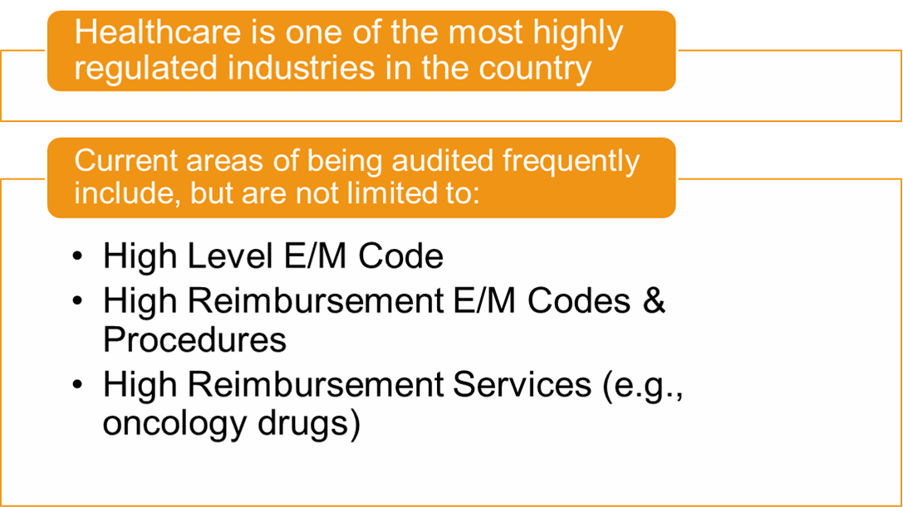

Healthcare Scrutiny

Slide 6
Healthcare Practices on the Front Lines
From Covid to Change Healthcare, medical practices continue to suffer the brunt of the damages
  Increased costs
  Increased risks
  Decreasing Reimbursements (inflation)
The one constant in healthcare?
  Payors remained profitable and active

Slide 7

Audits

Slide 8

Audits At An All Time High
Back to Business
      RAC Audits are in high gear
      SMRC Audits increased
      UPIC Audits increased
Private Payors adjusted quickly
      Pre-Payment Review remains the hot trend in auditing
      Return on Investment is still excellent for payors
www.frierlevitt.com
© 2024 Frier Levitt. All rights reserved.

Slide 9

Audits: General
Medical record audits target and evaluate procedural and diagnosis code selection as determined by physician documentation.
Reveal weaknesses in coding / documentation
Audits can expand in scope from original stated purpose

Slide 10

Audits: Key Identifiers
How was the practice notified?
Who addressed the letter to the practice?
How many charts are being requested?
Pursuant to provider agreement terms?

Slide 11

Audits: Red Flags
Audits from recovery audit contractors (RACs) or zone program integrity contractors (ZPICs)
Audits buzzwords: billing irregularities, outlier, etc.
Large number of documents requested
Specific high reimbursement procedures (e.g., chemotherapy drugs) or code (e.g., consultations)
Warning Letters!

Slide 12

ISSUES Under the Most Scrutiny
High Reimbursable Procedures
Contracts with vendors (e.g., allergy, DNA testing, stem cells, etc.)
Telemedicine
Opioid / TIRF REMS
Beware of specialty specific areas of focus (e.g., oncology and cancer drugs)

Slide 13
Common Areas of Auditing in Oncology
Use of Anti-Emetic Medications
  Medicare requires documentation of signs of intolerance (nausea, vomiting) during chemo, or history of intolerance
  Documentation is crucial to support billing for anti-emetic medications
Hydration
  Medicare denying hydration without evidence of dehydration
  Fluid solely to administer chemo drugs considered "incidental" hydration, not separately billable
B12
  Auditors target vitamin B12 injections to ensure they are supported by documented B12 deficiency
  Have documentation including progress notes and lab results showing current or historical B12 levels available
Notes:
Anti-Emetic Medications: To bill for anti-emetic medications, Medicare requires clear documentation showing the patient exhibited signs of intolerance like nausea or vomiting during chemo administration, or a demonstrated history of intolerance
Hydration: Medicare has focused in on and denied the provision of hydration without evidence the patient was dehydrated. Per Medicare, fluid used solely as a vehicle to administer chemo drugs is considered "incidental" hydration and not separately billable
B12: Payors are frequently denying claims for vitamin B12 injections administered to oncology patients. They require progress notes and lab results that definitively show the patient had a B12 deficiency. Without supporting documentation of a diagnosed B12 deficiency, they view these injections as unnecessary.

Slide 14
Auditing in Oncology (cont’d)
Reporting Wastage
  CMS now requires modifier JZ for reporting zero wastage and JW for discarded waste on single-dose vials. Claims lacking these modifiers will be denied.
  CMS will review policies on selecting appropriate single vs. multi-dose vials, focusing on billing accuracy and reported wastage.
  Providers should identify single-dose containers in their treatment regimens, review documentation, and billing for compliance concerns.
Notes:
CMS introduced modifier JZ to attest to zero wastage from a single-dose drug vial, in addition to continuing use of modifier JW when there’s discarded waste.
CMS will review documentation and policies around selecting appropriate single vs. multi-dose vials, and has targeted inaccurate billing and failure to account for wastage.
Detailed records on dosing, vial sizes, and wastage tracking are critical to avoid denials and recoupment demands in audits targeting this area.

Slide 15

Other Commonly Recurring Audit Issues
Cloned Notes
Missing or Poor Documentation of key information like Review of Systems (ROS), administering staff, route, lot numbers for chemo administration raises scrutiny
Relying on EMR system for coding the visit
Incorrect billing of separate office visit codes with modifier 25 alongside chemo administration without a separate service
Notes:
Cloned Notes: providers should avoid cloning or copying/pasting prior notes without updating documentation.
Missing/Poor documentation: Ensure chemotherapy administration notes have details like name of administering staff, administration route, lot numbers, expiration date etc.
EMR: Providers often rely on EMRs to guide their coding-related documentation, which can lead to errors of both down coding and upcoding
Modifier 25: Providers should avoid routinely billing office visit codes with modifier 25 together with chemotherapy administration unless documentation supports a visit where a full reassessment was required

Slide 16

Audits: Dos and Don’ts
DO comply with the audit!
DO copy all records, intakes, diagnostic testing, operative reports, etc. that support the DOS at issue!
DON’T give statements or hand over control of your work station!
DON’T send illegible records, sparse records and/or fail to keep a copy of what was produced!

Slide 17

Audit Response Plan
Determine intent of the audit
Conduct Self Assessment
Beware of deadlines & ask for extensions
Determine if an attorney, coder, statistician, etc. is needed
Most Audited Areas: Consults, High Level E/M, Modifiers 25/59 & high reimbursement services

Slide 18

When Is It More Than Just An Audit?
Usually starts with a Subpoena
Subpoena comes from a Special Investigations Unit (“SIU”) or entity with “Fraud” in it (e.g., MFD, BFD, etc.)
Subpoena asks for more than just medical records

Slide 19

Overpayment Demands

Slide 20

Overpayment Demands: General
Demand for Overpayment are secondary to audits and document demands
They can be based on documentation, failure to credential, the services being performed by an unauthorized provider or a litany of other reasons
Overpayment demands can also come after a subpoena targeting potential False Claims Act action from a whistleblower

Slide 21

Is An Overpayment Demand Looming?
How many documents are being requested?
Who is requesting the documents?
Does it relate to a “hot topic” area?
Is the request general or specific?
What is the language of the demand letter?

Slide 22

Overpayment Demand: Common Mistakes
Not keeping a copy of what was sent out / copied
Giving statements to investigators without first speaking to an attorney
Producing incomplete or illegible records
Treating all requests as routine
Not reviewing what is being sent out

Slide 23

How To Respond To An Overpayment Demand
Fight Every Overpayment Demand!
Determine Potential Insurance Coverage
  Coverage for Legal Fees & Expert Costs
Do not give insurance auditors the benefit of the doubt
  Coding
  Medical Necessity
  Statistical Sampling
  Lookback period

Slide 24

The Joys of Insurance

Slide 25

How to Deal with Insurance Companies
Deny – cannot accept findings wholeheartedly without an independent review
Delay – work with counsel and an independent coder to evaluate all possible defenses
Pay? – negotiate for the best financial outcome

Slide 26

Adapting to the Changing Landscape
Self-Audit your practice
  Billing and coding
  HIPAA / HITECH
  Compliance Plans
Ensure all providers and staff are trained
Consider forming / joining a super group

Slide 27

Final Thoughts
The healthcare industry is highly regulated and full of pitfalls
Handling a matter “in-house” can cost a practice far more than getting experts involved from the beginning (particularly if there is insurance!)
Take time to determine if something is routine or not
Never give statements without speaking to YOUR attorney first
Fight Every Overpayment Demand

Slide 28

Questions?
Notes:
A PBM market check allows health plans to compare their current PBM contract’s financial arrangements against prevailing current market conditions and prices. If this mid-contract review finds that the health plan’s prices aren’t competitive with current market rates offered by PBMs, the health plan can typically negotiate further price concessions from the PBM for the remainder of the contract. Given how quickly PBM pricing and rebate potential changes in today’s market, having effective market check language included in the PBM contract is highly effective in helping health plans maximize pricing leverage without necessarily always having to go out to bid. Plans should do the following when including market check provisions in their PBM contract:
Avoid market check language that gives your PBM too much leverage to say ‘no’ to your requests for better pricing. A common pitfall is for plans to agree to market check language that will allow them to compare their pricing to that of another plan of comparable size in its market.
Keep in mind that rebates can be difficult to market-check, especially if you have a custom formulary. If you include rebate guarantees in your market check, separate the evaluation of the rebate guarantee from the evaluation of other (non-rebate) guarantee components. The PBM contracts for rebates independently of non-rebate pricing components. Don’t let them offset in a market check.
Make sure your contract establishes a specific percentage (as close to zero as possible) that the value of market rate changes will have to exceed your contract’s current performance before the PBM is required to renegotiate terms.

Slide 29
Let's continue the conversation.
Guillermo J. Beades, Esq.
gbeades@frierlevitt.com
973.852.8354
linkedin.com/in/guillermo-beades-2a35233
Website: frierlevitt.com
LinkedIn: linkedin.com/company/frier-levitt-llc
Twitter: @FrierLevitt
NJ Office: 84 Bloomfield Ave, Pine Brook, NJ 07058
NYC Office: 101 Greenwich Street, Suite 8B, New York, NY 10006

