Slide 1


Oncology Practice Physician Dispensing: NJ state and federal law and Network Access
Presented by:
Jonathan E. Levitt, Esq.
Copyright © 2017. Frier & Levitt, LLC. All rights reserved.
Confidential/Proprietary
Not for dissemination.

Slide 2
DISCLAIMER
The materials and information provided in this presentation are for informational purposes only and not for the purpose of providing legal advice. The information contained in this presentation is a brief overview and should not be construed as legal advice or exhaustive coverage of the topics. You should contact your attorney to obtain advice with respect to any particular issue or problem. Statements, opinions and descriptions contained herein are based on general experience of Frier Levitt attorneys practicing in pharmacy law, and are not meant to be relied upon by anyone. Use of and access to this presentation or any of the materials or information contained within this presentation do not create an attorney-client relationship between Frier & Levitt, LLC (or any of its attorneys) and the user or viewer.
All product and company names are trademarks™ or registered® trademarks of their respective holders. Any use of such marks is for educational purposes and does not imply any affiliation with or endorsement by them.
Copyright © 2017. Frier & Levitt, LLC. All rights reserved.
Confidential/Proprietary
Not for dissemination.

Slide 3
Overview of physician dispensing in the united states
  Why is Physician Dispensing important?
    25% to 35% of drugs in pipeline are oral oncolytics
    Huge revenue potential. PBMs want to dispense. And, they make the rules.
  The majority of states permit practitioner dispensing
  44 states either explicitly permit physician dispensing (e.g., through Board licensing) or allow for the practice as part of the general authority granted to licensed physicians.
  Dispensing is restricted in minority of states: MT, NY, NJ, TX, UT, and MA
  In 16 states, non-pharmacist practitioners must register or notify their respective professional licensing board (e.g., medicine board) of their dispensing practice
  New Jersey and New York expressly permit physician dispensing in the oncological context
Copyright © 2017. Frier & Levitt, LLC. All rights reserved.
Confidential/Proprietary
Not for dissemination.

Slide 4

Quiz on arrangements where physicians can potentially benefit financially from dispensing
8. Is it permissible for a New Jersey physician to own an interest in a pharmacy that is not integrated into their practice and refer to it?
5. Is physician ownership in a free standing pharmacy that is owned 100% by the medical practice permitted under New Jersey law?
4. Is Physician dispensing directly under their medical license permitted under New Jersey law?
3. Any exceptions to these limitations?
2. Any limitations on physicians dispensing medication in New Jersey?
1. Can Physicians dispense outpatient medication directly to their own patients in New Jersey?
7. Are there any exceptions to the limitations under Federal or State law?
6. Are there any limitations under Federal or State law?
Answer: Yes.
Answer: No, New Jersey law is more restrictive than federal law on this one topic
Copyright © 2017. Frier & Levitt, LLC. All rights reserved.
Confidential/Proprietary
Not for dissemination.

Slide 5
  NEW JERSEY LAW ON PHYSICIAN DISPENSING
    BME regulations PERMIT physician dispensing to their own patients, with some exceptions.
    Doctor acting within the scope of lawful practice, after an evaluation of patient’s condition, may dispense directly to the patient (N.J.A.C. 13:35-7.5(h))
    Economic Limitation: For a drug dispensed by a physician to their patient, appropriate fee shall not exceed acquisition plus 10%
    A New Jersey physician cannot dispense more than 7 day supply
    EXCEPTION for oncological protocol; aids protocol; rural pharmacy (N.J.A.C. 13:35-7.5(i)(1))
Copyright © 2017. Frier & Levitt, LLC. All rights reserved.
Confidential/Proprietary
Not for dissemination.
Notes:
Oncological protocol is not a “defined term” in the regulations;
Oncologists can dispense to their patients without limitation for drugs that are within the care plan for oncology treatment, such as oral oncolytic, or drugs that supplement the oral oncolytic, e.g., Nupogren.
Drugs unrelated to the oncology protocol such as statins or anti-hypertensive medication would likely not fall within the exception for oncological protocol

Slide 6
New Jersey Codey law: May an oncology practice own a pharmacy and refer to it?
        New Jersey’s state law that limits physicians referral to entities where they hold a financial interest is called: The Codey Law.
        But, there are EXCEPTIONS
            Such as ASC; or
            Services provided to the patient in the physician's office.
        Codey would limit the physician from owning an outside pharmacy and referring to it;
        A pharmacy that is owned 100% by a medical practice (same tax id #) that meets the in-office ancillary exception of federal Stark Law will also be permissible under Codey.
        A physician dispensing medication pursuant to their medical license and billing under the medical practice tax id# would also be permissible under Codey
Copyright © 2017. Frier & Levitt, LLC. All rights reserved.
Confidential/Proprietary
Not for dissemination.

Slide 7
How do we know our interpretation is correct?
    New Jersey Supreme Court is uniquely protective of the Board of Medical Examiner’s powers to regulate the practice of medicine.
    There has been no regulatory enforcement adverse to physician dispensing by:
      New Jersey Board of Medical Examiners;
      New Jersey Board of Pharmacy; or
      New Jersey State Attorney General’s office.
Copyright © 2017. Frier & Levitt, LLC. All rights reserved.
Confidential/Proprietary
Not for dissemination.
Notes:
NJ discusses Physician dispensing “in the negative”, the limitations only; requires a legal interpretation;
NJSupCt ruled in landmark case by state and national nursing associations ruled against the BME’s restricted rule on who could administer anesthesia; limited CRNA’s to administer anesthesia only under supervision of anesthesiologist; it was challenge; NJSCt ruled that in NJ legislature conferred upon the BME the ability to regulate the practice medicine; the delivery of anesthesia is swept within that; state created other regulatory bodies, but they have no jurisdiction over BME on issues of medical care; in other states CRNAs can practice independently to deliver anesthesia without supervision; S.Ct’s ruling is that the BME is supreme on issues of medicine, so the NJBME’s restrictive rule was upheld. So, if the BME allows it, its ok.
NJBME has the power to allow physician dispensing to their own patients;

Slide 8
Additional legal support from other states for interpretation that new jersey law permits oncological dispensing
New York’s BME (office of the professions) limits physician dispensing to a 72 hour supply of drugs;
New York law also limits physician dispensing, but contains exceptions for oncological and AIDS protocols
Copyright © 2017. Frier & Levitt, LLC. All rights reserved.
Confidential/Proprietary
Not for dissemination.
Notes:
Virginia has very specific laws; VA requires dr. to get permit from the BOP (not BME);

Slide 9
Pharmacy Benefits Landscape
PLAN SPONSORS
PBM
MANUFACTURERS
PBMs negotiate with manufacturers for rebates
Employers
Unions
Government programs
Health Insurers (or Plan Sponsors directly) contract with PBMs to administer pharmacy benefits
Administrative Services Only
Group Health Insurance
Manufacturers sell drug products to pharmacies through wholesalers
PBMs in turn contract with a network of retail and specialty pharmacies and dispensing physicians
PBMs also own mail order and specialty pharmacies
HEALTH INSURANCE COMPANIES
Both PBM-owned and independent pharmacies provide medications to the patient
PBM-OWNED PHARMACY
PHARMACIES AND DISPENSING PHYSICIANS
Patients are employees of the Plan Sponsor, who either self-funds their claims or covers health insurance premiums
PATIENTS
Copyright © 2017. Frier & Levitt, LLC. All rights reserved.
Confidential/Proprietary
Not for dissemination.
Notes:
Virginia has very specific laws; VA requires dr. to get permit from the BOP (not BME);

Slide 10



























Industry at a Glance
Plan
Sponsors
PBMs
PBM
Pharmacy Solutions
Specialty Pharmacy
PBM-Owned
Specialty
Pharmacies
Specialty
Pharmacy
Specialty Pharmacy
Specialty Pharmacy Services
PBM-Owned
Chain Pharmacies
Copyright © 2017. Frier & Levitt, LLC. All rights reserved.
Confidential/Proprietary
Not for dissemination.

Slide 11
PBMs want to Exclude your Physician Dispensing Practice, Can PBMs do Whatever They Want?
NO!!!
Numerous federal and state laws limit PBM behavior.
• Prompt Payment Laws
• Administrative Procedure Act (APA)
• Fair Audit Protection
• ERISA
• MAC Transparency
• Federal Any Willing Provider Law (APWL)
•State laws including the Unfair Trade Practices Act
Copyright © 2017. Frier & Levitt, LLC. All rights reserved.
Confidential/Proprietary
Not for dissemination.

Slide 12





Financial Motives of CVS/Caremark
BEFORE
NOW
Physician in-office administration of IV chemotherapy
Oral oncolytics dispensed by physicians or pharmacies
= $
CVS/Caremark uses PBM to shift business to wholly-owned pharmacies
Copyright © 2017. Frier & Levitt, LLC. All rights reserved.
Confidential/Proprietary
Not for dissemination.

Slide 13
Efforts to Limit Physician dispensing: Cvs/Caremark
After our notification, Oncology Association of West Kentucky submitted an application to
directly enroll with CVS/caremark; however, our credentialing review determined they did not
meet our terms and conditions to be a retail pharmacy provider. Oncology Association of West
Kentucky is a two physician practice and not a community retail pharmacy. As such, they do not
carry a full array of medications for patients as would a community pharmacy. Also, they are
also a “closed door” facility, only treating the patients under their care. Our pharmacy network
is comprised of community pharmacies that provide a wide array of drug therapies to our
members.
After our notification, Oncology Association of West Kentucky submitted an application to
directly enroll with CVS/caremark; however, our credentialing review determined they did not
meet our terms and conditions to be a retail pharmacy provider. Oncology Association of West
Kentucky is a two physician practice and not a community retail pharmacy. As such, they do not
carry a full array of medications for patients as would a community pharmacy. Also, they are
also a “closed door” facility, only treating the patients under their care. Our pharmacy network
is comprised of community pharmacies that provide a wide array of drug therapies to our
members.
1) You do not meet CVS/Caremark’s
definition of a “retail pharmacy”
Outside of not meeting our “general” requirements for being a community pharmacy with a
broad assortment of drug therapies, our ongoing regulatory review also made clear that CMS
considers such physician dispensing facilities as out-of-network providers. CMS Medicare Part
D rules define “sponsor networks” as pharmacy only networks, and “retail pharmacy” is defined
as a licensed pharmacy from which enrollees can purchase a drug without being required to
receive medical services. CMS has also explicitly stated that “covered Part D drugs that are
appropriately dispensed and administered in a physician’s office will be subject to the same
treatment under our out-of-network access rules.” Based on a recent inquiry to CMS, we
understand that CMS has not changed its policy towards non-pharmacy dispensers.
Outside of not meeting our “general” requirements for being a community pharmacy with a
broad assortment of drug therapies, our ongoing regulatory review also made clear that CMS
considers such physician dispensing facilities as out-of-network providers. CMS Medicare Part
D rules define “sponsor networks” as pharmacy only networks, and “retail pharmacy” is defined
as a licensed pharmacy from which enrollees can purchase a drug without being required to
receive medical services. CMS has also explicitly stated that “covered Part D drugs that are
appropriately dispensed and administered in a physician’s office will be subject to the same
treatment under our out-of-network access rules.” Based on a recent inquiry to CMS, we
understand that CMS has not changed its policy towards non-pharmacy dispensers.
2) Dispensing Physicians are out-of-
network providers under
Medicare Part D
Copyright © 2017. Frier & Levitt, LLC. All rights reserved.
Confidential/Proprietary
Not for dissemination.

Slide 14
WhAT CVS/CAREMARK DID
In early 2016, CVS Caremark announced that beginning January 1, 2017, physician dispensing class of trade will no longer be included in Caremark’s Medicare Part D network
Medicare Part D Plans
Physician Owned Pharmacies
Dispensing Physicians
Copyright © 2017. Frier & Levitt, LLC. All rights reserved.
Confidential/Proprietary
Not for dissemination.

Slide 15
ENTER FRIER LEVITT’S WHITE PAPER

Slide 16
Caremark’s Legal Argument
VERSUS REALITY
Copyright © 2017. Frier & Levitt, LLC. All rights reserved.
Confidential/Proprietary
Not for dissemination.

Slide 17
What does this mean for new oncology practices applying for medicare d network admission?
Dear non-pharmacy dispenser:
This notice is to communicate that CVS Caremark is not currently processing provider enrollment applications for non-Pharmacy dispensers into our retail pharmacy network. Over the next several months, CVS Caremark will be evaluating our client’s requirements and demand for a physician dispensing network.
Thank you,
CVS Caremark
Provider Enrollment
YOUR ONCOLOGY PRACTICE MAY HAVE RECEIVED THIS COMMUNICATION…
Copyright © 2017. Frier & Levitt, LLC. All rights reserved.
Confidential/Proprietary
Not for dissemination.

Slide 18


What Express Scripts is doing
Starting April 1, 2016, certain oncology medicines will have additional edits applied for members with certain types of cancer who are new to therapy. These edits may require the drug be filled through Accredo® specialty pharmacy with no initial fill at retail.
Top 25 Oncology Drugs
AFINITOR | SUTENT
ERIVEDGE | TAFINLAR
GILOTRIF | TARCEVA
GLEEVEC | TASIGNA
IBRANCE | TEMOZOLOMIDE
INLYTA | THALOMID
JAKAFI | VOTRIENT
LUPRON DEPOT | XALKORI
MEKINIST | XTANDI
NEXAVAR | ZYTIGA
POMALYST | LENVIMA
REVLIMID | INTRON A
SPRYCEL
March 3rd Weekly
March 10th Weekly
Copyright © 2017. Frier & Levitt, LLC. All rights reserved.
Confidential/Proprietary
Not for dissemination.

Slide 19
Which providers WILL Be AFFECTED by Express Scripts’ action?
All of them
Copyright © 2017. Frier & Levitt, LLC. All rights reserved.
Confidential/Proprietary
Not for dissemination.

Slide 20
Which plans WILL BE AFFECTED by
Express Scripts’ action?
Affected Plans
Likely affecting Self-Funded and Regional Plans
Copyright © 2017. Frier & Levitt, LLC. All rights reserved.
Confidential/Proprietary
Not for dissemination.

Slide 21
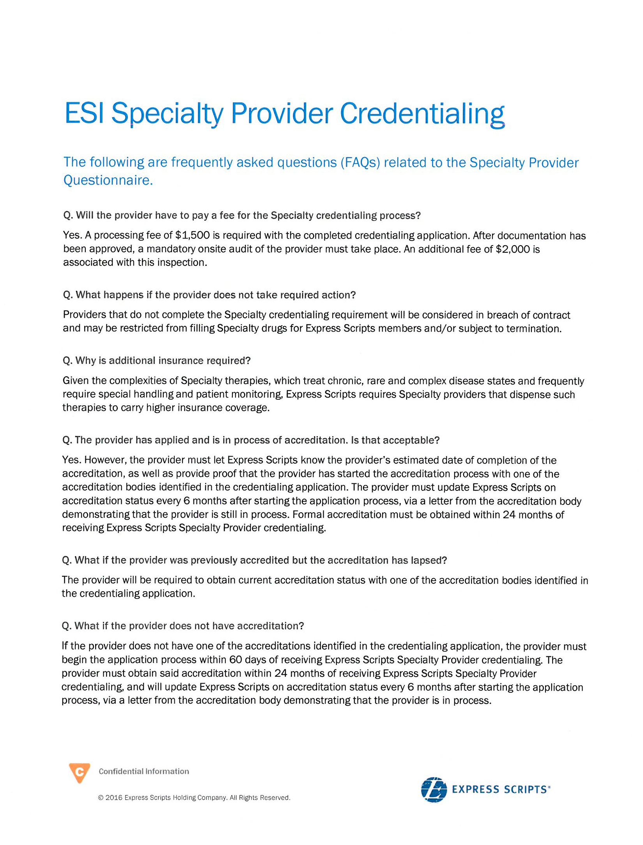
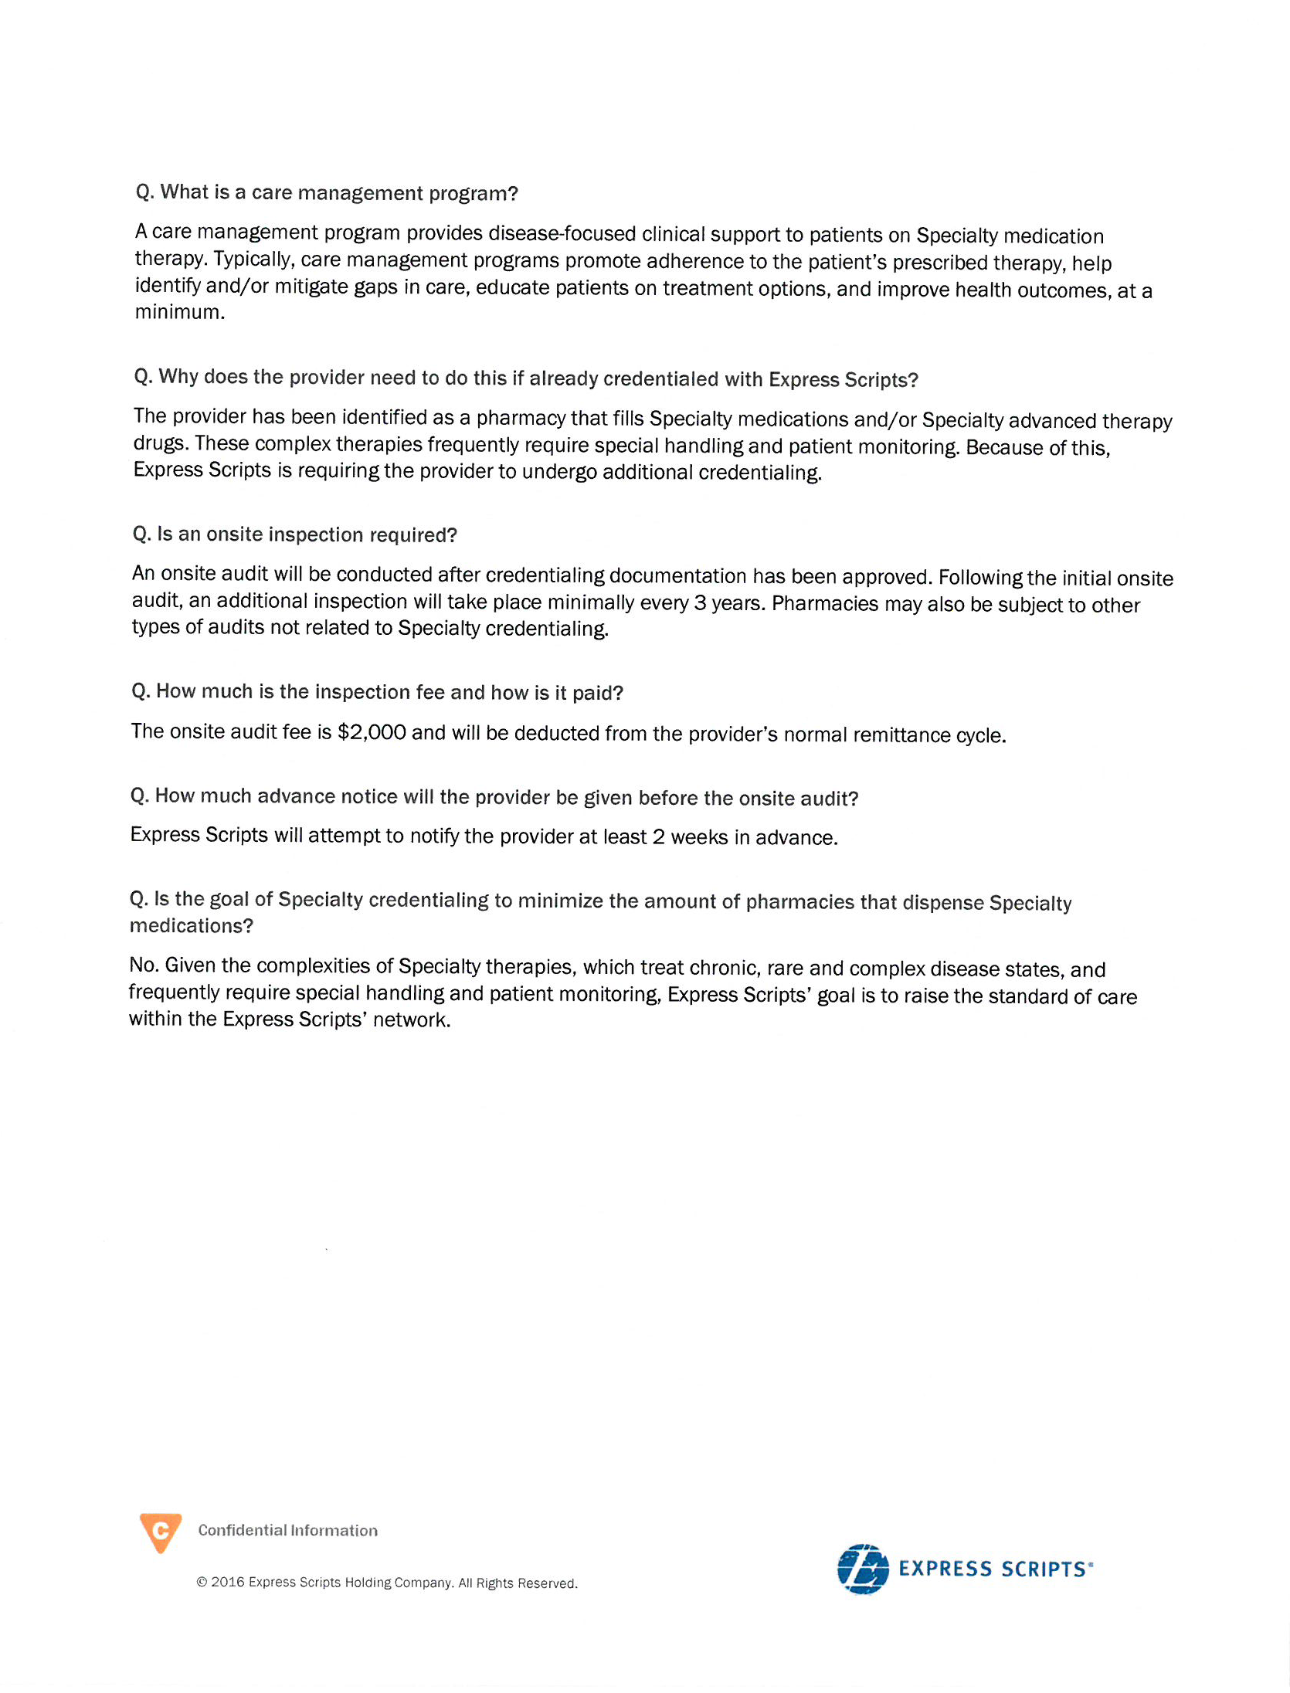
What Express Scripts is also doing
Q. Will the Provider have to pay a fee for the Specialty credentialing process?
Yes. A processing fee of $1,500 is required with the completed credentialing application. After Documentation has been approved , a mandatory onsite audit of the provider must take place. An additional fee of $2,000 is associated with this inspection.
Copyright © 2017. Frier & Levitt, LLC. All rights reserved.
Confidential/Proprietary
Not for dissemination.

Slide 22
Laws that protect providers:
Medicare freedom of choice laws
42 U.S.C. § 1395a – Free Choice By Patient Guaranteed
    Any individual entitled to insurance benefits under this subchapter [Medicare] may obtain health services from any institution, agency, or person qualified to participate under this subchapter if such institution, agency, or person undertakes to provide him such services.
Provider has Medicare provider number and is thus qualified to participate under Medicare
Copyright © 2017. Frier & Levitt, LLC. All rights reserved.
Confidential/Proprietary
Not for dissemination.

Slide 23
Caremark is simply an agent of the government, limited by federal law
If CMS is limited by statute…
CMS
Part A
Part B
Part C
Part D
PBMs
…then so too are the Plans…
…and so too are the First Tier Entities
PBMs cannot do what CMS doesn’t have the right to do
Copyright © 2017. Frier & Levitt, LLC. All rights reserved.
Confidential/Proprietary
Not for dissemination.

Slide 24
Laws that protect providers:
Medicare freedom of choice laws
42 U.S.C. § 1395a – Free Choice By Patient Guaranteed
    Any individual entitled to insurance benefits under this subchapter [Medicare] may obtain health services from any institution, agency, or person qualified to participate under this subchapter if such institution, agency, or person undertakes to provide him such services.
Provider has Medicare provider number and is thus qualified to participate under Medicare
    Denying a patient the right to see that provider arguably violates freedom of choice
    Custom and practice for ten years guides interpretation
    Laches
Patient could have a claim having paid premiums for coverage
    May require a coverage determination process and appeal
Copyright © 2017. Frier & Levitt, LLC. All rights reserved.
Confidential/Proprietary
Not for dissemination.

Slide 25
Laws that protect providers:
Medicare Any Willing Provider LAw
Requires PDPs to permit “the participation of any pharmacy that meets the terms and conditions under the plan.” 42 U.S.C. § 1395w-104(b)(1)(A)
Sponsors “must contract with any pharmacy that meets the Part D sponsor’s standard terms and conditions.” 42 C.F.R. § 423.120(a)(8)(i)
Plan must agree to have a “a standard contract with reasonable and relevant terms and conditions of participation whereby any willing pharmacy may access the standard contract and participate as a network pharmacy.” 42 C.F.R. 423.505(b)(18)
Hinges on definition of “pharmacy”
Creature of State law
Copyright © 2017. Frier & Levitt, LLC. All rights reserved.
Confidential/Proprietary
Not for dissemination.

Slide 26
Laws that protect providers:
Medicare Any Willing Provider law
Must be able to meet Terms and Conditions
      Terms and Conditions must be “reasonable and relevant”
      Recent CMS Letter referring only to having appropriate “licensure”
Copyright © 2017. Frier & Levitt, LLC. All rights reserved.
Confidential/Proprietary
Not for dissemination.

Slide 27
Laws that protect providers:
New Jersey any willing provider law (AWPL)
New Jersey law requires that insurance companies allow subscribers to select a pharmacy or pharmacist of their choice
      No pharmacy or pharmacist shall be denied the right to participate as a contracting provider or preferred provider contingent upon their acceptance of the same terms applicable to all other providers
Dispensing physicians can take advantage of New Jersey’s AWPL by:
      Employing a pharmacist in their practice; or
      Starting a pharmacy.
New Jersey’s AWPL is applicable to Commercial insurance and Medicaid Plans alike
Copyright © 2017. Frier & Levitt, LLC. All rights reserved.
Confidential/Proprietary
Not for dissemination.
Notes:
a. Notwithstanding any provision of law to the contrary, [a certificate of authority to establish and operate a health maintenance organization in this State shall not be issued or continued on or after the effective date of this act for a health maintenance organization which provides pharmacy services, prescription drugs, or a prescription drug plan, unless the coverage for health care services]:
(2) Provides that no pharmacy or pharmacist shall be denied the right to participate as a preferred provider or as a contracting provider, under the same terms and conditions currently applicable to all other preferred or contracting providers, if the contract provides for coverage by contracted or preferred providers for pharmaceutical services, provided the pharmacy or pharmacist is registered pursuant to R.S.45:14-1 et seq., and accepts the terms and conditions of the contract;
Language identical for all statutes, just applicable to different insurance forms.
N.J. Stat. Ann. § 17:48-6j (Hospital Service Corporations); N.J. Stat. Ann. § 17:48A-7i (Medical Service Corporations); N.J. Stat. Ann. § 17:48E-35.7(Health Service Corporations); N.J. Stat. Ann. § 17B:26-2.1i (Individual Health Insurance Policy); N.J. Stat. Ann. § 17B:27-46.1i (Group Health Insurance Policy); N.J. Stat. Ann. § 26:2J-4.7 (HMO)
Some caselaw from Trilogy that alls into question whether there is a private right of action.

Slide 28
Patient care and public policy arguments in favor of physician dispensing
In office physician dispensing presents improved and more cost-effective care compared with traditional pharmacies, resulting in improved patient outcomes (Journal of Value Health, 2016 Mar;19(2):277-85)
Dispensing Physician Practices coordinate all aspects of patient medication management:
    Joint electronic medical records
    Reductions in “time to therapy” and “nimble” medication management
    Real time face-to-face patient education
    Direct and continuous monitoring for side effects
Oral oncolytics are uniquely positioned to be managed by physician dispensers
Copyright © 2017. Frier & Levitt, LLC. All rights reserved.
Confidential/Proprietary
Not for dissemination.

Slide 29










What are DIR fees?
DIR stands for “direct and indirect remuneration”
DIR was a term coined by the Centers for Medicare and Medicaid Services (CMS)
CMS was concerned that the actual cost for a drug under a Part D Plan was being obfuscated by price concessions (e.g. manufacturer rebates) that were not captured at the point of sale
PBMs have hijacked the term “DIR” to extract fees from pharmacies after the point-of-sale and after the claim has been adjudicated
Pharmacy buys drug through Wholesaler for $85
And PBM then remits payment back to Pharmacy for $100
PBM submits a “prescription drug event” to CMS for $100
Pharmacy submits a claim to PBM for $100
CMS then covers the claim for $100
But Manufacturer thereafter pays a rebate to PBM, reducing actual cost of drug
Copyright © 2017. Frier & Levitt, LLC. All rights reserved.
Confidential/Proprietary
Not for dissemination.

Slide 30
What certain PBMs ARE doing
You’ve probably seen this chart…what does it mean?
Percentage Based Recoupment Based on “Performance”
    Provider will be charged a “network variable rate” (formerly a “network rebate” to the Plan Sponsors) that will range from 3% to 5% of cost paid based on Provider’s performance on the performance criteria
    Score is measured annually in 4 month measurement periods
    Network rebates are deducted from PBM payments to Provider as a lump sum deduction divided proportionately over the 16 weeks following each measurement period
Copyright © 2017. Frier & Levitt, LLC. All rights reserved.
Confidential/Proprietary
Not for dissemination.

Slide 31
What Certain PBMs ARE doing
At “recoupment” time, pharmacy will receive a “bill” looking like this:
Copyright © 2017. Frier & Levitt, LLC. All rights reserved.
Confidential/Proprietary
Not for dissemination.

Slide 32
PBMs’ “Performance” criteria: No Basis In Law
No where are these metrics contemplated in the statutes.
Performance Criteria | Criteria Weight
1. ACE/ARB Adherence | 20%
2. Statin Adherence | 20%
3. Diabetes Adherence | 20%
4. GAP therapy (statin) | 25%
5. CMR Completion Rate (MTM) | 5%
6. % High Risk Meds (HRM’s) | 5%
7. Formulary Compliance | 5%
“Performance” is measured for these drug categories only
No where are these metrics contemplated in the regulations.
No where are these metrics contemplated in the guidances.
Copyright © 2017. Frier & Levitt, LLC. All rights reserved.
Confidential/Proprietary
Not for dissemination.

Slide 33

Problems with Percentage Based Recoupment Per Claim
Assume these are all claims submitted by Pharmacy in Measurement Period
Drugs subject to performance criteria (i.e., ACE inhibitors, statins, diabetes medications, etc.)
All other medications dispensed by the pharmacy, including high priced specialty medications
Copyright © 2017. Frier & Levitt, LLC. All rights reserved.
Confidential/Proprietary
Not for dissemination.

Slide 34
Problems with Percentage Based Recoupment Per Claim
PBM is taking performance on these claims (which account for <10% of Pharmacy’s revenue)
Drugs subject to performance criteria (i.e., ACE inhibitors, statins, diabetes medications, etc.)
All other medications dispensed by the pharmacy, including high priced specialty medications
Copyright © 2017. Frier & Levitt, LLC. All rights reserved.
Confidential/Proprietary
Not for dissemination.

Slide 35
Problems with Percentage Based Recoupment Per Claim
PBM is taking performance on these claims (which account for <10% of Pharmacy’s revenue)
And applying it to take back 3-5% on all claims, including specialty medications which account for 90% of Pharmacy’s revenue
Drugs subject to performance criteria (i.e., ACE inhibitors, statins, diabetes medications, etc.)
All other medications dispensed by the pharmacy, including high priced specialty medications
Copyright © 2017. Frier & Levitt, LLC. All rights reserved.
Confidential/Proprietary
Not for dissemination.

Slide 36

Legislative Action on DIR fees
In June 2016, as many as 16 U.S. Senators and 30 House Representatives urged CMS to finalize its proposed guidance on DIR fees:
In September 2016, “Improving Transparency and Accuracy in Medicare Part D Spending Act,” S. 3308 / H.R. 5951 was introduced in Congress
“DIR fees prevent the pharmacy from knowing the true reimbursement amount of drugs being dispensed at the point of sale, and in some cases DIR fees have resulted in preferred pharmacy prices appearing lower than they actually are.”
    Aimed at ending retroactive DIR fees and
    increasing transparency
Copyright © 2017. Frier & Levitt, LLC. All rights reserved.
Confidential/Proprietary
Not for dissemination.

Slide 37
What Can pROVIDERS do to Combat Unreasonable DIR Fees?
Arbitration Against PBMs challenging DIR Fees
  Breach of Contract
  Violation of Federal Law;
  Federal Any Willing Provider Law (AWPL)
  State Unfair Trade, Insurance, and/or Business Practices Acts
  “Agency Through Contract” theory
Direct action against CMS/HHS
  Administrative Procedure Act violations
White Paper and Public Relations Campaign
Copyright © 2017. Frier & Levitt, LLC. All rights reserved.
Confidential/Proprietary
Not for dissemination.

Slide 38
Thank You!
Jonathan E. Levitt, Esq.
jlevitt@frierlevitt.com
973.618.1660
FrierLevitt.com
Copyright © 2017. Frier & Levitt, LLC. All rights reserved.
Confidential/Proprietary
Not for dissemination.

