Slide 1
NJSOM Meeting
From Capitol Hill to Bridgewater…
A Crystal Ball Look at Oncology Policy for 2017 and Beyond
Ted Okon
Bridgewater, New Jersey
1/20/2017

Slide 2

And the Crystal Ball Says…
Policy environment for community oncology should be more favorable “for now”
Oncology payment reform a reality, regardless of who is in power in DC
  Embrace it and make it work in your practice
  MACRA, OCM
The drug price issue not going away
  The incoming President won’t let it go away
340B in hospitals will be an issue in 2017
  Big fight brewing!
PBMs will fight hard to control and dispense more oral cancer drugs
Obamacare will be repealed and replaced; just a very cloudy picture of what “Trumpcare” will look like

Slide 3
Why An Improved Political Environment?
Obama Administration gave us the Part B “experiment”
  Very unlikely the Trump Administration will follow
  GOP very supportive in stopping it
HHS/CMS have not been very supportive of community oncology
  Obama Administration pressed for consolidation
Republicans in Congress have been more supportive of our issues
  Application of the sequester cut to Part B drug payment
  Medicare Part B experiment
  General consolidation of cancer care across the country
HHS Secretary nominee Dr. Tom Price very supportive of physicians and our issues

Slide 4
Oncology Payment Reform
Private insurers have already started years ago
  United, Aetna, Anthem, Priority, etc.
Medicare COME HOME project already done
Oncology Care Model (OCM) is now rolling
  196 practices implementing it (or trying!)
  Payers at all different levels of readiness
MACRA final rule out and the implementation clock is ticking
  Need to make choices now
Both sides of the political aisle want “value” in payment for medical services and drugs
Community oncology needs to be even more agressive in moving on payment reform, especially with the change in DC!!!

Slide 5
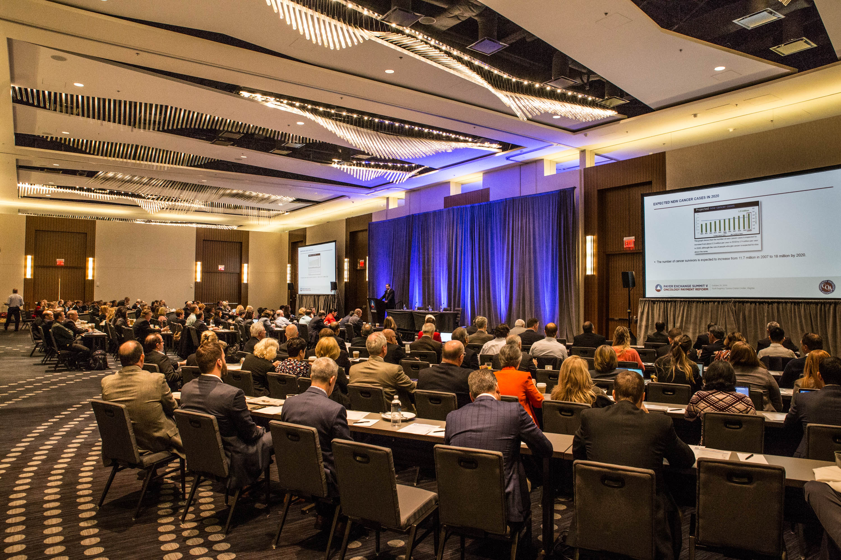
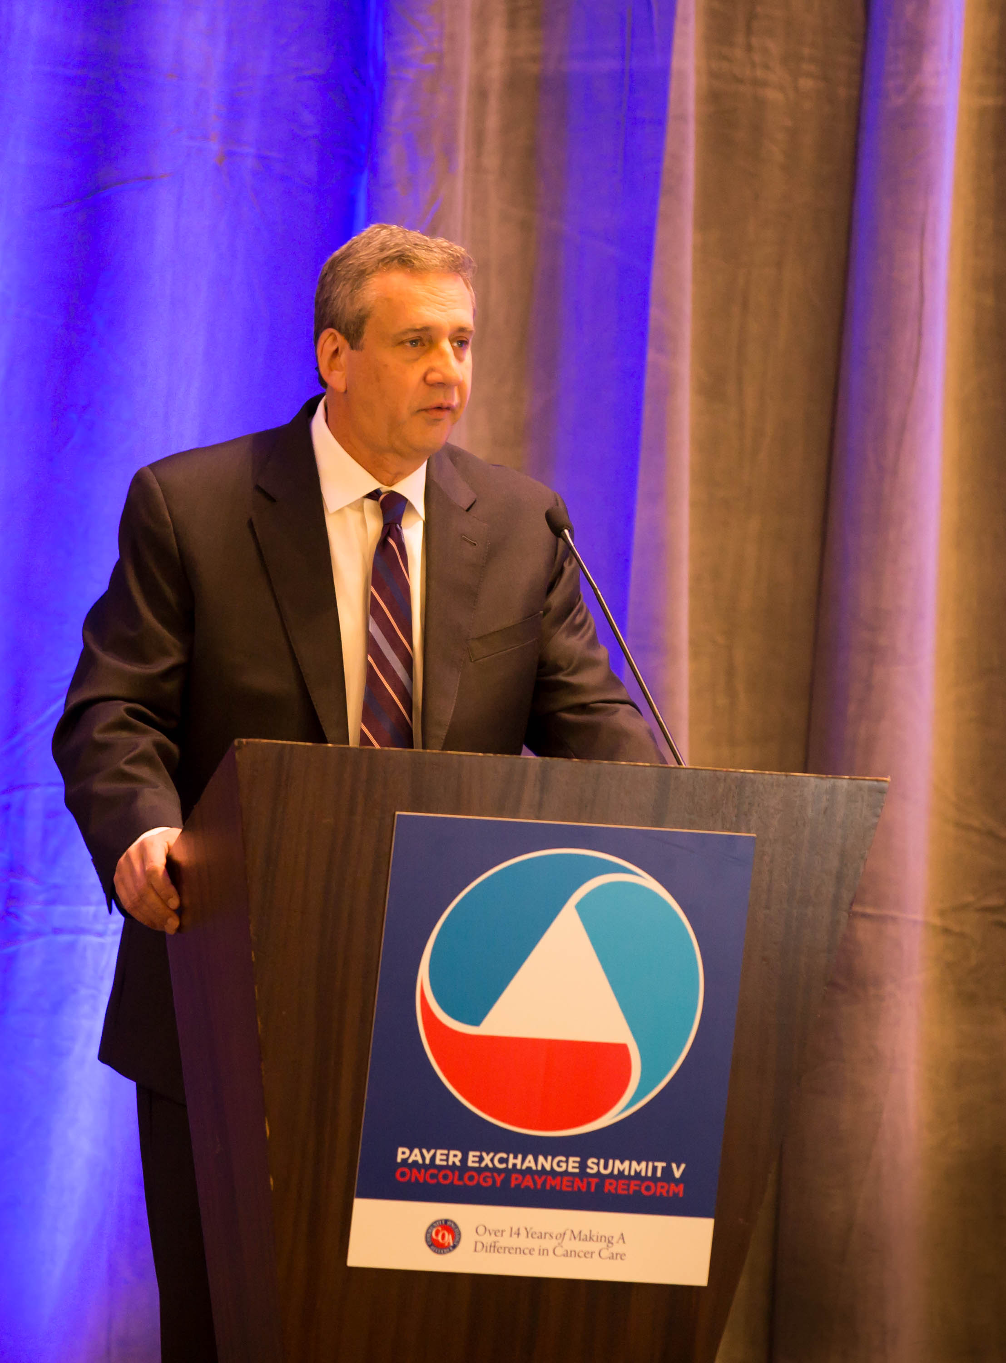
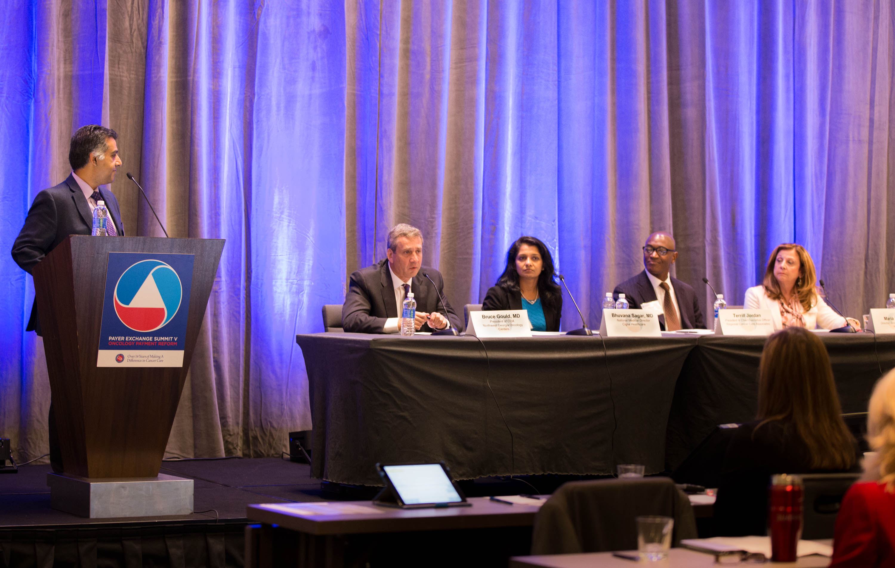
COA Oncology Care Model (OCM) Strategy
Help practices make the OCM really work
  Have close to 80% of the practices networked
Provide materials to help facilitate implementation
Created peer-to-peer information exchange
  Dedicated listserv
  Affinity groups
  Meetings and calls
Brought on very experienced experts (Kavita Patel, MD, Basit Chaudhry, MD, Laura Long, MD)
Proactive outreach to CMMI on implementation issues and now big concerns
Evolve the model as needed so it actually works and can be used elsewhere

Slide 6
OCM Evolution to OCM 2.0
OCM is a good start but has a ton of issues/problems
  Trying to make it as “good” as possible in working through the deficiencies
What would the perfect OCM-type model look like?
OCM 2.0 is attempt to make the OCM better and to serve as a universal oncology payment reform model
  Smooths the “rough edges” of the OCM 1.0
  Takes a more global look at cancer treatment, not just the chemotherapy episode
  Two variations:
    Single sided (no practice risk)
    Double sided (practice at risk but with a floor)

Slide 7
My Thoughts on MACRA – MIPS and AAPMs
MIPS is going to be a real crapshoot in terms of where you land
  Can’t just ignore it because a severe downside penalty (9%!) is out there in later years
  Make a wise decision for 2017 because that’s the baseline measurement year for 2019
  Get your house (practice) in order NOW!
    Understand what you will be measured on and put new procedures in place as needed
  Putting your head in the sand is the worse thing you can do!
Future of community oncology may be in advanced alternative payment models (AAPMs)
  Good news is they offer 5% bonuses plus upside of the model savings
  Bad news is you are going at risk
  Need to incorporate actuarial expertise into your thinking
  Can’t put your head in the sand on this one either!
MACRA may be simplified but not sure it is going away

Slide 8
Drug Price Issue Front and Center

Slide 9
Breaking Down the Drug Price Issue
Escalating drug prices are a problem and not sustainable
  Pharma/bio companies part of the problem and need to get innovative with solutions
Escalating drug prices only part of the problem of increasing cancer care costs
  Only 18-20% of the cost of cancer care relates to drugs
    Pharma/bio an easy target for the media, politicians, and academics
  Technology advances and demographics are a large part of the problem
    Better diagnosis and treatment keeping people alive
    Shifting demographics and health behaviors increasing cancer cases and costs
Everyone part of the problem — and everyone needs to be part of the solution!!!
  FDA
  Pharmaceutical/biotechnology companies
  Insurers — private and Medicare
  Community oncology
  Hospitals, including 340B and cancer hospitals with special Medicare exemption

Slide 10
Where is Drug Price Debate Likely Heading?
Direct or overt price controls unlikely – regardless of Trump’s tweets
Tough to imagine ”negotiations” between Medicare and pharmaceutical companies on drug prices
  Pits the Trump Administration against the GOP Congress
  Sounds good on paper; unworkable in cancer treatment
Possible greater regulation like the insurance industry
  Price increases regulated and have to be approved; or are at least transparent
Tools available to ”control” prices include CMMI, IPAB, and importing from Canada (all on the books now)
“The Art of the Deal” opening salvo just like to Carrier, Boeing, Ford, etc.

Slide 11
Study on the Cost Drivers of Cancer Care
Conducted by the actuarial firm Milliman
Analyzed Medicare and commercial data from 2004 through 2014 to:
  Identify trends in the overall costs of cancer care
  Identify trends in the component costs of cancer care
  Create comparisons between trends in costs for actively treated cancer patients and general population
  Examine site of care cost differences
Commissioned by COA
  Sponsors: Bayer, Bristol-Myers Squibb, Eli Lilly and Company, Janssen Pharmaceuticals, Merck, Pfizer, PhRMA, and Takeda.

Slide 12
Key Findings
Total cancer care costs not increasing any faster than overall medical costs
  Both for Medicare and commercial populations
Drugs are the fastest growing component of cancer care costs but increases offset by lower increases in inpatient hospitalizations and cancer surgeries
  Drug cost increases fueled by biologics
Site of care – where cancer care delivered – shifts dramatic and also fueling increased costs of cancer care
  $2 billion higher spending to Medicare alone in 2014

Slide 13
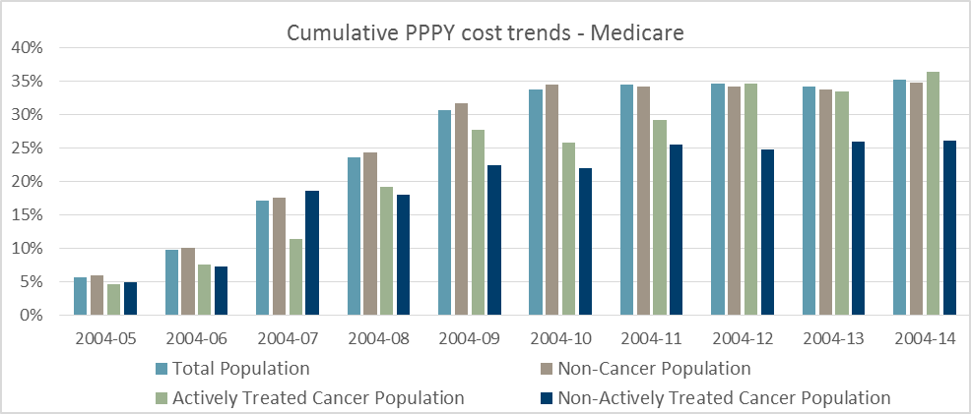
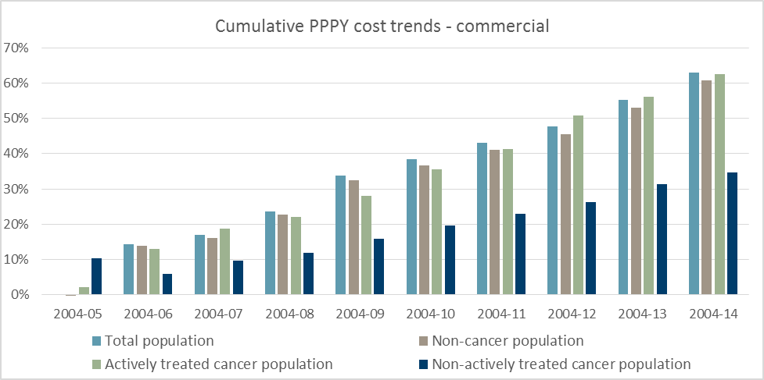
Cancer & Overall Costs
Increasing at Similar Rates
Per-patient costs increasing at similar rates throughout the study period for 3 populations:
  Total population
  Actively treated cancer population
  Non-cancer population
For Medicare, these 3 populations trended at 35.2% versus 36.4% and 34.8% respectively
For commercial, these 3 populations trended at 62.9% versus 62.5% and 60.8%
The 95% confidence intervals for each cohort’s trend line overlap and by this measure the 10-year cost trends between these 3 populations are not statistically different.

Slide 14
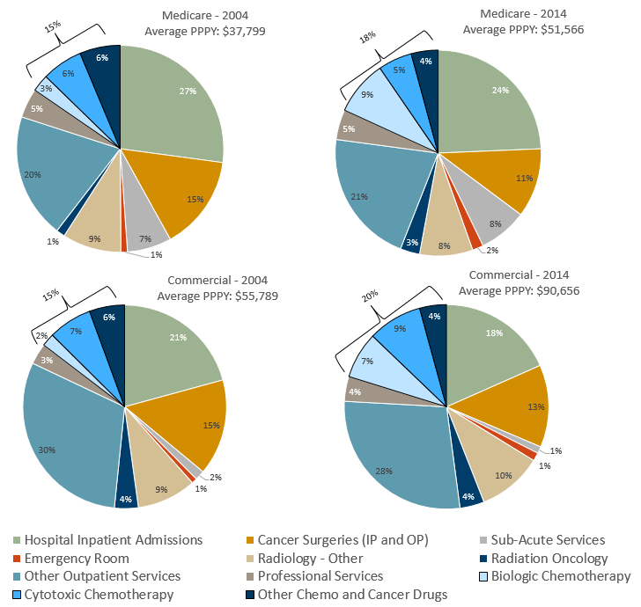
Component Cost Drivers Present a
More Complex Picture Than Just Drugs
Increases in spending:
  Chemotherapy
    15% to 18% in Medicare and 15% to 20% in commercial
  Biologics
    3% to 9% in Medicare and 2% to 7% in commercial
Lower rate in increased spending:
  Hospital inpatient admissions
    27% to 24% in Medicare and 21% to 18% in commercial
  Cancer surgeries
    15% to 11% in Medicare and 15% to 13% in commercial

Slide 15
Cost Drivers Vary Over Study Period
Service Category | 2004-2014 PPPY Cost Trends
 | Medicare | Commercial
Hospital Inpatient Admissions | 22% | 44%
Cancer Surgeries (inpatient and outpatient) | 0%* | 39%
Sub-Acute Services | 51% | 15%
Emergency Room | 132% | 147%
Radiology – Other | 24% | 77%
Radiation Oncology | 204% | 66%
Other Outpatient Services | 48% | 49%
Professional Services | 40% | 90%
Biologic Chemotherapy | 335% | 485%
Cytotoxic Chemotherapy | 14% | 101%
Other Chemo and Cancer Drugs | -9% | 24%
Total PPPY Cost Trend | 36% | 62%

Slide 16
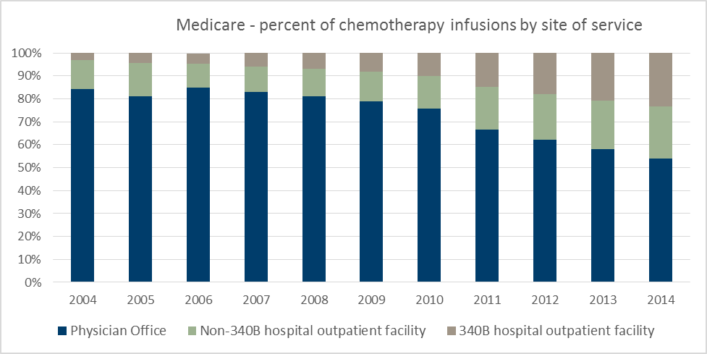
Substantial Shift in the Site of Care
84%
54%
Percent of chemotherapy administered in community oncology practices decreased from 84.2% to 54.1%
  Cost Medicare $2 billion more in 2014 alone
Percent of chemotherapy administered in 340B hospitals increased from 3.0% to 23.1% (670% increase)
  340B hospitals account for 50.3% of all hospital outpatient chemotherapy administrations

Slide 17
Pricing Not a Clean PIcture
Source: The Pharmaceutical Supply Chain: Gross Drug Expenditures Realized By Stakeholders, Berkley Research Group, January 2017

Slide 18
And Even Muddier!

Slide 19
The Medicare Part B “Experiment”
Desperate attempt by the Obama Administration to do something about drug prices
It’s wasn’t just another reimbursement cut
  It was truly an experiment on patient care without any of the patient information and safeguards with any clinical research
  It was the Executive branch stepping over the line in the Constitution that separates Executive and Legislative powers
And it was government regulators saying they know better than oncologists on how to treat their patients
Bolder and far worse than any previous reimbursement cut

Slide 20
COA Position That Stopped the Experiment
Bad Medicine
  Few truly interchangeable drugs in oncology
  Experiment on cancer care
  Absolutely no evidence to support this experiment
Flawed Economics
  10-year CMS experiment has consolidated care and led to higher drug prices
  CMS adding more fuel to the fire
Destructive Policy
  CMS can overturn any law by making a CMMI model out of it
  Unconstitutional

Slide 21
Consolidation of Cancer Care
2010
2016
Source: Community Oncology Alliance 2016 Practice Impact Report

Slide 22
Consolidation of Cancer Care
Source: Community Oncology Alliance 2016 Practice Impact Report

Slide 23
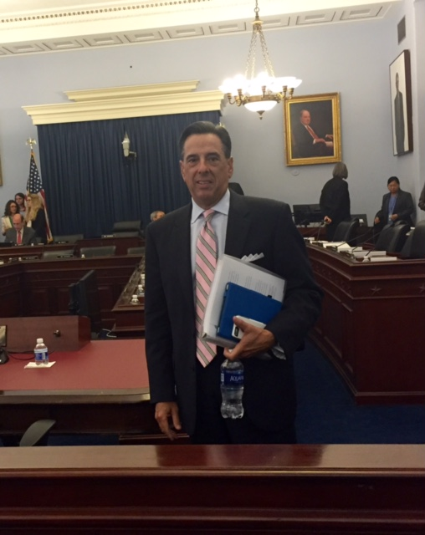
What COA Did
Involved in spearheading multiple letters from Congress to CMS
Major national radio ad campaign supported by print and digital ads, mailers, SM targeting specific members of Congress
Developed/hosting 2 dedicated websites for providers & patients
  www.cancerexperiment.org
  www.StopCMSCuts.com
Major OpEd campaign
Generating national and local media coverage
Working with congressional committees on several approaches to stopping this experiment on seniors’ cancer care
4/5 meeting with CMS/CMMI leadership
Testified at 2 congressional hearings
Made it an election issue with 3 major Senate campaign ads about it

Slide 24

340B & Site Neutrality
340B in the crosshairs – Question is, “How long does the bubble expand?”
  There is actually legislative language to increase transparency and accountability
HOPPS final rule out implementing first step in site neutral payments
  Result of the Bipartisan Budget Act of 2015
  CMS held pretty firm in actually operationalizing payment cuts (50% or so)
  Gave in on existing (grandfathered) facilities expanding services and still billing under hospital fees
  Hospitals fought to get some relief in the CURES bill passed last Congress
  More push-back on hospital consolidation of practices and financial impact at federal and state levels

Slide 25
PBM/Specialty Pharmacy Issues
CVS Caremark moved to shift all dispensing practices to “out of network” for Medicare Advantage plans effective January 2017
  Indications were that Express Scripts was ready to follow CVS lead
  Massive practice, media, and state/federal legislative effort stopped CVS
  COA not letting up on this and related issues
Absurd (and I mean ABSURD!) DIR fees
  Charge what they want, how they want, when they want
Express Scripts tightening ”formulary” access to treatments and steering business to Accredo
With more oral oncolytics coming out of the pharma R&D pipeline, expect more attempts to capture this business
  They will go after not only dispensing practices but those with retail pharmacies
  Profits before mankind!

Slide 26
What is COA Doing?
Hired legal firm specializing in pharmacy issues to fight for community oncology
  Legal letter to CVS
  White paper on PBMs featuring CVS decision
  State and federal congressional outreach on CVS
  Patient outreach on CVS
  DIR white paper almost completed
  Legal letter sent to Express Scripts this week
  Survey practices on how they are impacted (DIR fees, formularies)
  More

Slide 27
CMS Report on DIR (Versus DIR Fees)

Slide 28
The Obamacare Crisis in 2 Pictures
Sources: Washington Post & Vox.com

Slide 29
Dismantling of Obamacare
GOP majority Congress passed “budget reconciliation” bills (Senate and House) setting up repeal and replace
  Reconciliation only requires majority vote in the Senate (and House)
  Ironically, Congress used reconciliation to pass Obamacare
Unclear as to the timing of repeal
  Growing calls among the GOP to not repeal until a replacement is ready
  All variations of “replace” plans but no clear path forward at this time
  Trump tweets about replace immediately & “universal coverage” muddying the picture
CBO scored repeal bill as causing 18 million to lose insurance in first year and premiums rising 20-25% in the non-group market
  Catch is score included no replacement

Slide 30
Clarification From VP Elect Pence
“Orderly transition out of Obamacare”
Pass a replacement bill that will lower cost of health insurance and make it more affordable
Trump Administration is “very close” to completing a replacement plan with congressional leadership
Replacement plan passed near simultaneously with repeal
Stay tuned!

Slide 31
Trick Repealing/Replacing Obamacare
Obamacare simply ingrained in the healthcare system
Aspects of Obamacare are liked
  Overcoming preexisting conditions, annual/lifetime caps
  Having children up to 26 on parents’ policies
Big dilemma is how to overcome the mandate
  Mandating people have insurance OR pay a penalty drives the positive score (economics) on Obamacare
  One solution is for automatic insurance enrollment
    Op out if you don’t want it
    What’s the difference?
    Not the Republican way
Do Republicans take the opportunity to touch Medicare?

Slide 32
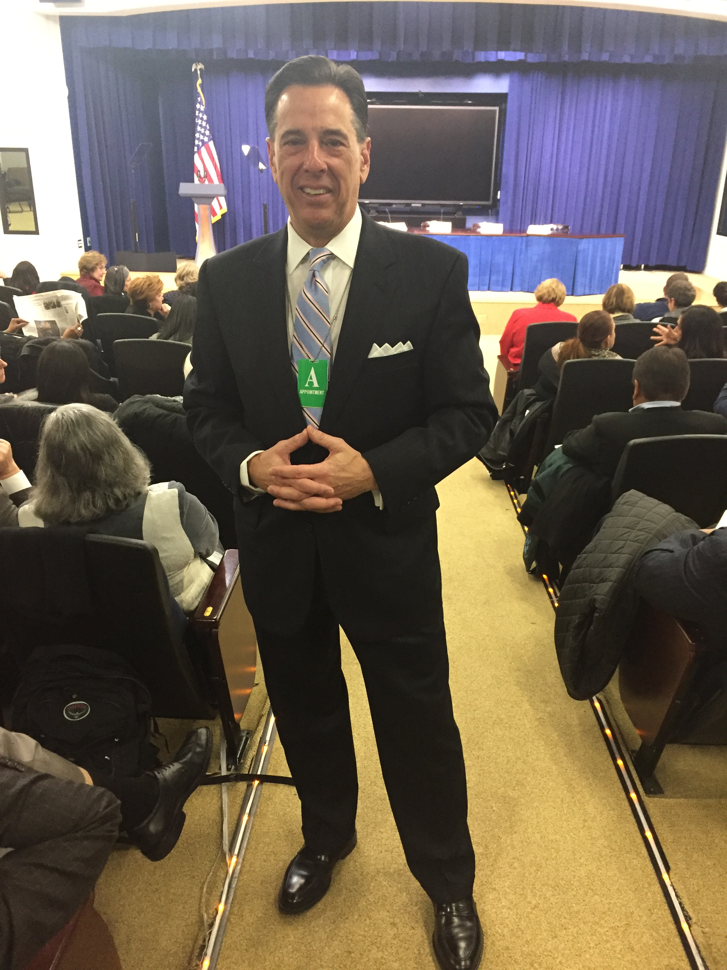
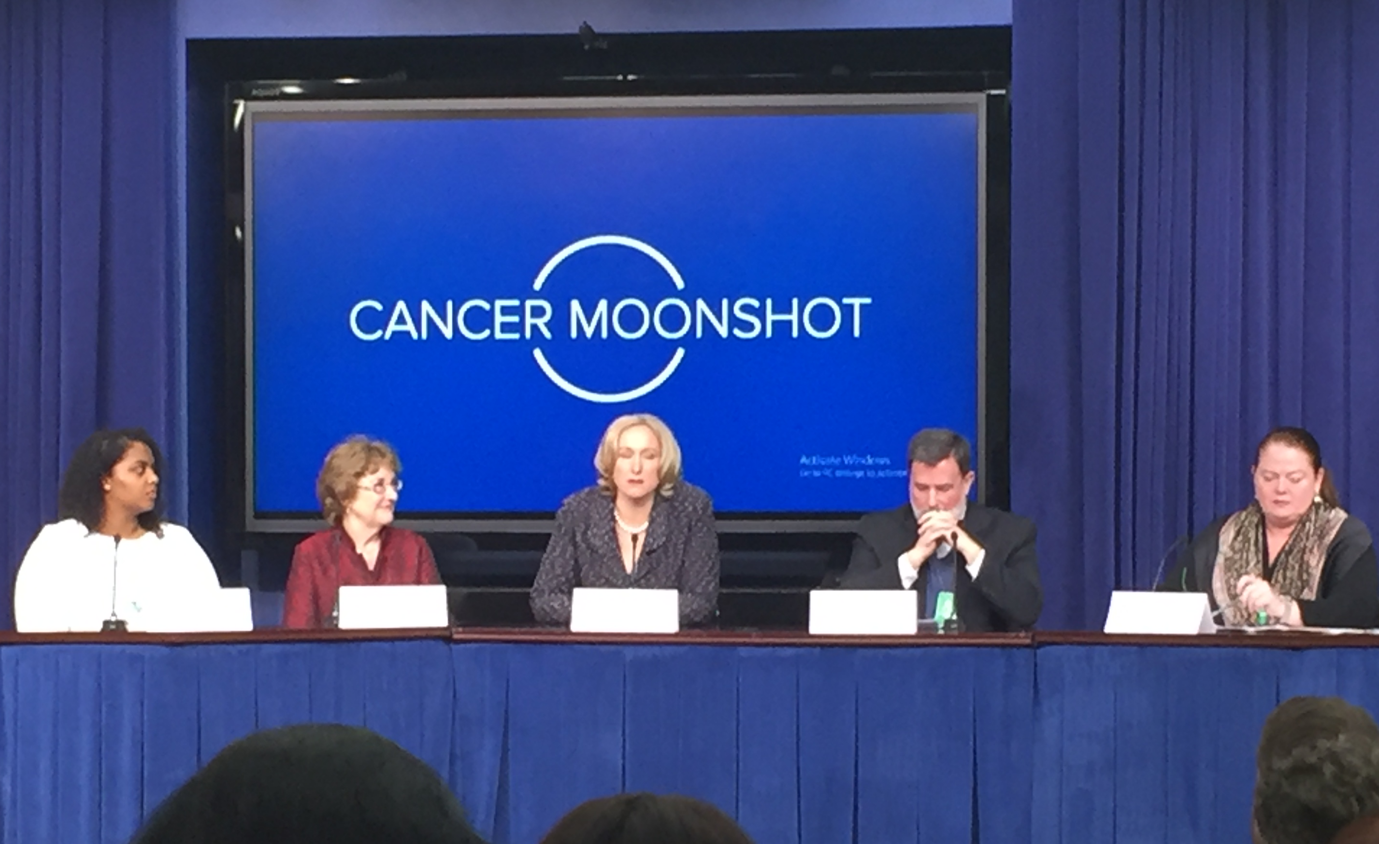
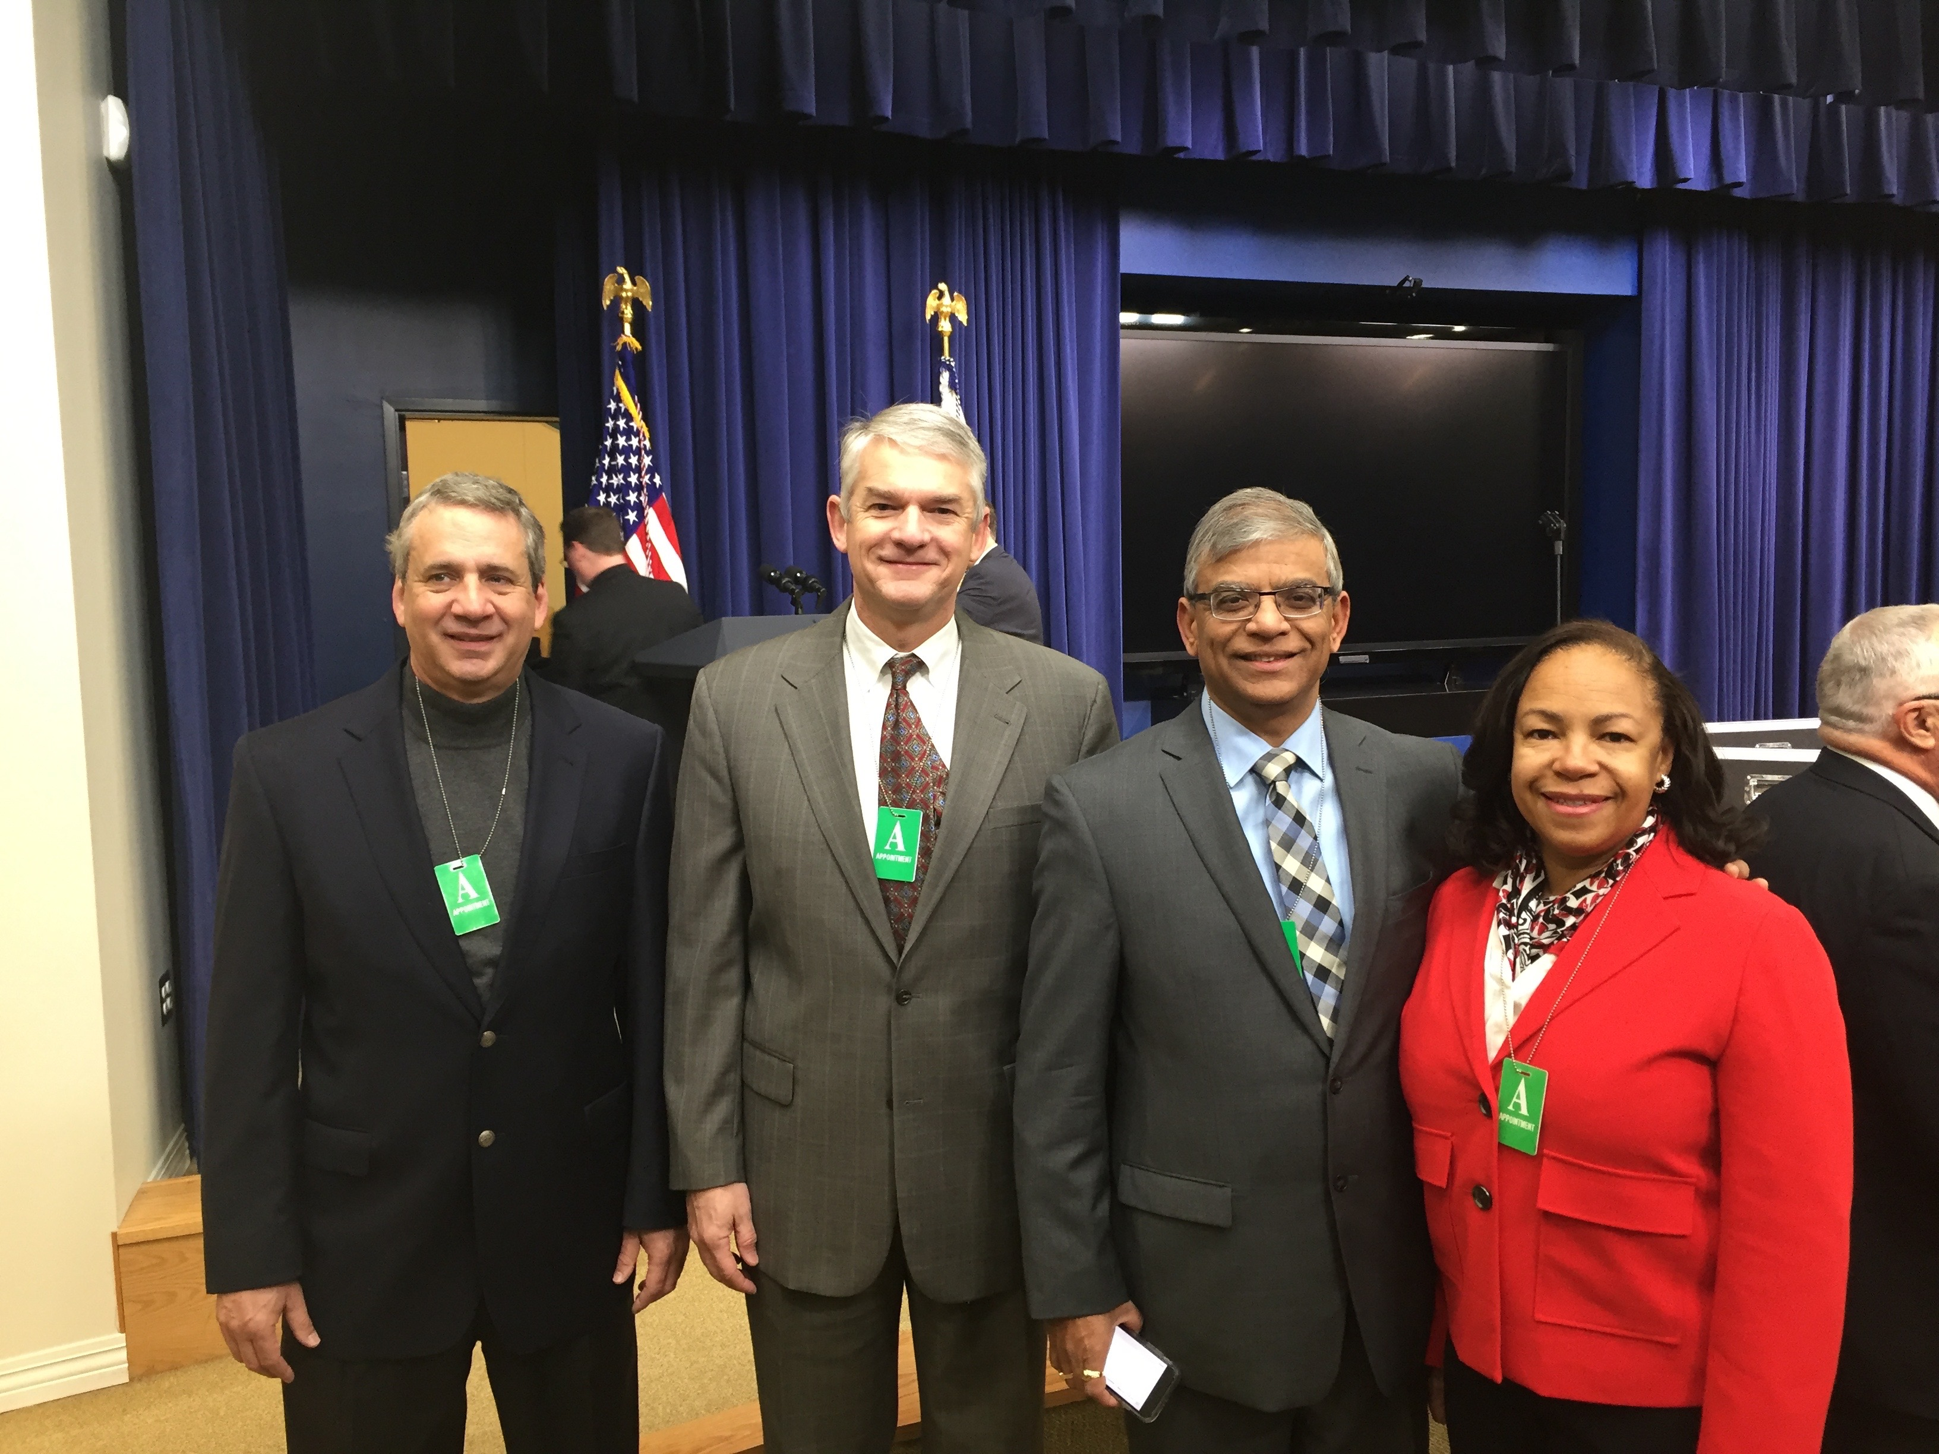
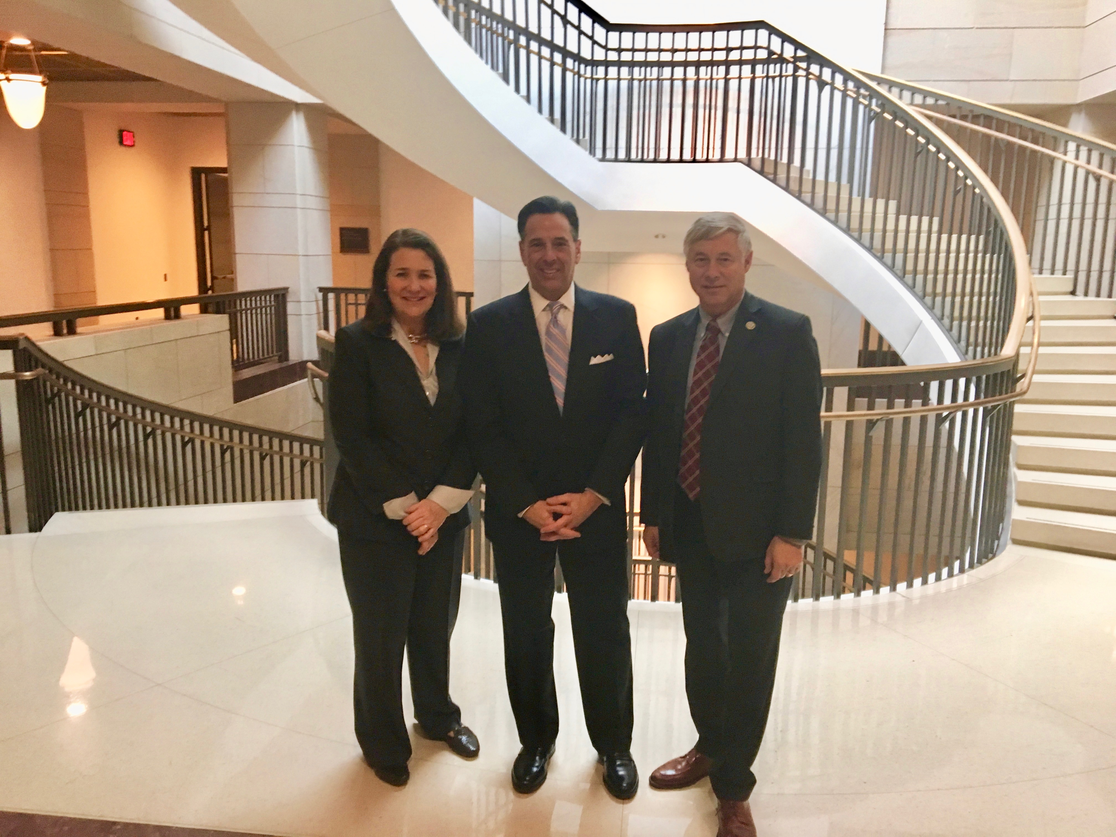
Cancer Moonshot???

Slide 33
COA 2017 Priorities
Legislative focus
  Sequester cut to Part B drug payment
  Oncology payment reform
  340B and site payment parity
  PBM issues
    DIR fees
    Steerage
Advance oncology payment reform
  OCM changes
  OCM 2.0
Ramp up patient advocacy

Slide 34
2017 Community Oncology Conference

Slide 35
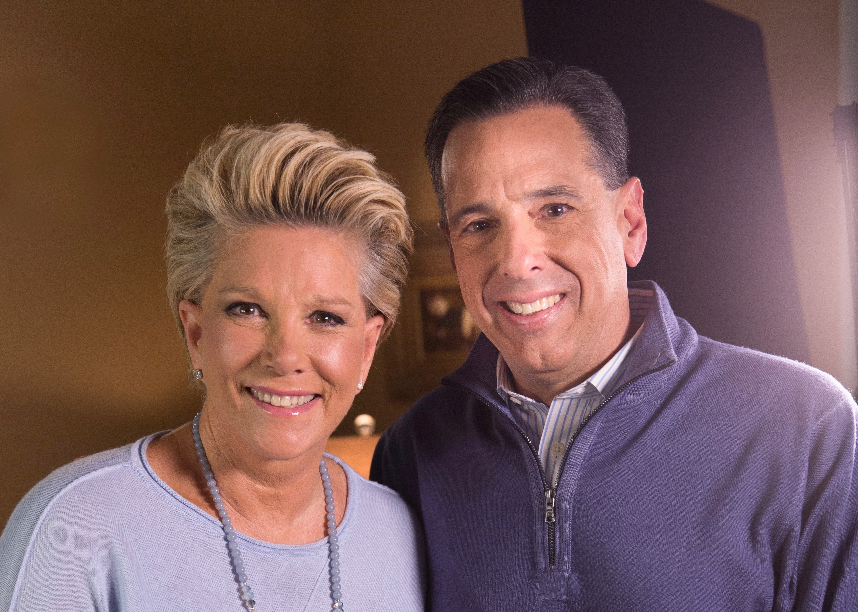
Thank You!
Ted Okon
tokon@COAcancer.org
Twitter @TedOkonCOA
www.CommunityOncology.org
www.MedicalHomeOncology.org
www.COAadvocacy.org (CPAN)
www.facebook.com/CommunityOncologyAlliance

